Slide 1

DEVOPS PROFESSIONAL
“Building the Future with DevOps"
By – Amit Bhatt

Slide 2
Welcome to the DevOps Training Program
Learn the core technologies powering DevOps
Master automation, orchestration, and cloud-native platforms
Become a certified DevOps professional

Slide 3
Course Overview
RHCSA - Fundamentals of Linux
  Core Linux skills for managing systems and servers
  Command-line proficiency and system troubleshooting
RHCE - Ansible Automation
  Automating tasks with Ansible
  Deploying, configuring, and managing applications efficiently
Red Hat OpenShift
  Building and managing containerized applications
  Introduction to Kubernetes and hybrid cloud platforms

Slide 4
Why Learn DevOps?
Statistics:
  DevOps professionals earn 20-30% higher salaries.
  Over 75% of global enterprises use DevOps practices.
Opportunities:
  High demand for Linux, Ansible, and OpenShift skills in the job market.
  Career paths: DevOps Engineer, Cloud Architect, Automation Specialist.
Value:
  Faster software delivery cycles, improved collaboration, and cutting-edge tools.

Slide 5
RHCSA – Starting Point of Your DevOps Journey
Linux is the backbone of servers, cloud, and automation.
Key Topics:
  Understanding the Linux file system.
  Managing users, groups, and permissions.
  Networking and basic troubleshooting.
Practical skills that pave the way for advanced automation and orchestration.

Slide 6
How We Train You for Success
Interactive Sessions:
  Real-time command practice.
  Step-by-step configuration guides.
Projects:
  Deploy a services on Linux.
  Automate repetitive tasks with Ansible.
Certifications:
  RHCSA → RHCE → REDHAT OpenShift Certification.

Slide 7
What is DevOps?
Philosophy
Practices
DevOps emphasizes collaboration between development and operations teams.
Key practices include continuous integration, continuous delivery, and automation.
The goal is faster, more reliable software delivery.
Infrastructure as Code (IaC) is also central.

Slide 8

Linux's Role in DevOps
1
Server OS
Linux is the dominant operating system for servers.
2
Containers
Docker and Kubernetes rely heavily on Linux.
3
Automation
Many DevOps tools are built on or for Linux.
4
Open Source
Linux's open-source nature supports collaboration.

Slide 9

Continuous Integration (CI)
Automated Builds
Faster Feedback
Automates code compilation and testing.
Quickly identifies and fixes integration issues.
Improved Quality
Leads to more stable and reliable software.

Slide 10




Continuous Delivery/Deployment (CD)
Rapid Releases
Scalability
Reduced Errors
Automates software deployment to various environments.
Enables easy scaling of applications.
Minimizes manual intervention and potential for error.

Slide 11



Infrastructure as Code (IaC)
2
Version Control
Allows for managing infrastructure changes like code.
Automation
Automates the provisioning of servers and networks.
1
Repeatability
Ensures consistent environments across different deployments.
3

Slide 12

Configuration Management
1
Ansible
Agentless automation tool.
2
Chef
Uses Ruby for configuration.
3
Puppet
Uses a declarative language.

Slide 13




Containerization with Docker
Lightweight
Reduces resource usage.
Portable
Runs consistently across different environments.
Scalable
Easily scales up or down applications.

Slide 14

Orchestration with Kubernetes
Deployment
Automates deployment and scaling of containers.
Management
Manages the lifecycle of containerized applications.
Scalability
Allows for horizontal scaling of applications.

Slide 15
Course Structure & Timeline
DevOps Fundamentals & Linux
1
Weeks 1–2
2
Automation & Scripting
Weeks 3–4
Programming & SDLC
3
Weeks 5–6
4
Continuous Integration & Continuous Delivery
Weeks 7–8
Cloud Computing with AWS
5
Weeks 9–10
6
Infrastructure as Code & Containerization
Weeks 11–12
Kubernetes & Observability
7
Weeks 13–14
8
Advanced DevOps & Future Trends
Weeks 15–16

Slide 16
REDHAT LINUX V9 FUNDAMENTALS
PART 1
The Basics
By – Amit Bhatt

Slide 17
Chapter 1: Get Started with Red Hat Enterprise Linux
Section 1.1: Origin Of Linux

Slide 18
What is an Operating System
An operating system (OS) is system software that manages computer hardware, software resources, and provides common services for computer programs.
Hardware (Motherboard, RAM, Processor, Hard disk etc.)
Memory management
Managing multitasking
Managing multiple users
Process management
Device management
Error handling and logging

Slide 19
Origin of Linux : UNIX and Linus Torvalds
The Operating system UNIX
  Developed in the 1960s at Bell Labs by luminaries like Ken Thompson and Dennis Ritchie.
  Originally designed for mini computers but later ported to various hardware platforms, Known for stability, security, and scalability.
  Unix emphasizes simplicity and powerful tools.
  Multiuser Support, Multitasking, Shell Scripting, Security Model, Portability, Communication Tools, Process Tracking
  Unix’s legacy extends to modern operating systems, Variants like Linux and macOS are based on Unix principles.
Who is Linus Torvalds
  Born on December 28, 1969, in Helsinki, Finland, Torvalds began his journey into computer programming at the age of 10
  Linux Kernel: Linus Torvalds is best known as the creator and lead developer of the Linux kernel. In 1991, while studying computer science at the University of Helsinki, he decided to create his own PC-based version of the UNIX operating system. His relentless programming efforts resulted in the beginnings of an operating system called Linux.
  Open Source Revolution: Torvalds posted a message on the Internet, making the Linux software available for free downloading. He also released the source code, allowing other programmers to modify and improve it. Over time, a community of developers contributed to refining Linux. By 1994, the Linux kernel (original code) reached version 1.0.
  Linux’s Impact: Although Linux initially required technical expertise, it evolved into a remarkably reliable and efficient system. It gained popularity in the late 1990s as an alternative to proprietary operating systems like Windows. Companies such as Netscape, Corel, Oracle, and Intel recognized its potential and supported it. Linux’s open-source nature allowed for customization and security benefits.

Slide 20
The World OF Open Source
What is Open Source - Open source software (OSS) is a type of software that is developed and maintained through open collaboration. Here are the key points:
  Open source software is designed to be publicly accessible.
  Anyone can view, modify, and distribute the source code without restrictions.
  Users have the freedom to examine, alter, and redistribute the software.
  Developers collaborate across the globe, contributing improvements and fixes.
  The development process is transparent and inclusive.
  Cost: Most open source software is available at no cost.
  Flexibility: Users can customize and adapt it to their needs.
  Longevity: Community-driven development ensures ongoing support.
  Examples: Popular open source projects include Linux, Ansible, and Kubernetes.

Slide 21
Linux and Red Hat
What is Linux Distribution
  A Linux distribution is an installable operating system that is constructed from a Linux kernel and that supports user programs and libraries. A complete Linux system is developed by multiple independent development communities that work cooperatively on individual components. A distribution provides an easy method to install and manage a working Linux system.
  The Linux kernel also includes other open source components, such as the Sendmail mail server and the Apache HTTP web server, to become a complete open source UNIX-like operating system.
  A major challenge for Linux users is to assemble all these software pieces from many sources. Early Linux developers provided a distribution of prebuilt and tested tools that users could download and install to quickly implement Linux systems.
  Many Linux distributions exist, each with differing goals and support criteria. Generally, distributions have some common characteristics:
    Distributions consist of a Linux kernel and support user-space programs.
    Distributions can be small and single-purpose, or can include thousands of open source programs.
    Distributions provide a means to install and update the software and its components.
    The distribution provider supports the software, and ideally, participates in the development community.

Slide 22
Linux and Red Hat
Red Hat is the world's leading provider of open source software solutions, by using a community-powered approach to reliable and high-performance cloud, Linux, middleware, storage, and virtualization technologies. The mission of Red Hat is to be the catalyst in communities of customers, contributors, and partners to create better technology the open source way.
The role of Red Hat is to help customers to connect with the open source community and their partners to effectively use open source software solutions. Red Hat actively participates in and supports the open source community. Many years of experience have convinced the company of the importance of open source to the future of the IT industry.
Red Hat is best known for its participation in the Linux community and the Red Hat Enterprise Linux distribution. Red Hat is also active in other open source communities, including middleware projects that are centered on the JBoss developer community. Red Hat also provides virtualization solutions, cloud technologies such as OpenStack and OpenShift, and the Ceph and Gluster software-based storage projects, plus others.
Red Hat Enterprise Linux Ecosystem
Red Hat Enterprise Linux (RHEL) is Red Hat's commercial production-grade Linux distribution. Red Hat develops and integrates open source software into RHEL through a multistage process.
  Red Hat participates in supporting individual open source projects. It contributes code, developer time, resources, and support, and often collaborates with developers from other Linux distributions, to improve the general quality of software for everyone.
  Red Hat sponsors and integrates open source projects into the community-driven Fedora distribution. Fedora provides a free working environment to serve as a development lab and proving ground for features to be incorporated into CentOS Stream and RHEL products.
  Red Hat stabilizes the CentOS Stream software to be ready for long-term support and standardization, and integrates it into RHEL, the production-ready distribution.

Slide 23
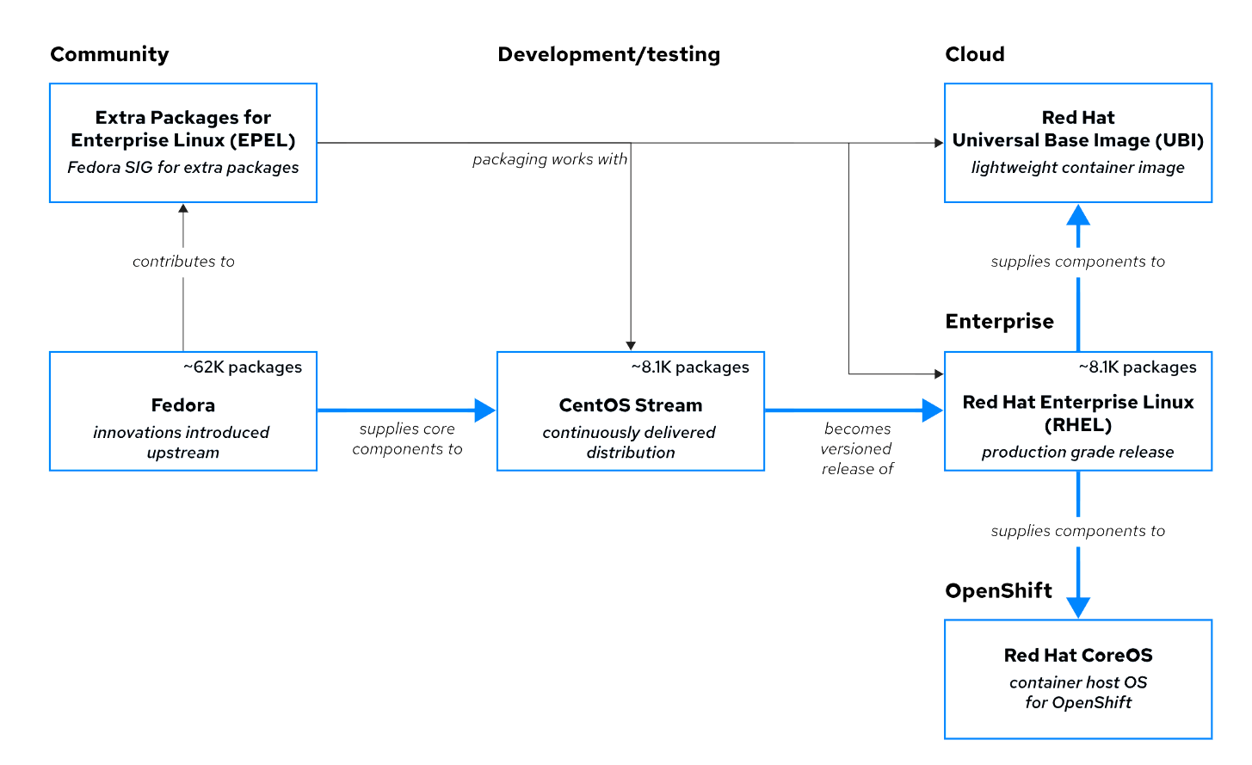
Red Hat Enterprise Linux Eco System

Slide 24
Red Hat Enterprise Linux Server Operating System
Red Hat Enterprise Linux (RHEL) is Red Hat's production-ready, commercially supported Linux distribution. In the computing industry, RHEL is acknowledged as the leading platform for open source computing. RHEL is extensively tested and has a worldwide ecosystem of support partners for hardware and software certifications, consulting services, training, and multi-year support and maintenance guarantees.
Red Hat builds RHEL major releases directly from the CentOS Stream continuous development project, which is sourced from Fedora. In contrast to the previous RHEL development model, the releases were constructed internally with less transparency, and the source was provided only for building as CentOS Linux after the RHEL release. Now the new CentOS Stream development model is open and available to all, for feedback and contribution, and the code is prepared to be the next major RHEL release.
RHEL uses a subscription-based support model, and does not charge license fees for open-source software. Red Hat support subscriptions provide product support, maintenance, updates, security patches, and access to the Customer Portal Knowledgebase, utilities, and downloadable releases of Red Hat products.

Slide 25
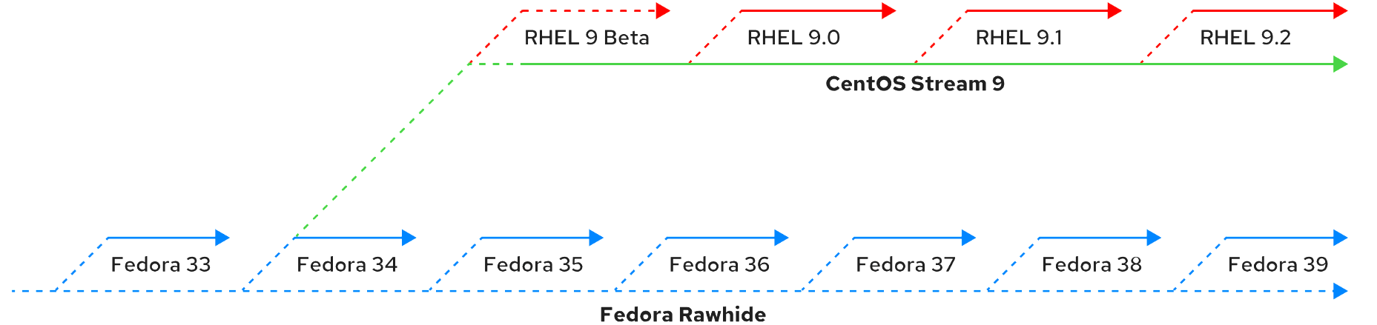
RHEL Continuous Development

Slide 26
Obtaining Red Hat Enterprise Linux
Red Hat Enterprise Linux is typically obtained with a paid support subscription, and Red Hat provides multiple ways to obtain RHEL and other RHEL ecosystem products, many without cost.
  Fedora Linux and derivatives are freely available from the Fedora project at https://getfedora.org/ , including an emerging version of Fedora CoreOS.
  CentOS Stream is freely available at https://www.centos.org/centos-stream/.
Red Hat Developer Subscription
  An evaluation copy of RHEL is available at https://access.redhat.com/products/red-hat-enterprise-linux/evaluation
  You must have a (free) Customer Portal account for https://access.redhat.com
  to access and download evaluation products. Product evaluations entitle you to receive updates and support for a limited period. Support ends when the evaluation period ends, but the evaluation software continues to operate.
  Red Hat provides a freely available subscription for many products through the Red Hat Developer Program at https://developers.redhat.com
    https://developers.redhat.com/blog/2016/03/31/no-cost-rhel-developer-subscription-now-available?source=sso#what_you_get
  With a Developer subscription, developers can quickly create, prototype, test, and demonstrate their applications on the same Red Hat software as on production systems.
  Create a personal account at https://access.redhat.com , and then register for the Developer program. You can use an existing personal account, but do not use an account that is already associated with any organization's support subscription.
  To Download RHEL9 ISO file use this link - https://access.redhat.com/downloads/content/479/ver=/rhel---9/9.4/x86_64/product-software

Slide 27
Install RHEL on a Virtual Machine
Get RHEL 9 ISO with 1 year developer License
  Get the ISO from https://access.redhat.com/downloads/content/479/ver=/rhel---9/9.4/x86_64/product-software. Make sure you are logged in with developer account, OR you can also register for a developer account from the same link.
Download and install VMWARE Workstation or Hyper V or VirtualBox
  VMware Workstation Pro
    https://profile.broadcom.com/web/registration
    https://support.broadcom.com/group/ecx/productdownloads?subfamily=VMware%20Workstation%20Pro
    https://knowledge.broadcom.com/external/article/368734
  VirtualBox - https://download.virtualbox.org/virtualbox/6.1.16/VirtualBox-6.1.16-140961-Win.exe
  Hyper V- https://docs.microsoft.com/en-us/virtualization/hyper-v-on-windows/quick-start/enable-hyper-v
Create a new Virtual Machine
  RHEL 9 can be installed on physical hardware and on virtual hardware. For the availability of specific features, it does not really matter which type of hardware is used, as long as the following minimal conditions are met:
    1 GiB of RAM
    A 10-GiB hard disk
    A network card

Slide 29
Chapter 2: Access the Command Line
Section 2.1: Access the Command Line
Section 2.2: Access the Command Line with the Desktop
Section 2.3: Execute Commands with the Bash Shell

Slide 30
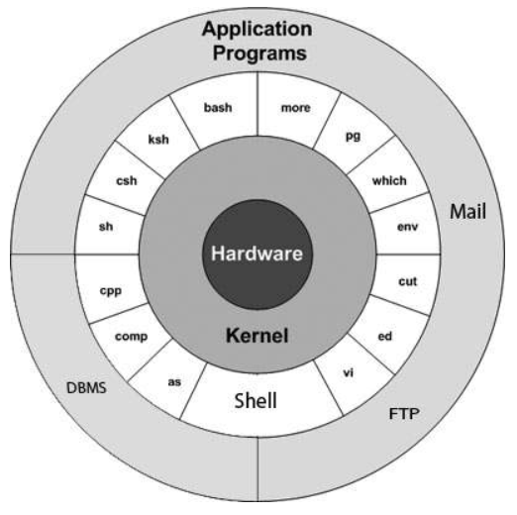
Linux Architecture
Hardware
Kernel (Program)
  The kernel is the core component of an operating system. It manages low-level operations, directly interacting with hardware resources (such as the CPU, memory, and disks).
  Key responsibilities include memory management, process scheduling, device drivers, and system resource allocation.
  The kernel operates at a level below the shell.
Shell (Program)
  The shell serves as an intermediary between the user and the kernel.
  It provides a command-line interface (CLI) for users to interact with the operating system.
  When you enter commands in the shell, it translates them into instructions that the kernel can execute.
User and Applications
  Issue commands using Shell

Slide 31
Points to Remember
Everything is a file
CLI is your friend
Automate everything
  Shell Scripting – 20 Hours
  Ansible automation tool – 50 Hours

Slide 32
Introduction to the Bourne Shell
A command line (CLI) is a text-based interface that is used to input instructions to a computer system.
The Linux command line is provided by a program called the shell. Many shell program variants have been developed over the years. Every user can use a different shell
The default shell for most Linux distributions is the Bash shell. Bash stands for Bourne again shell because the Bash shell is based upon the older Bourne shell which was written by Steven Bourne in 1977.
Red Hat recommends using the default shell for system administration. The default user shell in Red Hat Enterprise Linux (RHEL) is the GNU Bourne-Again Shell (bash). The bash shell is an improved version of the original Bourne Shell (sh) on UNIX systems.
The shell displays a string when it is waiting for user input, called the shell prompt.
When a regular user starts a shell, the prompt includes an ending dollar ($) character: [user@host ~]$
A hash (#) character when the shell is running as the superuser, root , which helps to avoid mistakes that can affect the whole system : [root@host ~]#

Slide 33
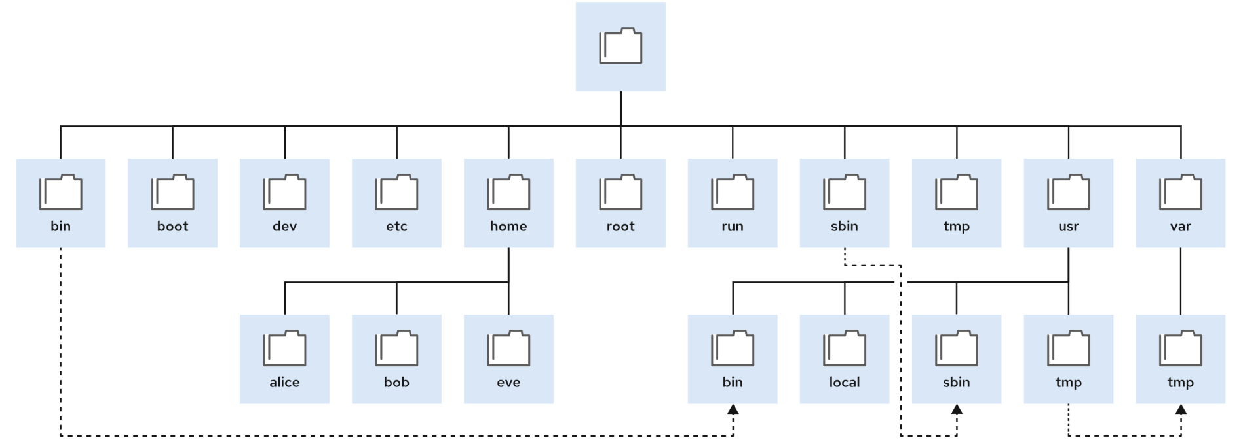
The File-system Hierarchy
The Linux system stores all files on file systems, which are organized into a single inverted tree known as a file-system hierarchy. This hierarchy is an inverted tree because the tree root is at the top, and the branches of directories and subdirectories stretch below the root.
/ = root = starting point

Slide 34
The File-system Hierarchy
The following terms help to describe file-system directory contents:
  Static content remains unchanged until explicitly edited or reconfigured.
  Dynamic or variable content might be modified or appended by active processes.
  Persistent content remains after a reboot, such as configuration settings.
  Runtime content from a process or from the system is deleted on reboot.
/boot
  Files to start the boot process.
/dev
  Special device files that the system uses to access hardware.
/etc
  System-specific configuration files.
/home
  Home directory, where regular users store their data and configuration files.
/root
  Home directory for the administrative superuser, root.
/run
  Runtime data for processes that started since the last boot. The contents of this directory are re-created on reboot.
/tmp
  A world-writable space for temporary files. Files that are not accessed, changed, or modified for 10 days are deleted from this directory automatically. The /var/tmp directory is also a temporary directory, in which files that are not accessed, changed, or modified in more than 30 days are deleted automatically.
/usr
  Installed software, shared libraries, including files, and read-only program data. Significant subdirectories in the /usr directory include the following commands:
    /usr/bin: User commands
    /usr/sbin: System administration commands
    /usr/local: Locally customized software
/var
  System-specific variable data should persist between boots. Files that dynamically change, such as databases, cache directories, log files, printer-spooled documents, and website content, might be found under /var.

Slide 35
Shell Basics
Commands that are entered at the shell prompt have three basic parts:
command [-o(ptions)] [arg1] [arg2] ... [argX]
  Command to run.
  Options to adjust the behavior of the command.
  Arguments, which are typically targets of the command.
The command is the name of the program to run. It might be followed by one or more options, which adjust the behavior of the command or what it does. Options normally start with one or two dashes (-a or --all, for example) to distinguish them from arguments. Commands might also be followed by one or more arguments, which often indicate a target that the command should operate on.
For example
  ls –l /root
  ls
  ls –ltrh /root /tmp
Explanation
  ls = command
  -l = option
  /root = argument

Slide 36
Access Command Line
A terminal is a text-based interface to enter commands into and print output from a computer system. To run the shell, you must log in to the computer on a terminal.
A hardware keyboard and display for input and output might be directly connected to the computer. This is the physical console from the Linux machine.
The physical console supports multiple virtual consoles, which can run on separate terminals. Each virtual console supports an independent login session.
You can switch between the virtual consoles by pressing Ctrl+Alt and a function key (F1 through F6) at the same time.
The shell prompt is provided in an application window of your graphical terminal program.
Many system administrators choose not to run a graphical environment on their servers, because users do not log in to servers as a desktop workspace. A server's workload can more effectively use the significant resources that a graphical environment uses.
In Red Hat Enterprise Linux 9, if the graphical environment is available, then the login screen runs on the first virtual console, which is called tty1. Five additional text login prompts are available on virtual consoles two (tty2) through six (tty6).

Slide 37
Log in to a Remote System and Logout
In Linux, the most common way to get a shell prompt on a remote system is to use Secure Shell (SSH).
Most Linux systems (including Red Hat Enterprise Linux) and macOS provide the OpenSSH command-line program ssh for this purpose.
In this example, a user with a shell prompt on the host machine uses ssh to log in to the remote Linux system remotehost as the user remoteuser:
  [user@host ~]$ ssh remoteuser@remotehost
  remoteuser@remotehost's password: password
  [remoteuser@remotehost ~]$
You can enter the exit command to terminate the current shell session. Alternatively, finish a session by pressing CTRL+D

Slide 38
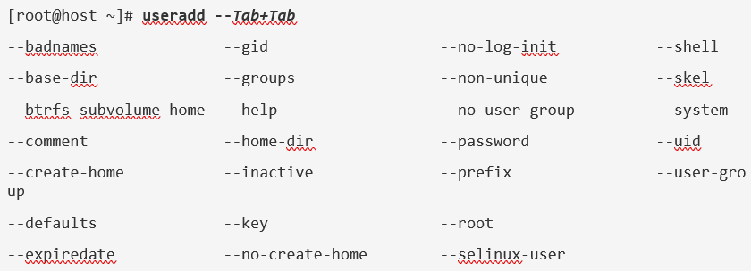
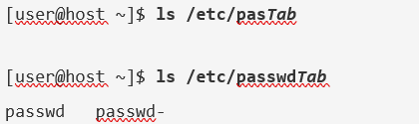
Execute Commands with Bash and its Features
Auto Complete using TAB key
  With tab completion, users can quickly complete commands or file names after typing enough at the prompt to make it unique.
  If the typed characters are not unique, then pressing the Tab key twice displays all commands that begin with the typed characters.
Write a Long Command on Multiple Lines
Display the Command History

Slide 39
Bash Features
The arrow keys help to navigate through previous commands in the shell's history.
  The UpArrow edits the previous command in the history list.
  The DownArrow edits the next command in the history list.
  The LeftArrow and RightArrow move the cursor left and right in the current command from the history list so that you can edit the command before running it.

Slide 40
Basic commands to start Practicing Linux
ls | List directory contents ls [-options] [arguments…]
-l | Long list format
-a | Display hidden files
-h | Human readable size units
-d | Show directory properties
--help | Show command help
rm | Delete/ remove files and dirs. rm [-options][arguments…]
-r | Removes directory recursively
-f | Forcefully – non interactive
-i | Interactive
--help | Show command help
mkdir | Create a new directory mkdir [-options ][arguments…]
-p | Create parent dirs. If not present
--help | Show command help
touch | Create a new file touch [-options ][arguments…]
--help | Show command help

Slide 41
Basic commands to start Practicing Linux
FILE COMMANDS
  ls, file, touch,mkdir, rm, rmdir, cat,head,tail,more,less,clear
DIRECTORY NAVIGATION COMMANDS
  cd, cd .. , cd /path , pwd
COMMANDS TO FETCH USER INFORMATION
  id, last, whoami, who,w,
COMMANDS TO FETCH SYSTEM INFORMATION
  uname, hostname, date, free , lscpu, cat /etc/os-release,dmidecode
COMMANDS TO FETCH NETWORK INFORMATION
  ip a , ping,nmtui
COMMANDS HISTORY
  history, crtl+r, !number

Slide 42
Basic commands to start Practicing Linux
echo
  echo “hello world”
  echo $PATH
su
  su – student
  su – root
  su -
sudo
  sudo dmidecode
  sudo su – root
  sudo su –
  /etc/sudoers
  Wheel group

Slide 43
Grep command
grep | Find text from text file(s) grep [-options] [what_to_find] [from_where]
-i | Ignore the case
-n | Show line numbers
-v | Ignore the pattern and return the remaining lines
-c | Count result lines
-o | Show only occurrences
-r | Search recursively
--help | Show command help

Slide 44
Alias and User Environment
Alias and unalias
  An alias is a command that a user can define as needed. Some aliases are provided by default;
  type alias on the command line to get an overview.
  To define an alias, use alias newcommand='oldcommand’
  Aliases are executed before anything else.
  Use unalias newcommand to unset the alias
User Environment and $PATH variable
  use env or set command.
  To look up commands, shell uses the $PATH variable.
  This variable defines a list of directories that is searched for a matching filename when a user enters a command.
  To find out which exact command the shell will be using, you can use the which command.
  For instance, type which ls to find out where the shell will get the ls command from.
  If you need to start a command that is in the current directory but not in $PATH then add ./ in front of it.
  The dot stands for the current directory, and by running it as ./, you tell Bash to look for the command in the current directory.

Slide 45
Chapter 3: Manage Files from the Command Line
Section 3.1: Describe Linux File System Hierarchy Concepts
Section 3.2: Specify Files by Name
Section 3.3: Manage Files with Command-line Tools
Section 3.4: Guided Exercise: Manage Files with Command-line Tools
Section 3.5: Make Links Between Files
Section 3.6: Guided Exercise: Make Links Between Files
Section 3.7: Match File Names with Shell Expansions
Section 3.8: Lab: Manage Files from the Command Line
Section 3.9: Summary

Slide 46
Absolute Paths and Relative Paths
Absolute Paths
  An absolute path is a fully qualified name that specifies the exact location of the file in the file-system hierarchy.
  The absolute path begins at the root (/) directory and includes each subdirectory that must be traversed to reach the specific file.
  Every file in a file system has a unique absolute path name, which is recognized with a simple rule: a path name with a forward slash (/) as the first character is an absolute path name.
  For example : cat /var/log/messages
Current Working Directory
  When a user logs in and opens a command window, the initial location is typically the user's home directory.
  The working directory and current working directory terms refer to their current location.
Relative Path
  identifies a unique location, and specifies only the necessary path to reach the location from the working directory.
  For example, relative to the /var directory, the message log file is log/messages.

Slide 47
Absolute Paths and Relative Paths
  [user@host ~]$ pwd
  [user@host ~]$ cd ..
  [user@host ~]$ pwd
  [user@host ~]$ cd ../..
  [user@host ~]$ cd .
  [user@host ~]$ pwd
  [user@host ~]$ cd ~
  [user@host ~]$ pwd
  [user@host ~]$ touch ~/helloworld.txt
  [user@host ~]$ cd ../../tmp
  [user@host ~]$ pwd
  [user@host ~]$ cd
  [user@host ~]$ cd /tmp
Navigate Paths in the File System
  [user@host ~]$ pwd
  [user@host ~]$ ls
  [user@host ~]$ cd videos
  [user@host ~]$ cd /home/student/Documents
  [user@host ~]$ cd -
  [user@host ~]$ cd
  [user@host ~]$ touch Videos/blockbuster1.ogg
  [user@host ~]$ touch Videos/blockbuster2.ogg
  [user@host ~]$ touch Documents/thesis_chapter1.odf
  [user@host ~]$ touch Documents/thesis_chapter2.odf
  [user@host ~]$ ls -la

Slide 48
Copy , Move
cp | Copy files and directories cp [-options] [src] [dest]
-r | Copy dirs. recursively
-i | Prompt before overwrite
-n | Do not overwrite
-v | Verbose; print info messages
--help | Show command help
mv | Move files and directories mv [-options ] [src] [dest]
-i | Prompt before overwrite
-u | Update dest only when the src is diff from dest
-v | Verbose
--help | Show command help

Slide 49
EXERCISE: Manage Files with Command-line Tools
In the student user's home directory, use the mkdir command to create three subdirectories: Music, Pictures, and Videos.
Use the touch command to create sets of empty practice files to use during this lab. In each set, replace X with the numbers 1 through 6.
  Create six files with names of the form songX.mp3.
  Create six files with names of the form snapX.jpg.
  Create six files with names of the form filmX.avi.
Move the song files (.mp3 extension) to the Music directory, the snapshot files (.jpg extension) to the Pictures directory, and the movie files (.avi extension) to the Videos directory.
Create three subdirectories for organizing your files, and name the subdirectories friends, family, and work. Use a single command to create all three subdirectories at the same time.
Copy the family and friends directories and their contents to the work directory.
Your project tasks are now complete, and it is time to clean up the directories. Use the rm -r command to recursively delete the family, friends, and work directories and their contents.

Slide 50
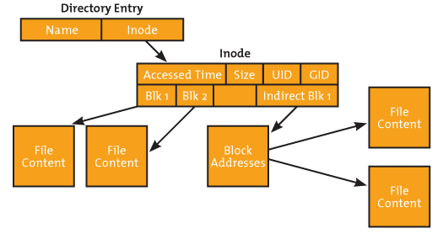
Inodes and Links
Linux must allocates an index node (inode) for every file and directory in the filesystem.
Inodes do not store actual data. Instead, they store the metadata where you can find the storage blocks of each file's data
When a file is created on a system, a file name and Inode number is assigned to it.
Internally file name is first mapped with respective Inode number stored in a table. –i option with ls command will display inode numbers
ls -li

Slide 51
Make Links Between Files
You can create multiple file names that point to the same file. These file names are called links. You can create two types of links:
Hard link
  A hard link points a name to data on a storage device.
  [user@host ~]$ ln originalfile_path hlink_path
symbolic link (sometimes called a soft link).
  A symbolic link points a name to another name, which points to data on a storage device.
  [user@host ~]$ ln –s originalfile_path slink_path

Slide 52
Match File Names with Shell Expansions
Pattern | Matches
* | Any string of zero or more characters
? | Any single character
[abc…​] | Any one character in the enclosed class (between the square brackets)
[!abc…​] | Any one character not in the enclosed class
[^abc…​] | Any one character not in the enclosed class
[[:alpha:]] | Any alphabetic character
[[:lower:]] | Any lowercase character
[[:upper:]] | Any uppercase character
[[:alnum:]] | Any alphabetic character or digit
[[:punct:]] | Any printable character that is not a space or alphanumeric
[[:digit:]] | Any single digit from 0 to 9
[[:space:]] | Any single white space character, which might include tabs, newlines, carriage returns, form feeds, or spaces
Command Line Expansion : When you type a command at the Bash shell prompt, the shell processes that command line through multiple expansions before running it. You can use these shell expansions to perform complex tasks that would otherwise be difficult or impossible. Following are the main expansions that Bash shell performs:
  Brace expansion, which can generate multiple strings of characters
  Tilde expansion, which expand to a path to a user home directory
  Variable expansion, which replaces text with the value that is stored in a shell variable
  Command substitution, which replaces text with the output of a command
  Pathname expansion, which helps to select one or more files by pattern matching

Slide 53
Guided Exercise: Match File Names with Shell Expansions
Pattern Examples:
mkdir glob; cd glob
touch alfa bravo charlie delta echo able baker cast dog easy
ls a*
ls *a*
ls [ac]*
ls ????
ls ?????
Brace Examples:
echo {Sunday,Monday,Tuesday,Wednesday}.log
echo file{1..3}.txt
echo file{a..c}.txt
echo file{a,b}{1,2}.txt
echo file{a{1,2},b,c}.txt
mkdir ../RHEL{7,8,9}
ls ../RHEL*
Variable Examples:
USERNAME=operator
echo $USERNAME
echo ${USERNAME}
Command Substitution Examples:
echo Today is $(date +%A)
echo The time is $(date +%M) minutes past $(date +%l%p)
echo ${USERNAME}

Slide 54
Summary
Files on a Linux system are organized into a single inverted tree of directories, a file-system hierarchy.
Absolute paths start with a forward slash character (/) and specify the location of a file in the file-system hierarchy.
Relative paths do not start with a forward slash character.
Relative paths specify a file location in relation to the current working directory.
You can use commands in combination with the dot (.), double dot (..), and tilde (~) special characters to refer to a file location in the file system.
The mkdir, rmdir, cp, mv, and rm commands are key commands to manage files in Linux.
Hard links and soft links are different ways for multiple file names to point to the same data.
The Bash shell provides pattern matching, expansion, and substitution features to help you to run commands efficiently.

Slide 55
Chapter 4: Get Help in Red Hat Enterprise Linux
Section 4.1: Read Manual Pages
Section 4.2: Guided Exercise: Read Manual Pages
Section 4.3: Lab: Get Help in Red Hat Enterprise Linux
Section 4.4: Summary

Slide 56
Introduction to the Linux Manual Pages
One source of documentation that is generally available on the local system is system manual pages or man pages.
Software packages ship these pages to provide documentation, and you can access them from the command line by using the man command. The pages are stored in subdirectories of the /usr/share/man directory.
Man pages are split into multiple sections. Each section contains information about a particular topic.
Section | Content type | Description
1 | User commands | Both executable and shell programs
2 | System calls | Kernel routines that are invoked from user space
3 | Library functions | Provided by program libraries
4 | Special files | Such as device files
5 | File formats | For many configuration files and structures
6 | Games and screensavers | Historical section for amusing programs
7 | Conventions, standards, and miscellaneous | Protocols and file systems
8 | System administration and privileged commands | Maintenance tasks
9 | Linux kernel API | Internal kernel calls

Slide 57
Navigate man Pages
Command | Result
Spacebar | Scroll forward (down) one screen.
PageDown | Scroll forward one screen.
PageUp | Scroll backward (up) one screen.
DownArrow | Scroll forward one line.
UpArrow | Scroll backward one line.
D | Scroll forward one half-screen.
U | Scroll backward one half-screen.
/string | Search forward for string in the man page.
N | Repeat previous search forward in the man page.
Shift+N | Repeat previous search backward in the man page.
G | Go to the start of the man page.
Shift+G | Go to the end of the man page.
Q | Exit man and return to the command shell prompt.

Slide 58
Search for man Pages by Keyword
[user@host ~]$ man -k passwd
chgpasswd (8) - update group passwords in batch mode
chpasswd (8) - update passwords in batch mode
fgetpwent_r (3) - get passwd file entry
getpwent_r (3) - get passwd file entry
passwd (1) - update user's authentication tokens
passwd (1ossl) - OpenSSL application commands
passwd (5) - password file
passwd2des (3) - RFS password encryption

Slide 59
Guided Exercise: Read Manual Pages
man gedit
man 1 su
man man
whereis passwd
man -k zip
man -k boot
man -k ext4

Slide 60
Summary
Use the man command to view man pages and to display information about components of a Linux system, such as files, commands, and functions.
By convention, to refer to a man page, the name of a page is followed by its section number in parentheses.
You can use regular expressions to search content in man pages.

Slide 61
Chapter 5: Create, View, and Edit Text Files
Section 5.1: Redirect Output to a File or Program
Section 5.2: Quiz: Redirect Output to a File or Program
Section 5.3: Edit Text Files from the Shell Prompt
Section 5.4: Guided Exercise: Edit Text Files from the Shell Prompt
Section 5.5: Change the Shell Environment
Section 5.6: Guided Exercise: Change the Shell Environment
Section 5.7: Lab: Create, View, and Edit Text Files
Section 5.8: Summary

Slide 62
Standard Input, Standard Output, and Standard Error – Standard Streams
A running program, or process, reads input and writes output. When you run a command from the shell prompt, it normally reads its input from the keyboard and sends its output to the terminal window.
A process uses numbered channels called file descriptors to get input and send output. All processes start with at least three file descriptors. Standard input (channel 0) reads input from the keyboard. Standard output (channel 1) sends normal output to the terminal. Standard error (channel 2) sends error messages to the terminal.
If a program opens separate connections to other files, then it might use higher-numbered file descriptors.
Number | Channel name | Description | Default connection | Usage
0 | stdin | Standard input | Keyboard | Read only
1 | stdout | Standard output | Terminal | Write only
2 | stderr | Standard error | Terminal | Write only

Slide 63
Output Redirection Operators
> file - Redirect stdout to overwrite a file.
>> file - Redirect stdout to append to a file.
2> file - Redirect stderr to overwrite a file.
2>> file - Redirect stderr to append a file.
2> /dev/null - Discard stderr error messages by redirecting them to /dev/null.
> file 2>&1 OR &> file - Redirect stdout and stderr to overwrite the same file.
>> file 2>&1 - Redirect stdout and stderr to append to the same file.
Examples:
date > /tmp/saved-timestamp
tail -n 100 /var/log/secure > /tmp/last-100-log-secure
cat step1.sh step2.log step3 step4 > /tmp/all-four-steps-in-one
ls -a > my-file-names
echo "new line of information" >> /tmp/many-lines-of-information

Slide 64
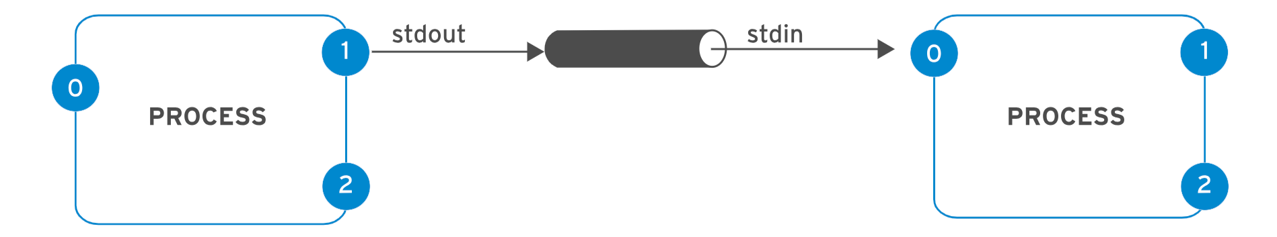
Pipelines
A pipeline is a sequence of one or more commands that are separated by the vertical bar character (|). A pipeline connects the standard output of the first command to the standard input of the next command.
ls -l /usr/bin | less
ls | wc -l
ls -t | head -n 10 > /tmp/first-ten-changed-files

Slide 65
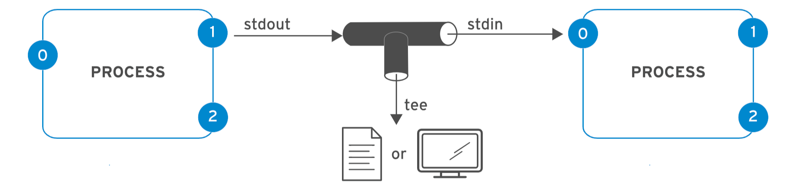
Pipelines, Redirection, and Appending to a File
In the next example, the output of the ls command goes to the /tmp/saved-output file, and the less command displays nothing on the terminal.
ls > /tmp/saved-output | less
The tee command overcomes this limitation. In a pipeline, tee copies its standard input to its standard output and also redirects its standard output to the files that are given as arguments to the command. If you imagine data as water that flows through a pipeline, then you can visualize tee as a "T" joint in the pipe that directs output in two directions.
ls -l | tee /tmp/saved-output | less
ls -t | head -n 10 | tee /tmp/ten-last-changed-files
ls -l | tee -a /tmp/append-files

Slide 66
Edit Text Files from the Shell Prompt
Edit Files with Vim - Vim is an improved version of the vi editor, which is distributed with Linux and UNIX systems.
  Vim is a highly configurable and efficient editor that provides split-screen editing, color formatting, and highlighting for editing text.
Benefits of the Vim Editor
  When a system uses a text-only shell prompt, user would need a text editor to modify files
  The key reason to learn Vim is that it is almost always installed by default on a server for editing text-based files.
  Vim is also used often as the vi implementation on other standard operating systems or distributions.
Get Started with Vim
  You can open a file for editing by using the vi command:
[user@host ~]$ vi filename
Alternatively, you can use the vim-enhanced package to install the Vim editor. This package provides a more comprehensive set of features, an online help system, and a tutorial program. Use the vim command to start Vim in this enhanced mode:
[user@host ~]$ vim filename

Slide 67
Vim Operating Modes
Vim editor offers various modes of operation such as
  command mode
  Edit/insert mode,
  visual mode.
When you first open Vim, it starts in command mode, which is used for navigation, cut and paste, and other text modification. Pressing the required keystroke accesses specific editing functions.
vi Editing commands
  i - Insert at cursor (goes into insert mode)
  a - Write after cursor (goes into insert mode)
ESC - Terminate insert mode and enter command mode
  u - Undo last change
  dd - Delete line
  3dd - Delete 3 lines.
  yy – copy 1 line
  3yy-copy 3 lines
  p – paste
  :se nu
  /word
Saving and Closing the file
:w – Save the file but keep it open
:q – Quit without saving
:wq – Save the file and quit
! – forcefully

Slide 68
Configure Programs with Environment Variables
You can assign any variable that is defined in the shell as an environment variable by marking it for export with the export command
  [user@host ~]$ EDITOR=vim
  [user@host ~]$ export EDITOR
You can set and export a variable in one step and set vi or nano as default editor:
  [user@host ~]$ export EDITOR=vim
  [user@host ~]$ export EDITOR=nano
[user@host ~]$ echo $PATH
/home/user/.local/bin:/home/user/bin:/usr/share/Modules/bin:/usr/local/bin:/usr/bin:/usr/local/sbin:/usr/sbin
[user@host ~]$ export PATH=${PATH}:/home/user/sbin\
[user@host ~]$ USERNAME=‘Demo’
[user@host ~]$ unset USERNAME

Slide 69
Bash History
HISTFILE, HISTFILESIZE, and HISTTIMEFORMAT shell variables affect the shell history and the history command.
The HISTFILE variable specifies which file to save the shell history to, and defaults to the ~/.bash_history file.
The HISTFILESIZE variable specifies how many commands to save in that file from the history.
The HISTTIMEFORMAT variable defines the time stamp format for every command in the history. This variable does not exist by default.
HISTTIMEFORMAT="%F %T "

Slide 70
Summary
Running programs, or processes, have three standard communication channels: standard input, standard output, and standard error.
You can use I/O redirection to read standard input from a file or to write the output or errors from a process to a file.
Pipelines can connect standard output from one process to the standard input of another process, and can format output or build complex commands.
Know how to use at least one command-line text editor, and Vim is the recommended option because it is commonly installed by default in Linux distributions.
Shell variables can help you to run commands, and are unique to a shell session.
You can modify the behavior of the shell or the processes with environment variables.

Slide 71
Chapter 6: Manage Local Users and Groups
Section 6.1: Describe User and Group Concepts
Section 6.2: Quiz: Describe User and Group Concepts
Section 6.3: Gain Superuser Access
Section 6.4: Guided Exercise: Gain Superuser Access
Section 6.5: Manage Local User Accounts
Section 6.6: Guided Exercise: Manage Local User Accounts
Section 6.7: Manage Local Group Accounts
Section 6.8: Guided Exercise: Manage Local Group Accounts
Section 6.9: Manage User Passwords
Section 6.10: Guided Exercise: Manage User Passwords
Section 6.11: Lab: Manage Local Users and Groups
Section 6.12: Summary

Slide 72
User and Groups
User accounts are of the following main types: the superuser, system users, and regular users.
  The superuser account administers the system. The superuser name is root and the account has a UID of 0. The superuser has full system access.
  The system user accounts are used by processes that provide supporting services. System users do not interactively log in with a system user account.
  Most users have regular user accounts for their day-to-day work. Like system users, regular users have limited access to the system.
  User details are stored in /etc/passwd file
A group is a collection of users that need to share access to files and other system resources. Groups can grant access to files to a set of users instead of to a single user.
  Like users, groups have group names for easier recognition. Internally, the system distinguishes groups by the unique identification number, the group ID or GID, which is assigned to them. The mapping of group names to GIDs is defined in identity management databases of group account information. By default, systems use the /etc/group file to store information about local groups.
  Each line in the /etc/group file contains information about one group. Each group entry is divided into four colon-separated fields

Slide 73
Passwd file and Group file
/etc/passwd
  user01 : The username for this user.
  x : The user's encrypted password was historically stored here; it is now a placeholder.
  1000 : The UID number for this user account.
  1000 : The GID number for this user account's primary group. Groups are discussed later in this section.
  User One : A brief comment, description, or the real name for this user.
  /home/user01 : The user's home directory, and the initial working directory when the login shell starts.
  /bin/bash : The default shell program for this user that runs at login. Some accounts use the /sbin/nologin shell to disallow interactive logins with that account.
/etc/group
  group01 : Name for this group.
  x : Obsolete group password field; it is now a placeholder.
  10000 : The GID number for this group (10000).
  user01,user02,user03 : A list of users that are members of this group as a supplementary group.

Slide 74
Primary Groups and Supplementary Groups
Every user has exactly one primary group. For local users, this group is listed by GID in the /etc/passwd file. The primary group owns files that the user creates.
When a regular user is created, a group is created with the same name as the user, to be the primary group for the user. The user is the only member of this User Private Group. This group membership design simplifies the management of file permissions, to have user groups separated by default.
Users might also have supplementary groups. Membership in supplementary groups is stored in the /etc/group file. Users are granted access to files based on whether any of their groups have access, regardless of whether the groups are primary or supplementary. For example, if the student user has a student primary group and wheel as supplementary group, then that user can read files that any of those three groups can read.
The id command can show group membership for a user.
[user@host ~]$ id student

Slide 75
Create Users from the Command Line
useradd username command creates a user called username. It sets up the user's home directory and account information, and creates a private group for the user called username.
useradd --help command displays the basic options to override the defaults. Usually, you can use the same options with the usermod command to modify an existing user.
The /etc/login.defs file sets some default options for user accounts, such as the range of valid UID numbers and default password aging rules. The values in this file affect only newly created user accounts. A change to this file does not affect existing users.
In Red Hat Enterprise Linux 9, the useradd command assigns new users the first free UID that is greater than or equal to 1000, unless you explicitly specify a UID by using the -u option.

Slide 76
Create Users from the Command Line
useradd / usermod options: | Usage – useradd –opt value username
-a, --append | Use it with the -G option to add the supplementary groups to the user's current set of group memberships instead of replacing the set of supplementary groups with a new set.
-c, --comment COMMENT | Add the COMMENT text to the comment field.
-d, --home HOME_DIR | Specify a home directory for the user account.
-g, --gid GROUP | Specify the primary group for the user account.
-G, --groups GROUPS | Specify a comma-separated list of supplementary groups for the user account.
-L, --lock | Lock the user account.
-m, --move-home | Move the user's home directory to a new location. You must use it with the -d option.
-s, --shell SHELL | Specify a particular login shell for the user account.
-U, --unlock | Unlock the user account.
-u | Set a custom UID for user account
userdel options: | Usage – userdel –opt username
-r | removes the user from /etc/passwd and deletes the user's home directory
passwd username command sets the initial password or changes the existing password for the username user.
The root user can set a password to any value.

Slide 77
UID Ranges
Red Hat Enterprise Linux uses specific UID numbers and ranges of numbers for specific purposes.
UID 0 : The superuser (root) account UID.
UID 1-200 : System account UIDs that are statically assigned to system processes.
UID 201-999 : UIDs that are assigned to system processes that do not own files on this system. Software that requires an unprivileged UID is dynamically assigned a UID from this available pool.
UID 1000+ : The UID range to assign to regular, unprivileged users.

Slide 78
Guided Exercise: Create users
useradd operator1
tail /etc/passwd
passwd operator1
usermod -c "Operator One" operator1
tail /etc/passwd
userdel -r operator1
tail /etc/passwd

Slide 79
Su and sudo commands
differences between the su, su -, and sudo commands
 | su | su - | sudo
Become new user | Yes | Yes | Per escalated command
Environment | Current user's | New user's | Current user's
Password required | New user's | New user's | Current user's
Privileges | Same as new user | Same as new user | Defined by configuration
Activity logged | su command only | su command only | Per escalated command
[user@host ~] $ su - root
[user@host ~] $ su root
[user@host ~] $ sudo useradd demouser
[user@host ~] $ sudo su -
[user@host ~] $ sudo –I
%wheel ALL=(ALL:ALL) ALL
%wheel ALL=(ALL) NOPASSWD: ALL

Slide 80
Su and sudo commands
%wheel ALL = (ALL) ALL
  student ALL=(ALL) useradd,userdel,passwd
  Read it as — User Root can Run Any Command as Any User from Any Group on Any Host.
  First ALL is used to define HOSTS. We can define Hostname/Ip-Address instead of ALL. ALL means any host.
  Second ALL : Third ALL is User:Group. Instead of ALL we can define User or User with the group like User:Group. ALL:ALL means All users and All groups.
  Last ALL is the Command. Instead of ALL, we can define a command or set of commands. ALL means all commands.
  To put it very simple, it is “who where = (as_whom) what”.

Slide 81
Manage Local Groups
groupadd | Usage – groupadd -opts grpname
-g | Set GID
-r | Creates system group
-n | Rename a group
groupdel | Usage – groupdel grpname
--help
The groupadd command creates groups.
As with normal groups, system groups use a GID from the range of listed valid system GIDs in the /etc/login.defs file. , /etc/defaults/useradd
The SYS_GID_MIN and SYS_GID_MAX configuration items in the /etc/login.defs file define the range of system GIDs.
The groupdel command deletes the group

Slide 82
Manage Local Groups
Compare Primary and Supplementary Group Membership
  A user's primary group is the group that is viewed on the user's account in the /etc/passwd file. A user can belong to only one primary group at a time.
  A user's supplementary groups are the additional groups that are configured for the user and viewed on the user's entry in the /etc/group file.
  A user can belong to as many supplementary groups as is necessary to implement file access and permissions effectively.
  For configuring group-based file permissions, no difference exists between a user's primary and supplementary groups. If the user belongs to any group that is assigned access to specific files, then that user has access to those files.
  The only distinction between a user's primary and supplementary memberships is when a user creates a file. New files must have a user owner and a group owner, which is assigned when the file is created. The user's primary group is used for the new file's group ownership, unless command options override it

Slide 83
Guided Exercise: Manage Local Groups
useradd sysadmin
usermod -aG admin sysadmin1
id sysadmin
tail /etc/group
echo "%admin ALL=(ALL) ALL" >> /etc/sudoers.d/admin
su - sysadmin
sudo su –
Logout and delete the user – userdel –r sysadmin

Slide 84
Shadow Passwords and Password Policy
The cryptographically hashed passwords were moved to the /etc/shadow file, which only the root user can read.
An example entry from the /etc/shadow file has nine colon-separated fields:
[root@host ~]# cat /etc/shadow
user03:$6$CSsXsd3rwghsdfarf:17933:0:99999:7:2:18113:
Each field of this code block is separated by a colon:
  user03 : Name of the user account.
  $6$CSsXsd3rwghsdfarf : The cryptographically hashed password of the user.
  17933 : The days from the epoch when the password was last changed, where the epoch is 1970-01-01 in the UTC time zone.
  0 : The minimum days since the last password change before the user can change it again.
  99999 : The maximum days without a password change before the password expires. An empty field means that the password never expires.
  7 : The number of days ahead to warn the user that their password will expire.
  2 : The number of days without activity, starting with the day that the password expired, before the account is automatically locked.
  18113 : The day when the account expires in days since the epoch. An empty field means that the account never expires.
  The last field is typically empty and is reserved for future use

Slide 85
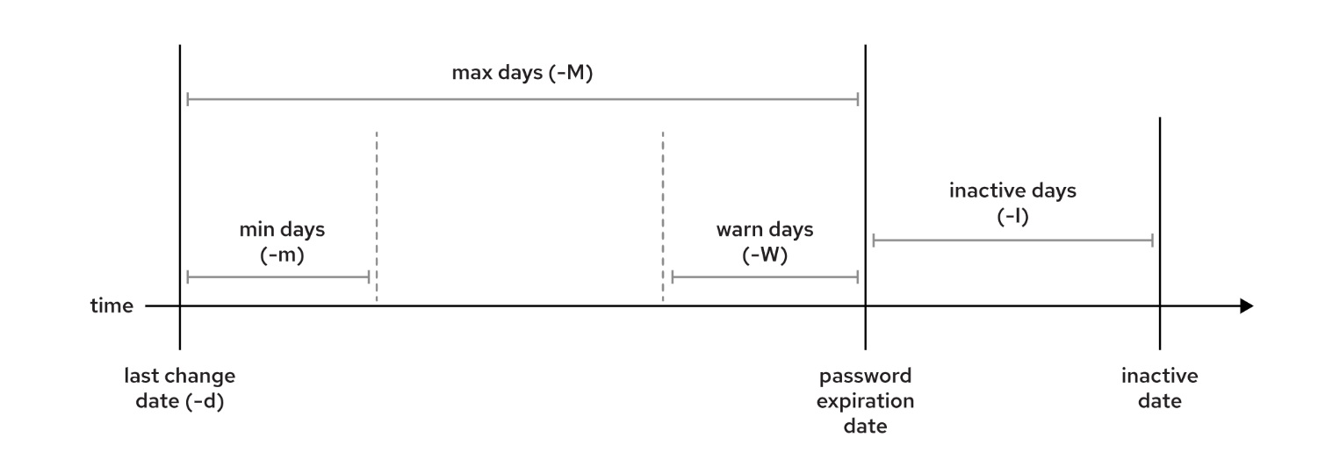
Configure Password Aging with chage
the command name is chage, which stands for "change age". Do not confuse the command with the word "change".
chage –l student
The above command will show minimum age (-m) of zero days, a maximum age (-M) of 99999 days, a warning period (-W) of 7 days
chage | Usage – chage -opts username
-m | Set minimum age
-M | Set Maximum age
-W | Set Warning period
-d | Force password change
-E | Set expiration date
-l | List password ageing details

Slide 86
Guided Exercise: Configure Password Aging with chage
As the student user, use administrative rights to lock the operator1 account.
sudo usermod -l operator1
Try to log in as operator1. This command should fail.
su - operator1
Unlock the operator1 account
sudo usermod -U operator1
Set the maximum age of the operator1 user's password to 90 days
chage -M 90 operator1
Verify that the operator1 user's password expires 90 days after it is changed.
chage -l operator1
Force a password change on the first login for the operator1 account
chage -d 0 operator1
Set the operator1 account to expire 180 days from the current day.
date -d "+180 days" +%F
chage -E 2022-09-06 operator1

Slide 87
Lab: User and Group Management
As the student user and switch to the root user
ensure that newly created users must change their passwords every 30 days.
vim /etc/login.defs
Set PASS_MAX_DAYS to 30
Create the consultants group with a GID of 35000
groupadd -g 35000 consultants
Configure administrative rights to enable all consultants group members to execute any command as any user. Place the configuration file in the /etc/sudoers.d directory.
echo "%consultants ALL=(ALL) ALL" >> /etc/sudoers.d/consultants
Create the consultant1, consultant2, and consultant3 users with the consultants group as their supplementary group
useradd -G consultants consultant1
Set the consultant1, consultant2, and consultant3 passwords to redhat
passwd consultant1
Determine the date 90 days in the future. Set the account expiry date of the consultant1, consultant2, and consultant3 accounts to the same value as determined in the preceding step.
date -d "+90 days" +%F
chage -E 2022-06-08 consultant1
Change the password policy for the consultant2 account to require a new password every 15 days.
chage -M 15 consultant2
Additionally, force the consultant1, consultant2, and consultant3 users to change their passwords on the first login.
chage -d 0 consultant1

Slide 88
Summary
The user account types in Linux are the superuser, system users, and regular users.
A user has a primary group and might be a member of supplementary groups.
The /etc/passwd, /etc/group, and /etc/shadow critical files contain user and group information.
You can run commands as the superuser with the su and sudo commands.
The useradd, usermod, and userdel commands manage users.
The groupadd, groupmod, and groupdel commands manage groups.
The passwd command manages passwords for users.
The chage command displays and configures password expiration settings for users.

Slide 89
Chapter 7: Control Access to Files
Section 7.1: Interpret Linux File System Permissions
Section 7.2: Quiz: Interpret Linux File System Permissions
Section 7.3: Manage File System Permissions from the Command Line
Section 7.4: Guided Exercise: Manage File System Permissions from the Command Line
Section 7.5: Manage Default Permissions and File Access
Section 7.6: Guided Exercise: Manage Default Permissions and File Access
Section 7.7: Lab: Control Access to Files
Section 7.8: Summary

Slide 90
Interpret Linux File System Permissions
File permissions control access to files. Linux file permissions are flexible and can handle most normal permission cases.
Files have three user categories that permissions apply to.
  The file is owned by a user, normally the file creator.
  The file is also owned by a single group, which is usually the primary group of the user who created the file
  Last one is others
You can set different permissions for the owning user (user permissions), the owning group (group permissions), and for all other users on the system that are not the user or a member of the owning group (other permissions).
The most specific permissions take precedence. User permissions override group permissions, which override other permissions.

Slide 91
Effects of Permissions on Files and Directories
Permission | Effect on files | Effect on directories
r (read) | File contents can be read. cat file | Contents of the directory (the file names) can be listed. ls –l dir
w (write) | File contents can be changed. vim file | Any file in the directory can be created or deleted. mkdir dir ; touch file
x (execute) | Files can be executed as commands. ./exefile | The directory can become the current working directory. You can run the cd command to it, but it also requires read permission to list files there. cd dir
The first character of the long listing is the file type, and is interpreted as follows:
- is a regular file.
d is a directory.
l is a symbolic link.
c is a character device file.
b is a block device file.

Slide 92
Change Permissions – Symbolic Method
What | Operation | Description
+ | add | Adds the permissions to the file.
- | remove | Removes the permissions to the file.
= | set exactly | Sets exactly the provided permissions to the file.
Change File and Directory Permissions
  chmod –opts permissions file/dir
Change Permissions with the Symbolic Method
  chmod who/what/which file/dir
Who | Set | Description
u | user | The file owner.
g | group | Member of the file's group.
o | other | Users who are not the file owner nor members of the file's group.
a | all | All the three previous groups.
Which | Mode | Description
r | read | Read access to the file. Listing access to the directory.
w | write | Write permissions to the file or directory.
x | execute | Execute permissions to the file. Allows entering the directory, and accessing files and subdirectories inside the directory.

Slide 93
Manage File System Permissions from the Command Line
chmod go-rw document.pdf
chmod a+x myscript.sh
chmod -R g+rwx /home/user/myfolder

Slide 94
Change Permissions – Octal Method
Change Permissions with the Octal Method
chmod xxx file/dir
chmod 664 file1
chmod 0664 file1
chmod 755 dir1
chmod 0755 dir1
Mode | Value | Description
r | 4 | Read permission
w | 2 | Write permission
x | 1 | Execute permission

Slide 95
Change File and Directory User or Group Ownership
chown command is used to change the ownership
chown user file/dir
chown .group file/dir
Chown :group file/dir
chown user:group file/dir
chown –R user:group dir

Slide 96
Guided Exercise: Manage File System Permissions
Create /home/consultant, Change the group ownership of the consultant directory to consultants
chown :consultants /home/consultant
Modify the permissions of the consultants group to allow its group members to create files in, and delete files from, the /home/consultants directory.
ls -ld /home/consultant
chmod g+w /home/consultant ; ls -ld /home/consultant
chmod 770 /home/consultant
ls -ld /home/consultant
As consultants group member , Navigate to the /home/consultant directory and create a file called consultant1.txt
cd /home/consultant ; touch consultant1.txt
ls -l consultant1.txt
Ensure that all members of the consultants group can edit the consultant1.txt file. Change the group ownership of the consultant1.txt file to consultants
chown :consultants consultant1.txt ; ls -l consultant1.txt
Ensure that the student user can add content to the consultant1.txt file
cd /home/consultant/
echo "text" >> consultant1.txt
cat consultant1.txt

Slide 97
Manage Default Permissions
A file is assigned initial permissions. Two factors affect these initial permissions.
  The first is whether you are creating a regular file or a directory.
  The second is the current umask, which stands for user file-creation mask.
Directory’s initial octal permissions are 0777 (drwxrwxrwx).
Regular file’s initial octal permissions are 0666 (-rw-rw-rw-).
You must always explicitly add execute permission to a regular file. This step makes it harder for an attacker to compromise a system, create a malicious file, and run it.
Shell session sets a umask to further restrict the initial permissions of a file.
The umask is an octal bitmask that clears the permissions of new files and directories that a process creates.
The umask command without arguments displays the current value of the shell's umask:
[user@host] $ umask

Slide 98
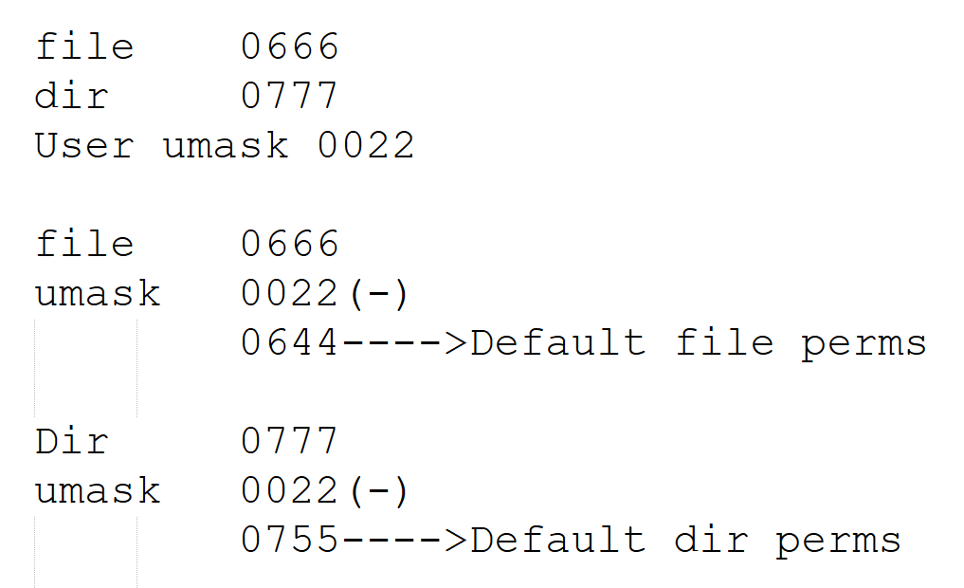
Manage Default Permissions
Append/modify following line to setup a new umask:
umask 022
Explain Octal umask Mode 022
  0 is for owner 2 is for group 2 is for others
  For a newly created directory , permissions are 022 minus 777 = 755 which means rwx rx rx
  For newly created file, permissions are 022 minus 666 = 644 which means rw-r—r--

Slide 99
Example: Manage Default Permissions
If you create a directory, then its initial octal permissions are 0777 ,Then, the 0022 umask (disables the write permission bit for group and other. Thus, the owner has read, write, and execute permissions on directories, and both group and other are set for read and execution
umask ; touch default.txt ; ls -l default.txt
umask ; mkdir default ; ls -ld default
By setting the umask value to 0, the file permissions for other change from read to read and write. The directory permissions for other change from read and execute to read, write, and execute
umask 0
touch zero.txt ; ls -l zero.txt
mkdir zero ; ls -ld zero
To mask all file and directory permissions for other, set the umask value to 007.
umask 007
touch seven.txt ; ls -l seven.txt
mkdir seven ; ls -ld seven
A umask of 027 ensures that new files have read and write permissions for user and read permission for group. New directories have read and execute permissions for group and no permissions for other.
umask 027
touch two-seven.txt ; ls -l two-seven.txt
mkdir two-seven ; ls -ld two-seven

Slide 100
Changing Default Permissions
In Red Hat Enterprise Linux 9, the /etc/login.defs file sets the default umask for users. By default, its UMASK line specifies that the default umask is 0022.
In Red Hat Enterprise Linux 9.0 and 9.1,. If you start a new terminal window or start an interactive non-login shell then settings in /etc/bashrc apply. For these shells, if the account's UID is 200 or greater and the username and primary group name are the same, then the account is assigned a umask of 0002. Otherwise, the umask is 0022.
The current umask of a shell applies until you log out of the shell and log back in, or until you change it manually with the umask command.
  /etc/login.defs
  vi /etc/profile
  vi /etc/bashrc
  vi ~/.bash_profile
  vi ~/.bashrc

Slide 101
Manage Default Permissions
Set same umask for all users
  vi /etc/login.defs -> UMASK 0022
  OR
  vi /etc/profile -> umask 0022
Set different umask for root and non-root users
  vi /etc/profile ->
  # Overrides default umask configuration
  if [ $UID -gt 199 ] && [ "`id -gn`" = "`id -un`" ]; then
  umask 002
  else
  umask 022
  fi
Set different umask for root and non-root users using bash shell
  vi /etc/bashrc ->
  # Overrides default umask configuration
  if [ $UID -gt 199 ] && [ "`id -gn`" = "`id -un`" ]; then
  umask 002
  else
  umask 022
  fi
Set umask to users using GUI login (Interactive non-login session)
  vi /etc/profile.d/local-umask.sh
  # Overrides default umask configuration
  if [ $UID -gt 199 ] && [ "`id -gn`" = "`id -un`" ]; then
  umask 007
  else
  umask 022
  fi

Slide 102
Special Permissions
Special permissions are a fourth permission type in addition to the user, group, and other types.
Special permissions provide additional access-related features beyond what the basic permission types allow.
Special Permission | Effect on files | Effect on directories,
4,u+s (suid) | File executes as the user that owns the file, not as the user that ran the file. | No effect.
2,g+s (sgid) | File executes as the group that owns the file. | Files that are created in the directory have a group owner to match the group owner of the parent directory.
1,o+t (sticky) | No effect. | Users with write access to the directory can remove only files that they own; they cannot remove or force saves to files that other users own.

Slide 103
Special Permissions
setuid / SUID - SUID special permission on an executable file means that commands run as the user that owns that file, rather than as the user that ran the command.
ls -l /usr/bin/passwd
-rwsr-xr-x. 1 root root 35504 Jul 16 2010 /usr/bin/passwd
setgid/SGID - SGID special permission on a directory means that created files in the directory inherit their group ownership from the directory, rather than inheriting group ownership from the creating user.
ls -ld /run/log/journal
drwxr-sr-x. 3 root systemd-journal 60 May 18 09:15 /run/log/journal
ls -ld /usr/bin/locate
-rwx--s--x. 1 root slocate 47128 Aug 12 17:17 /usr/bin/locate
Sticky - sticky bit special permission for a directory sets a special restriction on deletion of files. Only the owner of the file (and the root user) can delete files within the directory. An example is the /tmp directory:
ls -ld /tmp
drwxrwxrwt. 39 root root 4096 Feb 8 20:52 /tmp
Symbolic : setuid = u+s; setgid = g+s; sticky = o+t
Octal : In the added fourth preceding digit; setuid = 4; setgid = 2; sticky = 1

Slide 104
Guided Exercise: Manage Default Permissions and File Access
List the operator1 user's default umask value
umask
Create a /tmp/shared directory. In the /tmp/shared directory, create a defaults file.
mkdir /tmp/shared ; ls -ld /tmp/shared
touch /tmp/shared/defaults ; ls -l /tmp/shared/defaults
Change the group ownership of the /tmp/shared directory to the operators group.
chown :operators /tmp/shared ; ls -ld /tmp/shared
touch /tmp/shared/group ; ls -l /tmp/shared/group
Ensure that the operators group owns files that are created in the /tmp/shared directory.
chmod g+s /tmp/shared ; touch /tmp/shared/ops_db.txt ls -l /tmp/shared/ops_db.txt
Create an ops_net.txt file in the /tmp/shared directory. Change the umask for the operator1 user to 027. Create an ops_prod.txt file.
touch /tmp/shared/ops_net.txt
ls -l /tmp/shared/ops_net.txt
umask 027 ; touch /tmp/shared/ops_prod.txt
ls -l /tmp/shared/ops_prod.txt

Slide 105
Guided Exercise: Manage Default Permissions and File Access
List the operator1 user's default umask value
umask
Change the default umask for the operator1 user. The new umask prohibits all access for users that are not in their group. Confirm that the umask is changed
echo "umask 007" >> ~/.bashrc
cat ~/.bashrc
umask 007
Logout
Login
touch /tmp/shared/ops_prod2.txt ; ls -l

Slide 106
Access Control Lists
Access control list (ACL) provides an additional, more flexible permission mechanism for file systems
ACL allows you to give permissions for any user or group to any resource.
Think of a scenario in which a particular user is not a member of group created by you but still you want to give some read or write access, how can you do it without making user a member of group, here comes in picture Access Control Lists, ACL helps us to do this trick. Basically, ACLs are used to make a flexible permission mechanism in Linux.
setfacl and getfacl are used for setting up ACL and showing ACL respectively.
To add permission for user
setfacl -m "u:username:permissions" /path/to/file
Setfacl –m “u:mohit:rw-” filename or path to file
To add permissions for a group
setfacl -m "g:group:permissions" /path/to/file
Remove single entry
Setfacl –x “u:username” filename
Setfacl –x “g:groupname” filename
To remove all entries
setfacl -b path/to/file
To verify
getfacl path/to/file

Slide 107
Lab: Control Access to files
Log in to VM as the student user and become the root user
Create a /home/techdocs directory
Change the group ownership of the /home/techdocs directory to the techdocs group.
Verify that users in the techdocs group cannot create files in the /home/techdocs directory
Create a techdoc1.txt file in the /home/techdocs directory. This step should fail.
Set permissions on the /home/techdocs directory. On the /home/techdocs directory, configure setgid (2); read, write, and execute permissions (7) for the owner/user and group; and no permissions (0) for other users.
Confirm that users in the techdocs group can now create and edit files in the /home/techdocs directory
Switch to the tech2 user. Display the content of the /home/techdocs/techdoc1.txt file. Create a techdoc2.txt file in the /home/techdocs directory. Exit from the tech2 user shell.
Switch to the database1 user. Display the content of the /home/techdocs/techdoc1.txt file. You get a Permission Denied message. Verify that the database1 user does not have access to the file. Exit from the database1 user shell.
Modify the /etc/login.defs file to adjust the default umask for login shells. Normal users should have a umask setting that allows the user and group to create, write, and execute files and directories, and preventing other users from viewing, modifying, or executing new files and directories.
Edit the /etc/login.defs file and set a umask of 007. The /etc/login.defs file already contains a umask definition. Search the file and update with the appropriate value.

Slide 108
Summary
File ownership permissions have three categories. A file is owned by a user, a single group, and other users. The most specific permission applies. User permissions override group permissions, and group permissions override other permissions.
The ls command -l option expands the file listing to include both the file permissions and ownership.
The chmod command changes file permissions from the command line.
The chmod command can use one of two methods to represent permissions: symbolic or octal.
The chown command changes file ownership. The chown command -R option recursively changes the ownership of a directory tree.
The umask command without arguments displays the current umask value of the shell. Every process on the system has a umask.
The default umask values for Bash are defined in the /etc/login.defs file and might be affected by settings in the /etc/profile and /etc/bashrc files, files in /etc/profile.d, or your account's shell initialization files.
The suid, sgid, and sticky special permissions provide additional access-related features to files.

Slide 109
Chapter 8: Monitor and Manage Linux Processes
Section 8.1: Process States and Lifecycle
Section 8.2: Quiz: Process States and Lifecycle
Section 8.3: Control Jobs
Section 8.4: Guided Exercise: Control Jobs
Section 8.5: Kill Processes
Section 8.6: Guided Exercise: Kill Processes
Section 8.7: Monitor Process Activity
Section 8.8: Guided Exercise: Monitor Process Activity
Section 8.9: Lab: Monitor and Manage Linux Processes
Section 8.10: Summary

Slide 110
Process States and Lifecycle
A process is a running instance of a launched, executable program. From the moment that a process is created, it consists of the following items:
  An address space of allocated memory
  Security properties, including ownership credentials and privileges
  One or more execution threads of program code
  A process state
An existing parent process duplicates its own address space, which is known as a process fork, to create a child process structure. Every new process is assigned a unique process ID (PID) for tracking and security purposes. The PID and the parent's process ID (PPID) are elements of the new process environment. Any process can create a child process. All processes are descendants of the first system process, systemd, on a Red Hat system

Slide 111
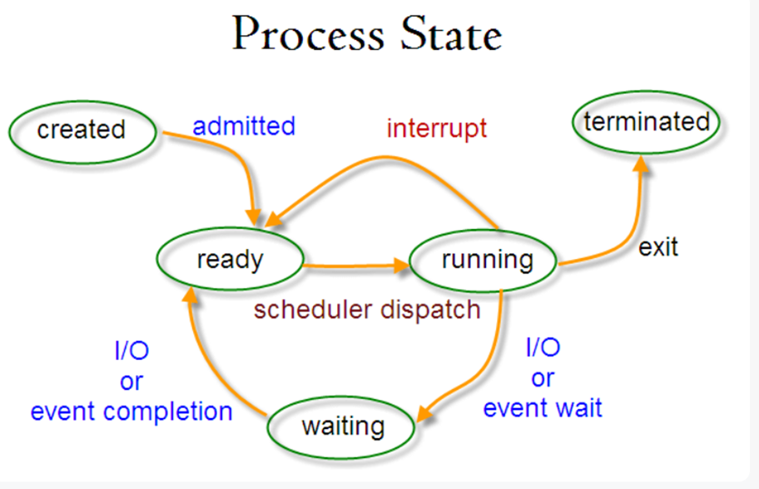
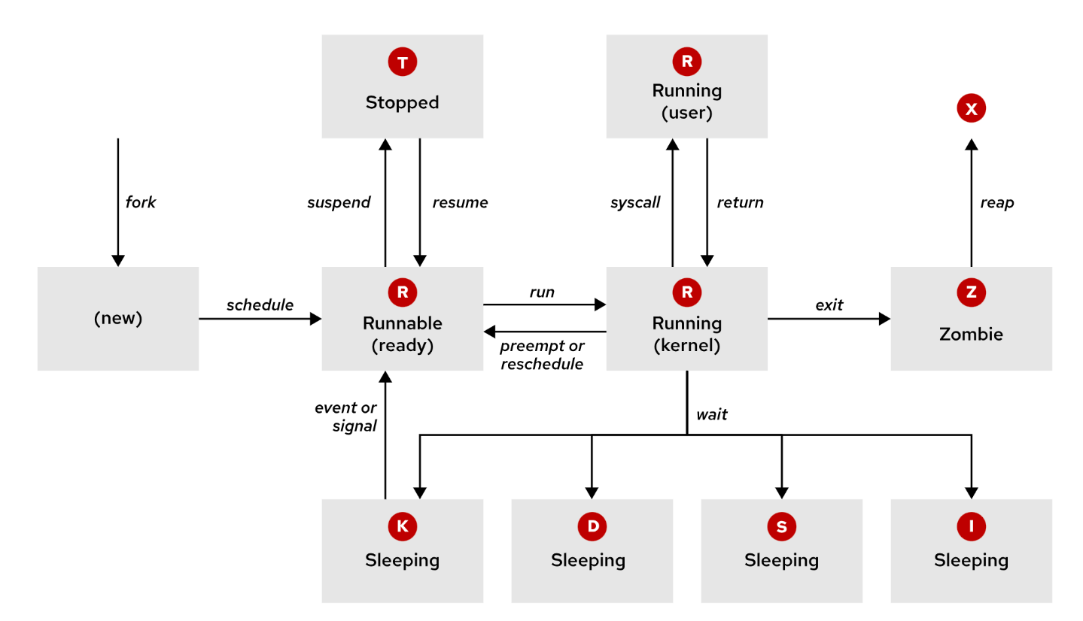
Process States and Lifecycle

Slide 112
Process States and Lifecycle
Name | Flag | Kernel-defined state name and description
Running | R | TASK_RUNNING: The process is either executing on a CPU or waiting to run. The process can be executing user routines or kernel routines (system calls), or be queued and ready when in the Running (or Runnable) state.
Sleeping | S | TASK_INTERRUPTIBLE: The process is waiting for some condition: a hardware request, system resource access, or a signal. When an event or signal satisfies the condition, the process returns to Running.
 | D | TASK_UNINTERRUPTIBLE: This process is also sleeping, but unlike the S state, does not respond to signals. It is used only when process interruption might cause an unpredictable device state.
 | K | TASK_KILLABLE: Same as the uninterruptible D state, but modified to allow a waiting task to respond to the signal to kill it (exit completely). Utilities often display Killable processes as the D state.
 | I | TASK_REPORT_IDLE: A subset of state D. The kernel does not count these processes when calculating the load average. It is used for kernel threads. The TASK_UNINTERRUPTIBLE and TASK_NOLOAD flags are set. It is similar to TASK_KILLABLE, and is also a subset of state D. It accepts fatal signals.
Stopped | T | TASK_STOPPED: The process is stopped (suspended), usually by being signaled by a user or another process. The process can be continued (resumed) by another signal to return to running.
 | t | TASK_TRACED: A process that is being debugged is also temporarily stopped and shares the T state flag.
Zombie | Z | EXIT_ZOMBIE: A child process signals to its parent as it exits. All resources except for the process identity (PID) are released.
 | X | EXIT_DEAD: When the parent cleans up (reaps) the remaining child process structure, the process is now released completely. This state cannot be observed in process-listing utilities.

Slide 113
Listing Process
The ps command is used for listing detailed information for current processes.
  User identification (UID), which determines process privileges
  Unique process identification (PID)
  Amount of used CPU and elapsed real time
  Amount of allocated memory
  The process stdout location, which is known as the controlling terminal
  The current process state
ps –aux - option displays all processes including processes without a controlling terminal.
ps –ef – options to display all processes
ps –aux
ps -ef
ps –eo user,pid,pri,cmd

Slide 114
Control Jobs
A job is associated with each pipeline that is entered at a shell prompt.
Only one job at a time can read input and keyboard-generated signals from a particular terminal window.
A background process of that controlling terminal is any other job that is associated with that terminal.
Any command or pipeline can be started in the background by appending an ampersand (&)
# sleep 10000 &
Use jobs command to display list of jobs
# jobs
Use the fg command to bring a background job to the foreground
# fg %1

Slide 115
Control Jobs
Adjust priority with nice and renice
# nice -n 5 test.sh &
# ps –aux|grep test.sh
# renice -n 10 -p 1234
Priority range is from -20 to 20 | -20 is highest
Use nohup command to keep the process active even if user session is terminated
  Close ssh session and rejoin
  Check the same process if its running
# nohup test.sh &

Slide 116
Guided Exercise: Process Control
$ nohup sleep 1000 &
$ top
$ lscpu
$nice -n 5 sleep 2000 &
$ps –aux|grep sleep
$renice -n 10 -p 1234

Slide 117
Kill Processes
Process Control with Signals - A signal is a software interrupt that is delivered to a process. Signals report events to an executing program. The following table lists the fundamental signals that system administrators use for routine process management.
Signal | Name | Definition
1 | HUP | Hangup : Reports termination of the controlling process of a terminal. Also requests process re-initialization (configuration reload) without termination.
2 | INT | Keyboard interrupt : Causes program termination. It can be blocked or handled. Sent by pressing the INTR (Interrupt) key sequence (Ctrl+c).
3 | QUIT | Keyboard quit : Similar to SIGINT; adds a process dump at termination. Sent by pressing the QUIT key sequence (Ctrl+\).
9 | KILL | Kill, unblockable : Causes abrupt program termination. It cannot be blocked, ignored, or handled; consistently fatal.
15 default | TERM | Terminate : Causes program termination. Unlike SIGKILL, it can be blocked, ignored, or handled. The "clean" way to ask a program to terminate; it allows the program to complete essential operations and self-cleanup before termination.
18 | CONT | Continue : Sent to a process to resume if stopped. It cannot be blocked. Even if handled, it always resumes the process.
19 | STOP | Stop, unblockable : Suspends the process. It cannot be blocked or handled.
20 | TSTP | Keyboard stop : Unlike SIGSTOP, it can be blocked, ignored, or handled. Sent by pressing the suspend key sequence (Ctrl+z).

Slide 118
Send Signals by Explicit Request
You can signal the current foreground process by pressing a keyboard control sequence to
  suspend (Ctrl+z) - Stop a running program (suspend) and wait to continue (resume).
  kill (Ctrl+c) - Terminate a program (exit) immediately.
  core dump (Ctrl+\) - Save a program's memory image (core dump), and then terminate.
The kill command uses a PID number to send a signal to a process.
you can use the kill command to send any signal, not just those signals for terminating programs. You can use the kill command -l option to list the names and numbers of all available signals.
sleep 1000 &
kill –l
ps aux | grep sleep
kill -9 5199
killall sleep

Slide 119
Monitor Process Activity
Load Average - Load average is a measurement that the Linux kernel provides, to represent the perceived system load for a period of time. It can be used to determine whether system load increases or decreases.
The kernel collects the current load number every five seconds and reported as an exponential moving average over the most recent 1, 5, and 15 minutes.
Load Average Calculation - The load average represents the perceived system load for a period of time. Linux determines load average by reporting how many processes are ready to run on a CPU and how many processes are waiting for disk or network I/O to complete.
  The load number is a running average of the number of processes that are ready to run (in process state R) or are waiting for I/O to complete (in process state D).
  Load average is a rough measurement of how many processes are currently waiting for a request to complete before they do anything else. The request might be for CPU time to run the process. Alternatively, the request might be for a critical disk I/O operation to complete, and the process cannot be run on the CPU until the request completes, even though the CPU is idle. Either way, system load is impacted, and the system appears to run more slowly because processes are waiting to run.

Slide 120
Monitor Process Activity
uptime - The uptime command is one way to display the current load average.
It prints the current time, how long the machine has been up, how many user sessions are running, and the current load average.
[user@host ~]$ uptime
15:29:03 up 14 min, 2 users, load average: 2.92, 4.48, 5.20
Use the lscpu command to determine the number of CPUs on a system.
# From lscpu, the system has four logical CPUs, so divide by 4:
# load average: 2.92, 4.48, 5.20
# divide by number of logical CPUs: 4 4 4
# ---- ---- ----
# per-CPU load average: 0.73 1.12 1.30
#
# With a load average of 2.92 on four CPUs, all CPUs were in use ~73% of the time.
# During the last 5 minutes, the system was overloaded by ~12%.
# During the last 15 minutes, the system was overloaded by ~30%.

Slide 121
Real-time Process Monitoring
The top command displays a dynamic view of the system's processes and a summary header followed by a process or thread list.
The default top output columns are as follows:
  The process ID (PID).
  The process owner username (USER).
  Virtual memory (VIRT) is all the memory that the process uses, including the resident set, shared libraries, and any mapped or swapped memory pages (labeled VSZ in the ps command).
  Resident memory (RES) is the physical memory that the process uses, including any resident, shared objects (labeled RSS in the ps command).
  Process state (S) can be one of the following states:
    D = Uninterruptible Sleeping
    R = Running or Runnable
    S = Sleeping
    T = Stopped or Traced
    Z = Zombie
  CPU time (TIME) is the total processing time since the process started. It can be toggled to include a cumulative time of all previous children.
  The process command name (COMMAND).
[student@servera ~]$ nohup sleep 1000 &
[student@servera ~]$ top
[student@servera ~]$ lscpu
[student@servera ~]$ uptime

Slide 122
Lab: Process Management
Log in to VM as the student user and become the root user
Run sleep 1000 command
Find the process id of sleep command
Kill sleep command
Run sleep command with -10 priority
Change the priority again to 5
Check jobs running in background

Slide 123
Summary
A process is a running instance of an executable program. Processes are assigned a state, which can be running, sleeping, stopped, or zombie. The ps command lists processes.
Each terminal has its own session, and can have a foreground process and independent background processes. The jobs command displays processes within a terminal session.
A signal is a software interrupt that reports events to an executing program. The kill, pkill, and killall commands use signals to control processes.
Load average is an estimate of how busy the system is. To display load average values, you can use the top, uptime, or w commands.

Slide 124
Chapter 9: Control Services and Daemons
Section 9.1: Identify Automatically Started System Processes
Section 9.2: Guided Exercise: Identify Automatically Started System Processes
Section 9.3: Control System Services
Section 9.4: Guided Exercise: Control System Services
Section 9.5: Lab: Control Services and Daemons
Section 9.6: Summary

Slide 125
Systemd Daemon
The systemd daemon manages the startup process for Linux, including service startup and service management in general.
The systemd daemon activates system resources, server daemons, and other processes, both at boot time and on a running system.
Daemons are processes that either wait or run in the background, to perform various tasks.
Generally, daemons start automatically at boot time and continue to run until shutdown or until you manually stop them. By convention, daemon names end with d.
A service in the systemd sense often refers to one or more daemons.
In Red Hat Enterprise Linux, the first process that starts (PID 1) is the systemd daemon, which provides these features:
  Parallelization capabilities (starting multiple services simultaneously), which increase the boot speed of a system.
  On-demand starting of daemons without requiring a separate service.
  Automatic service dependency management, which can prevent long timeouts. For example, a network-dependent service does not try to start until the network is available.
  A method of tracking related processes together by using Linux control groups.

Slide 126
Service Units
A systemd unit is an abstract concept to define objects that the system knows how to manage.
Units are represented by configuration files called unit files, which encapsulate information about system services, listening sockets, and other relevant objects for the systemd init system.
The systemd daemon uses units to manage different types of objects:
  Service units have a .service extension and represent system services. You can use service units to start often-accessed daemons, such as a web server.
  Socket units have a .socket extension and If a client connects to the socket, then the systemd manager starts a daemon and passes the connection to it.
To manage units, use the systemctl command. For example, display available unit types with the systemctl -t help command. The systemctl command can take abbreviated unit names, process tree entries, and unit descriptions.
Systemctl command :
systemctl
systemctl list-units --type=service
systemctl list-units --type=socket –all
systemctl status|start|stop|restart|reload chronyd
systemctl is-enabled|is-active sshd
systemctl list-dependencies sshd.service
systemctl enable|disable --now sshd.service

Slide 127
Guided Exercise: Identify Automatically Started System Processes
List all the installed service units on the servera machine
  systemctl list-units --type=service
List all socket units, active and inactive, on the servera machine.
  systemctl list-units --type=socket --all
Explore the status of the chronyd service. You can use this service for network time protocol synchronization (NTP).
  systemctl status chronyd
  systemctl disable chronyd
  systemctl enable --now chronyd
Confirm that the chronyd daemon is running by using its process ID. In the preceding command, the output of the process ID that is associated with the chronyd service is <pid>. The process ID might differ on your system
  ps -p <pid>
Explore the status of the sshd service. You can use this service for secure encrypted communication between systems.
  systemctl is-enabled sshd
  systemctl is-active sshd
  systemctl status sshd
List the enabled or disabled states of all service units
  systemctl list-unit-files --type=service

Slide 128
Summary
The systemd utility provides a method for activating system resources, server daemons, and other processes, both at boot time and on a running system.
Use the systemctl utility to start, stop, reload, enable, and disable services.
Use the systemd utility to manage service units, socket units, and path units.
Use the systemctl status command to determine the status of system daemons and network services that the systemd utility started.
The systemctl list-dependencies command lists all service units that a specific service unit depends on.

Slide 129
Chapter 10: Configure and Secure SSH
Section 10.1: Access the Remote Command Line with SSH
Section 10.2: Guided Exercise: Access the Remote Command Line
Section 10.3: Configure SSH Key-based Authentication
Section 10.4: Guided Exercise: Configure SSH Key-based Authentication
Section 10.5: Customize OpenSSH Service Configuration
Section 10.6: Guided Exercise: Customize OpenSSH Service Configuration
Section 10.7: Lab: Configure and Secure SSH
Section 10.8: Summary

Slide 130
Describe Secure Shell
The OpenSSH package provides the Secure Shell, or SSH protocol, in Red Hat Enterprise Linux. With SSH protocol, systems can communicate in an encrypted and secure channel over an insecure network.
Use the ssh command to create a secure connection to a remote system, authenticate as a specific user, and obtain an interactive shell session on the remote system. The ssh command can run a session on a remote system without running an interactive shell.
# systemctl status sshd
# ssh user@hostname
# cat /etc/ssh/sshd_config
# systemctl restart sshd

Slide 131
Configure SSH Key-based Authentication
Passwords can be easily learned or stolen, but securely stored private keys are harder to compromise
You can configure your account for passwordless access to SSH servers that enabled key-based authentication, which is based on public key encryption (PKI).
Generate a cryptographically related pair of key files. One key is private and held only by you. The second key is your related public key, which is not secret. The private key acts as your authentication credential, and it must be stored securely. The public key is copied to your account on servers that you will remotely access, and verifies your use of your private key.
When you log in to your account on a remote server, the remote server uses your public key to encrypt a challenge message and send it to your SSH client. Your SSH client must then prove that it can decrypt this message, which demonstrates that you have the associated private key. If this verification succeeds, then your request is trusted, and you are granted access without giving a password.

Slide 132
Configure SSH Key-based Authentication
Generate Keys
  ssh-keygen
Share the Public key
  ssh-copy-id user@remotehost
Connection verbose
  ssh –v user@remotehost
sshd configuration
  cat /etc/ssh/sshd_config
    Permitrootlogin yes
    PasswordAuthentication yes

Slide 133
Guided Exercise: Customize OpenSSH Service Configuration
From workstation, open an SSH session to the serverB machine as the student user
  ssh student@serverb
Use the su command to switch to the operator2 user on the serverB machine. Use redhat as the password for the operator2 user
  su – operator2
Use the ssh-keygen command to generate SSH keys. Do not enter any passphrase for the keys.
  ssh-keygen
Use the ssh-copy-id command to send the public key of the SSH key pair to the operator2 user on the serverA machine. Use redhat as the password for the operator2 user on serverA
  ssh-copy-id operator2@servera
Confirm that you can successfully log in to the serverA machine as the operator2 user with the SSH keys
  ssh operator2@servera
Configure the sshd service on the serverA machine to allow users to authenticate with SSH keys only, rather than with their passwords
  vi /etc/ssh/sshd_config
    PasswordAuthentication no
  systemctl reload sshd ; ssh operator2@servera

Slide 134
COCKPIT

Slide 135
Summary
With the ssh command, users can access remote systems securely with the SSH protocol.
A client system stores the identities of remote servers in the ~/.ssh/known_hosts and /etc/ssh/ssh_known_hosts files.
SSH supports both password-based and key-based authentication.
The ssh-keygen command generates an SSH key pair for authentication. The ssh-copy-id command exports the public key to remote systems.
The sshd service implements the SSH protocol on Red Hat Enterprise Linux systems.
Configure advanced SSH settings in the /etc/ssh/sshd_config configuration file.
It is a recommended practice to configure sshd to disable remote logins as root and to require public key authentication rather than password-based authentication.

Slide 136
Chapter 11: Manage Networking
Section 11.1: Describe Networking Concepts
Section 11.2: Quiz: Describe Networking Concepts
Section 11.3: Validate Network Configuration
Section 11.4: Guided Exercise: Validate Network Configuration
Section 11.5: Configure Networking from the Command Line
Section 11.6: Guided Exercise: Configure Networking from the Command Line
Section 11.7: Edit Network Configuration Files
Section 11.8: Guided Exercise: Edit Network Configuration Files
Section 11.9: Configure Hostnames and Name Resolution
Section 11.10: Guided Exercise: Configure Hostnames and Name Resolution
Section 11.11: Lab: Manage Networking
Section 11.12: Summary

Slide 137
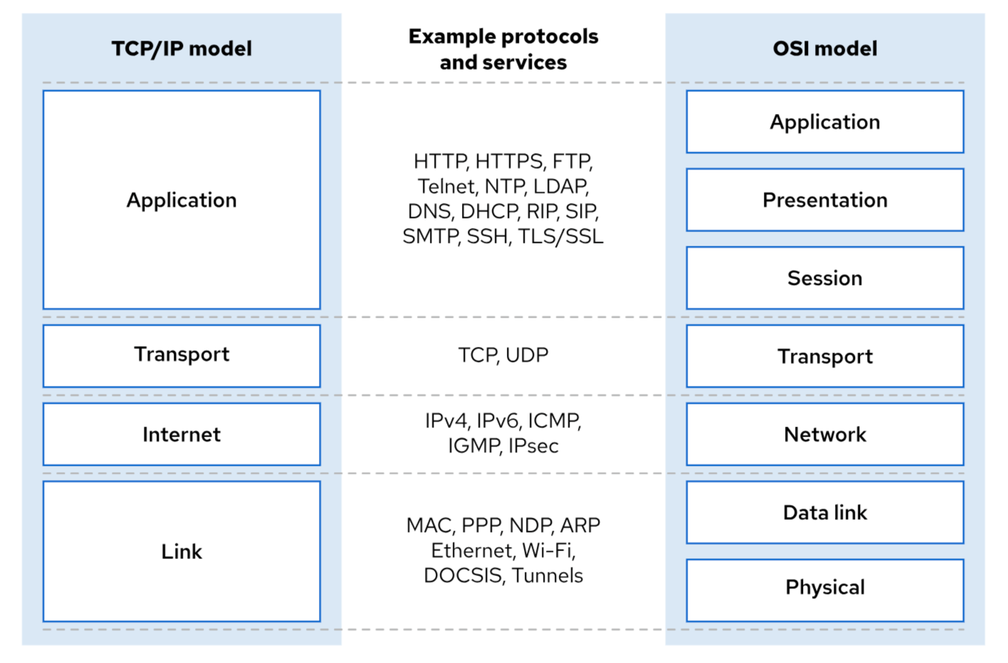
TCP/IP vs OSI
The TCP/IP network model is a four-layered set of communication protocols that describes how data communications are packetized, addressed, transmitted, routed, and received between computers over a network.
Following are the four layers of the TCP/IP network model:
  Application - Each application has specifications for communication so that clients and servers can communicate across platforms. Common protocols include SSH, HTTPS (secure web), FTP (file sharing), and SMTP (electronic mail delivery).
  Transport - TCP and UDP are transport protocols. TCP is a reliable connection-oriented communication, whereas UDP is a connectionless datagram protocol. A list of well-known and registered ports is in the /etc/services file. When a packet is sent on the network, the combination of the service port and IP address forms a socket. Each packet has a source socket and a destination socket. This information can be used when monitoring and filtering network traffic.
  Internet - The internet layer, or network layer, carries data from the source host to the destination host. The IPv4 and IPv6 protocols are internet layer protocols. Each host has an IP address and a prefix to determine network addresses. Routers are used to connect networks.
  Link - The link layer, or media access layer, provides the connection to physical media. The most common types of networks are wired Ethernet (802.3) and wireless Wi-Fi (802.11). Each physical device has a Media Access Control (MAC) address, which is also known as a hardware address, to identify the destination of packets on the local network segment.

Slide 138
IPv4 Address , Subnets and Netmasks
IPv4 address is a 32-bit number, which is expressed as four 8-bit octets in a decimal format that ranges in value from 0 to 255, separated by single dots. The address is divided into two parts: the network prefix and the host number
Subnet - The number of available host addresses in a subnet depends on the network prefix size. For example, a network prefix of /24 leaves 8 bits, or 255 possible host addresses in the subnet.
  network address for a subnet is the lowest possible address on a subnet, where the host number is all binary zeros.
  broadcast address for a subnet is the highest possible address on a subnet, where the host number is all binary ones, and is a special address for broadcasting packets to all subnet hosts.
  gateway address for a subnet can be any unique host number in the subnet, but is commonly set to the first available host number, which is a binary number of all zeroes except for a '1' in the last bit. This gateway numbering convention is not mandatory, and subnets that do not need external communication do not set a network gateway.

Slide 139
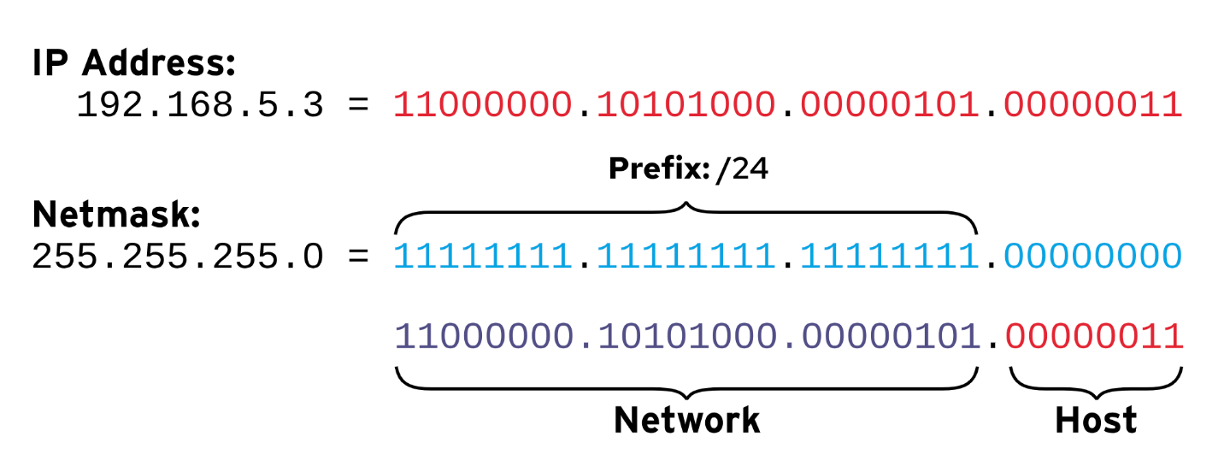
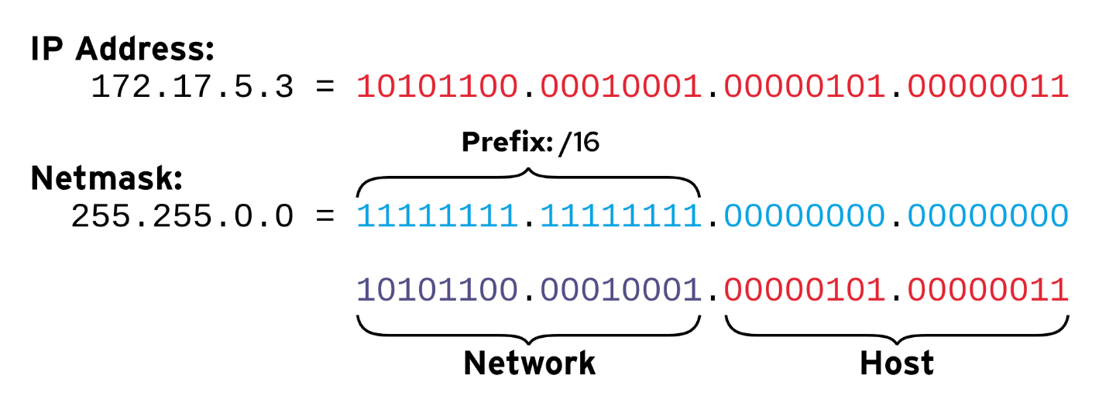
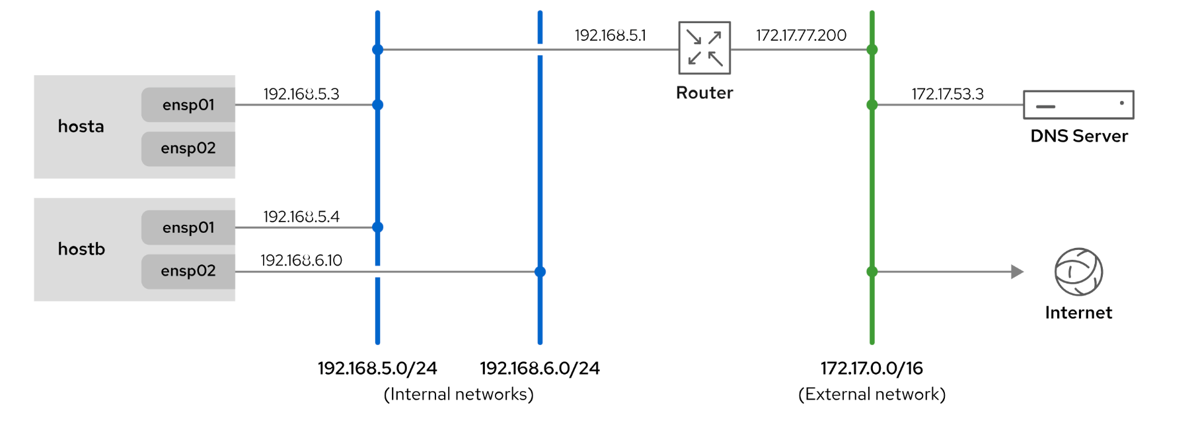

Slide 140
Gather Network Interface Information
ip a
ip address
ip address show ens160
ip link show
ip –s link show ens160
netstat -i
ping google.com
ping –c 3 google.com
ip route
netstat -nr
Option | Ss command - Description
-n | Show numbers instead of names for interfaces and ports.
-t | Show TCP sockets.
-u | Show UDP sockets.
-l | Show only listening sockets.
-a | Show all (listening and established) sockets.
-p | Show the process that uses the sockets.
-A inet | Display active connections (but not listening sockets) for the inet address family. That is, ignore local UNIX domain sockets. For the ss command, both IPv4 and IPv6 connections are displayed. For the netstat command, only IPv4 connections are displayed. (The netstat -A inet6 command displays IPv6 connections, and the netstat -46 command displays IPv4 and IPv6 at the same time.)
Port and Protocol
Ss command – used to fetch list of open ports
ss –tulnp
telnet ip port
curl –v telnet://ip:port

Slide 141
Ports and Protocols
Server will typically be running services, like
  Web Server 80,443
  DB server 3306
  FTP server 21
  ssh server 22
To identify these services, port addresses are used.
Every service has a specific port address
  Port 80 for Hypertext Transfer Protocol (HTTP)
  Port 22 for a Secure Shell (SSH) server
In network communication, the sender and the receiver are using port addresses. So, there is a destination port address as well as a source port address involved in network communications.
Because not all services are addressed in a similar way, a specific protocol is used between the IP address and the port address
  Transfer Control Protocol (TCP)
  User Datagram Protocol (UDP),
  Internet Control Message Protocol (ICMP).
Every protocol has specific properties:
  TCP is typically used when the network communication must be reliable and delivery must be guaranteed
  UDP is used when it must be fast and guaranteed delivery is not necessary.

Slide 142
Configure Network
The network addresses can be assigned in two ways:
  Fixed IP addresses: Useful for servers that always need to be available at the same IP address.
  Dynamically assigned IP addresses: Useful for end users’ devices, and for instances in a cloud environment. To dynamically assign IP addresses, a Dynamic Host Configuration Protocol (DHCP) server is usually used.
Use the systemctl status NetworkManager command to verify its current status
When NetworkManager comes up, it reads the network card configuration scripts, which are in /etc/NetworkManager/system-connections/xxxx.nmconnection and have a name that starts with ifcfg and is followed by the name of the network card.
  RHEL6 and below - /etc/sysconfig/network-scripts/ifcfg-xxx
nmtui command – Network manager terminal user interface
nmcli command – Network manager command line interface

Slide 143
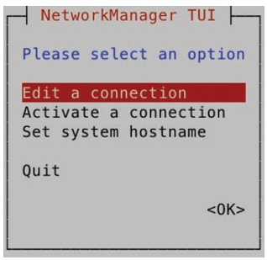
nmtui
# nmtui
  Up,down,left,right arrow keys
  space, tab, enter
The nmtui interface consists of three menu options
  Edit a Connection: Use this option to create new connections or edit existing connections.
  Activate a Connection: Use this to (re)activate a connection.
  Set System Hostname: Use this to set the hostname of your computer

Slide 144
nmcli
Info Gathering commands
nmcli con show
nmcli con show ens160
nmcli dev status
Create a new network connection for DHCP connection
nmcli con add con-name dhcp-ens160 type ethernet ifname ens160 ipv4.method auto autoconnect yes
nmcli con up dhcp-ens160
Create a connection with the name static-ens160 to define a static IP address and gateway:
nmcli con add con-name static-ens160 ifname ens160 autoconnect yes \
type ethernet ip4 192.168.106.130/24 gw4 192.168.106.2 ipv4.method manual.
nmcli con up static-ens160
modify a connection and add new dns and 1 more IP:
nmcli con mod static-ens160 ipv4.dns 8.8.8.8
nmcli con mod static-ens160 +ipv4.addresses 192.168.33.22/24
Type nmcli con show to show the connections, and use below to to activate the static connection.
nmcli con up static Switch back to the DHCP connection using nmcli con up dhcp.

Slide 145
Update System Hostname
The hostname command displays or temporarily modifies the system's fully qualified hostname.
[root@host ~]# hostname
host.example.com
Specify a static hostname in the /etc/hostname file.
Use the hostnamectl command to modify this file, and view the system's fully qualified hostname. If this file does not exist, then the hostname is set by a reverse DNS query when an IP address is assigned to the interface.
[root@host ~]# hostnamectl hostname host.example.com
[root@host ~]# hostnamectl status

Slide 146
Configure Name Resolution
OS attempts to resolve the query by first using the /etc/hosts file.
[root@host ~]# cat /etc/hosts
127.0.0.1 localhost localhost.localdomain localhost4 localhost4.localdomain4
::1 localhost localhost.localdomain localhost6 localhost6.localdomain6
172.25.254.254 classroom.example.com
The getent hosts hostname command tests hostname resolution with the /etc/hosts file.
If an entry is not found in the /etc/hosts file, then the stub resolver uses a DNS name server to look up the hostname.
The /etc/resolv.conf file controls how this query is performed:
  search : A list of domain names to try with a short hostname. Either search or domain should be set in the same file; if they are both set, then only the last entry takes effect. See resolv.conf(5) for details.
  nameserver : The IP address of a name server to query. Up to three name server directives can be given to provide backups if one name server is down.
[root@host ~]# cat /etc/resolv.conf
Use the nmcli command to modify the connections.

Slide 147
Lab: Manage Networking
Log in to the Virtual machine as the student user. Switch to the root user.
Create a connection with a static network configuration by using the settings in the table.
Modify the new connection to use also the 10.0.1.1/24 IP address
Configure the hosts file so that you can reference the 10.0.1.1 IP address with the private name.
Verify details
Parameter | Setting
Connection name | lab
Interface name | enX (might vary; use the interface with the 52:54:00:00:fa:0b MAC address)
IP address | 192.169.106.100/24
Gateway address | 192.168.106.2
DNS address | 8.8.8.8

Slide 148
Summary
The TCP/IP network model is a simplified, four-layered set of abstractions that describes how different protocols interoperate for computers to send traffic from one machine to another over the internet.
IPv4 is the primary network protocol on the internet today.
IPv6 is intended as an eventual replacement for the IPv4 network protocol.
Network routes determine the correct network interface to send packets to a particular network.
The NetworkManager daemon monitors and manages network configuration.
The nmcli command-line tool configures network settings with the NetworkManager daemon.
Starting in Red Hat Enterprise Linux 9, the default location for network configurations is the /etc/NetworkManager/system-connections directory.
The system's static hostname is stored in the /etc/hostname file.
The hostnamectl command modifies or views the status of the system's hostname and related settings.

Slide 149
Chapter 12: Install and Update Software Packages
Section 12.1: Register Systems for Red Hat Support
Section 12.2: Quiz: Register Systems for Red Hat Support
Section 12.3: Explain and Investigate RPM Software Packages
Section 12.4: Guided Exercise: Explain and Investigate RPM Software Packages
Section 12.5: Install and Update Software Packages with DNF
Section 12.6: Guided Exercise: Install and Update Software Packages with DNF
Section 12.7: Enable DNF Software Repositories
Section 12.8: Guided Exercise: Enable DNF Software Repositories
Section 12.9: Lab: Install and Update Software Packages
Section 12.10: Summary

Slide 150
Register Systems for Red Hat Support
Red Hat Subscription Management provides tools to entitle machines to product subscriptions, for administrators to get updates to software packages and to track information about support contracts and subscriptions that the systems use. Standard tools such as the dnf command obtain software packages and updates through a content distribution network that the Red Hat Content Delivery Network provides.
[root@host ~]# rhc connect
OR
[root@host ~]# subscription-manager register --username <yourusername>
Registering to: subscription.rhsm.redhat.com:443/subscription
Password: xxxxxxxx
The system has been registered with ID: 1457f7e9-f37e-4e93-960a-c94fe08e1b4f
The registered system name is: host.example.com
[root@host ~]# subscription-manager attach -–auto
[root@host ~]# subscription-manager unregister
Unregistering from: subscription.rhsm.redhat.com:443/subscription
System has been unregistered.

Slide 151
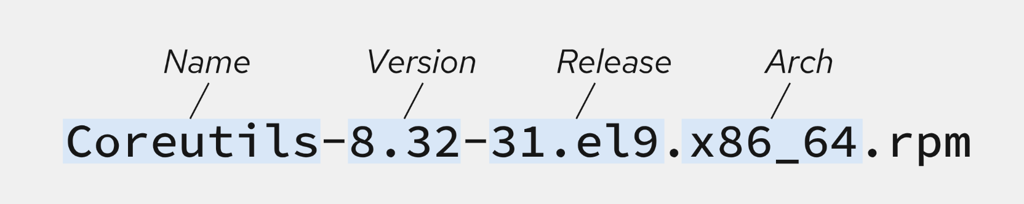
RPM Software Packages
The RPM Package Manager, which Red Hat originally developed, provides a standard way to package software for distribution.
Managing software in the form of RPM packages is simpler than working with software that is extracted to a file system from an archive.
With RPM packages, administrators can track which files the software package installs, which files the software package removes if you uninstall it, and it verifies that supporting packages are present when you install it.
The local RPM database on your system stores the information about installed packages. Red Hat provides all software for Red Hat Enterprise Linux as an RPM package.
RPM package file names consist of four elements

Slide 152
Query RPM database
The rpm utility is a low-level tool that can retrieve information about the contents of package files and installed packages.
rpm –opts arg
  -q : List the currently installed package version.
  -qa : List all installed packages.
  qi : Get detailed package information.
  ql : List the files that the package installs.
  qc : List only the configuration files that the package installs.

Slide 153
Inspect RPM Packages
Use the rpm2cpio command to extract files from an RPM package file without installing the package.
The rpm2cpio command converts an RPM package to a cpio archive. After the RPM package is converted to a cpio archive, the cpio command can extract a list of files.
Use the cpio command with the -i option to extract files from standard input. Use the -d option to create subdirectories as needed, starting in the current working directory. Use the -v option for verbose output.
Download nano rpm and extact contents – wget https://dl.rockylinux.org/pub/rocky/9/BaseOS/x86_64/os/Packages/n/nano-5.6.1-5.el9.x86_64.rpm
Download google chrome for linux - wget https://dl.google.com/linux/direct/google-chrome-stable_current_x86_64.rpm
[user@host ~S]$ rpm2cpio nano-5.6.1-5.el9.x86_64.rpm| cpio –idv
[user@host ~S]$ rpm2cpio google-chrome-stable.x86_64.rpm| cpio –idv

Slide 154
Install RPM Packages
Method #1 – Use rpm –ivh command
  rpm
    -i = install
    -v = verbose
    -h = display hash # as progress bar
    -U = update
    -e = erase
  rpm –ivh nano-5.6.1-5.el9.x86_64.rpm
  rpm –ivh google-chrome-stable.rpm
Method #2 – Use dnf command
  dnf install /root/google-chrome-stable.rpm

Slide 155
DNF Explained
Dnf actions: | Usage – dnf action –option args
install | dnf install firefox dnf install firefox nano
remove | dnf remove firefox dnf remove firefox nano
check-update | dnf check-update
update | dnf update firefox dnf update
list | dnf list all dnf list http*
search | dnf search all ‘web server’
info | dnf info firefox
whatprovides | dnf whatprovides telnet
DNF (Dandified YUM) is the package manager in Red Hat Enterprise Linux 9.
DNF improves RPM-based software installation and updates. With the dnf command, you can install, update, remove, and get information about software packages and their dependencies.
All installation and removal transactions are logged in the /var/log/dnf.rpm.log file
tail -5 /var/log/dnf.rpm.log
DNF Config file is located at /etc/yum.repos.d/xxx.repo
DNF Command Usage

Slide 156
DNF repo file and its cache
Repo file contents
[custom-repo]
name=repo name
baseurl=https://dl.fedoraproject.org/pub/epel/9/Everything/x86_64/
gpgcheck=0
enabled=1
Base URL
  http://
  file://
Commands to run after creating new repo file
dnf clean all
dnf repolist
dnf repolist all
dnf makecache
dnf install httpd
DNF Exclude and pre-approve
dnf update –y –exclude=kernel,httpd

Slide 157
DNF Groups and History
dnf groups are collections of related software that are installed together.
Similar to the dnf list command, the dnf group list command shows the names of installed and available groups.
dnf group list
dnf group info “RPM Development Tools”
dnf group install “RPM Development Tools”
dnf group update “RPM Development Tools”
dnf group remove “RPM Development Tools”
dnf history command displays a summary of installation and removal transactions.
dnf history
dnf history undo 6

Slide 158
Manage Package Module Streams with DNF
Modules - Managing alternative versions of an application's software package and its related packages meant maintaining different repositories for each version.
  Red Hat simplifies this process by using a technology called modularity. With modularity, a single repository can host multiple versions of an application's package and its dependencies.
BaseOS and Application Stream - Red Hat Enterprise Linux 9 distributes the content through two main software repositories: BaseOS and Application Stream (AppStream).
  BaseOS repository provides the core operating system content for Red Hat Enterprise Linux as RPM packages.
  Application Stream contains necessary parts of the system, as well as a wide range of applications that were previously available as part of Red Hat Software Collections and other products and programs.
  Both BaseOS and AppStream are necessary parts of a Red Hat Enterprise Linux 9 system.
  The Application Stream repository contains two types of content: modules and traditional RPM packages.
  Typically, modules organize the RPM packages around a specific version of a software application or programming language. A typical module contains packages with an application, packages with the application's specific dependency libraries, packages with documentation for the application, and packages with helper utilities.

Slide 159
Manage Modules with DNF
dnf module list : List the available modules with the module name, stream, profiles, and a summary.
dnf module list module-name : List the module streams for a specific module and retrieve their status.
dnf module info module-name : Display details of a module, including the available profiles and a list of the packages that the module installs.
dnf module provides package : Display which module provides a specific package.
dnf module install package : installs specific package.

Slide 160
Guided Exercise: Install and Update Software Packages with DNF
open an SSH session to the machine as the student user. Use the sudo command to switch to the root user : $ ssh student@servera
Try to run the nmap command. You should find that it is not installed: # nmap
Use the dnf search command to search for packages with nmap as part of their name or summary: # dnf search nmap
Use the dnf info command to obtain more information about the nmap package: # dnf info nmap
Use the dnf install command to install the nmap package: # dnf install nmap
Use the dnf remove command to remove the nmap package, but respond with no when prompted. How many packages are removed? # dnf remove nmap
Use the dnf remove command to remove the tar package, but respond with no when prompted. How many packages are removed? # dnf remove tar
Use the dnf group list command to list all available component groups: # dnf grouplist
Use the dnf group info command to obtain more information about the Security Tools component group, including a list of included packages: # dnf group info "Security Tools"
Use the dnf group install command to install the Security Tools component group: # dnf group install "Security Tools"
Use the dnf history command to display recent dnf history: # dnf history
Use the dnf history info command to confirm that the last transaction is the group installation: # dnf history info 3
Use the dnf history undo command to remove the set of packages that were installed when the nmap package was installed. On your system, find the correct transaction ID from the output of the dnf history command, and then use that ID in the following command: # dnf history undo 2

Slide 161
Enable DNF Software Repositories
List Repositories - Systems often have access to many Red Hat repositories. The dnf repolist all command lists all available repositories and their statuses
dnf repolist all
dnf config-manager command can enable and disable repositories.
dnf config-manager --enable rhel-9-server-debug-rpms
dnf config-manager --disable rhel-9-server-debug-rpms
Add DNF Repositories – the dnf config-manager command can also add repositories to the machine. The following command creates a .repo file by using an existing repository's URL.
dnf config-manager --add-repo="https://dl.fedoraproject.org/pub/epel/9/Everything/x86_64/"
DNF config file - The corresponding .repo file is visible in the /etc/yum.repos.d/ directory:
cd /etc/yum.repos.d
cat dl.fedoraproject.org_pub_epel_9_Everything_x86_64_.repo

Slide 162
Repo File and GPG Keys
The rpm command uses GPG keys to sign packages, and imports public keys to verify the integrity and authenticity of packages.
The dnf command uses repository configuration files to provide the GPG public key locations, and imports the keys to verify the packages. Keys are stored in various locations on the remote repository site
[EPEL]
name=EPEL 9
baseurl=https://dl.fedoraproject.org/pub/epel/9/Everything/x86_64/
enabled=1
gpgcheck=1
gpgkey=file:///etc/pki/rpm-gpg/RPM-GPG-KEY-EPEL-9
Some repositories provide a configuration file and a GPG public key as part of an RPM package to simplify their installation. You can import the GPG public key by using the rpm --import command. The dnf install command can download and install these RPM packages.
[user@host ~]$ rpm --import https://dl.fedoraproject.org/pub/epel/RPM-GPG-KEY-EPEL-9
[user@host ~]$ dnf install https://dl.fedoraproject.org/pub/epel/epel-release-latest-9.noarch.rpm

Slide 163
Guided Exercise: Enable DNF Software Repositories
Use the ssh command to log in to the VM as the student user. Use the sudo command to switch to the root user.
# sudo su –
Configure the software repositories on VM to obtain custom packages and updates from the following URL: https://packages.microsoft.com/rhel/9.0/prod/Packages/
# dnf config-manager --add-repo https://packages.microsoft.com/rhel/9.0/prod/Packages/
Examine the software repository file created in the /etc/yum.repos.d directory
# cat /etc/yum.repos.d/microsoft.repo
List the mdatp package and install it
# dnf list mdatp
# dnf install mdatp
Verify that the package is installed, and note the version number of the package.
# dnf list mdatp

Slide 164
Summary
Red Hat Subscription Management provides tools to entitle machines to product subscriptions, get updates to software packages, and track information about support contracts and subscriptions that the systems use.
Software is provided as RPM packages, to install, upgrade, and uninstall software on the system.
The rpm command can query a local database to provide information about the contents of installed packages and to install downloaded package files.
The dnf utility is a powerful command-line tool to install, update, remove, and query software packages.
Red Hat Enterprise Linux uses Application Streams to provide a single repository to host multiple versions of an application's packages and its dependencies.

Slide 165
Chapter 13: Access and Manage Linux Storage
Section 13.1: Identify File Systems and Devices
Section 13.3: Mount and Unmount File Systems
Section 13.4: Guided Exercise: Mount and Unmount File Systems
Section 13.5: Locate Files on the System
Section 13.6: Guided Exercise: Locate Files on the System
Section 13.7: Add Partitions, File Systems, and Persistent Mounts
Section 13.8: Guided Exercise: Add Partitions, File Systems, and Persistent Mounts
Section 13.9: Manage Swap Space
Section 13.10: Guided Exercise: Manage Swap Space
Section 13.11: Lab: Manage Basic Storage

Slide 166
Identify / Examine storage devices
Command | Purpose
lsblk | List block devices # lsblk # lsblk -fp
df | List disk free space # df –h #df –hT
du | Check disk usage # du –sh /usr # cd / ; du –sh *
blkid | Find block device uuid # blkid
mount | Mount device # mount /dev/sr0 /mnt # cd /mnt ; ls –l
umount | Unmount the device # umount /mnt
Command | Purpose
lsof | List of open files # lsof /mnt
find | Find files and dirs # find / -name “*.txt” # find /home -perm 664 # find / -type d -name test # find / -type f -perm 777 # find / -size +10k –size -1M # find /home/student -perm 777 -type f -exec rm -f {} \;
locate | The locate utility works better and faster than find command # locate sample.txt # locate "*.html" # locate -i *SAMPLE.txt* # updatedb

Slide 167
Guided Exercise: Mount and Locate Files on the System
Mount /dev/sr0 at the /mnt/part1 mount point.
# mkdir /mnt/part1
# mount /dev/sr0 /mnt/part1
# lsblk or df -h
Change to the /mnt/part1 directory
# cd /mnt/part1
Update the locatedb database manually on the server machine. Use the sudo updatedb command to update the database.
$ sudo updatedb
Locate the logrotate.conf configuration file.
$ locate logrotate.conf
Locate the networkmanager.conf configuration file, ignoring case sensitivity.
$ locate -i networkmanager.conf
List all files in the /var/lib directory that the chrony user owns.
  # sudo find /var/lib -user chrony
List all files in the /var directory that the root user and the mail group own.
  # sudo find /var -user root -group mail
List all files in the /usr/bin directory with a file size that is greater than 50 KB.
  # find /usr/bin -size +50k
List all files in the /home/student directory that changed in the last 120 minutes.
  # find /home/student -mmin -120
List all the block device files in the /dev directory
  # find /dev -type b
search result of all files in the /usr/share directory that are greater than 50 MB and less than 100 MB and store in /tmp/search.txt
  # find /usr/share -size +50M -size -100M > /mnt/freespace/search2.txt

Slide 168
Adding disks , partitions and filesystems
Disk partitioning divides a hard drive into multiple logical storage partitions. You can use partitions to divide storage based on different requirements, and this division provides many benefits:
Limit available space to applications or users.
Separate operating system and program files from user files.
Create a separate area for memory swapping.
Limit disk space use to improve the performance of diagnostic tools and backup imaging.

Slide 169
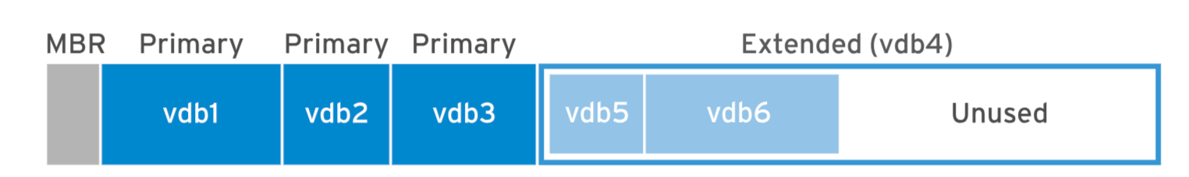
Master Boot Record (MBR)
Since 1982, MBR partitioning scheme being used
For systems running BIOS firmware
  Basic input output system
Supports maximum 4 primary partitions
With the help of extended partition sysadmin can create upto 15 logical partitions
With 32bit logical block address size , Max disk partition size – 2TB
1st Sector in the hard-disk- it stores partition info
Partition table will use 64bytes out of 512 bytes (Each sector is 512bytes on HDD)

Slide 170
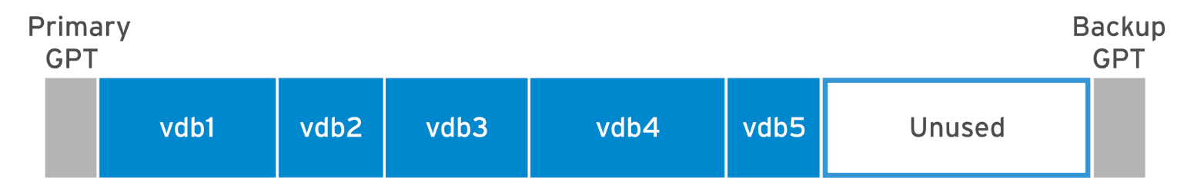
GUID Partition Table (GPT)
MBR is being superseded by GPT
A GPT uses a globally unique identifier (GUID) to identify each disk and partition. A GPT makes the partition table redundant, with the primary GPT at the head of the disk, and a backup secondary GPT at the end of the disk. A GPT uses a checksum to detect errors in the GPT header and partition table.
For system running UEFI Firmware
  Unified extensible firmware interface
By default GPT supports 128 partitions
With 64bit logical block address size , Max disk partition size 8zib or 8 Billion TB (if block size used as 4096bytes then max size =64zib )

Slide 171
Types of Linux File System Formats
Ext, Ext2, Ext3 and Ext4 File System (Extended File System. )
  Ext2 is the first Linux file system that allows managing 2TB of data.
  Ext3 it is an upgraded version of Ext2 and contains backward compatibility. Journaling has a dedicated area in the file system, where all the changes are tracked. if the system crashes, the possibility of file system corruption is less because of journaling. Maximum individual file size can be upto 2 TB
  Ext4 file system is the faster file system than previous versions, new features have improved the performance and reliability of the filesystem when compared to ext3. Maximum individual file size can be upto 16 TB
XFS File System (High Performance Scalable File System)
  XFS file system is developed for parallel I/O processing.
Swap File System
  The swap file system is used for memory paging in Linux operating system

Slide 172
Manage MBR Partitions with fdisk
List block devices
# echo "- - -" > /sys/class/scsi_host/host0/scan
# lsblk
Names- nvme0n1 or sda or hda
Path - /dev/nvme0n1 or /dev/sda or /dev/hda
Check for available disks
# fdisk –l /dev/disk
Run the command and follow the instructions (don’t forget to set partition type)
# fdisk /dev/device
Inform the kernel to re-read the partition table (for rhel4,5,6,7)
# partprobe /dev/device
# lsblk
Format the partition with ext4 / xfs filesystem
# mkfs.ext4 /dev/devicename
Mount the filesystem
# mount /dev/device /mountpoint

Slide 173
Manage GPT Partitions with gdisk
List block devices
# echo "- - -" > /sys/class/scsi_host/host0/scan
# lsblk
Check for available disks
# gdisk –l /dev/disk
Run the command and follow the instructions (don’t forget to set partition type)
# gdisk /dev/device
Inform the kernel to re-read the partition table (for rhel4,5,6,7)
# partprobe /dev/device
# lsblk
Format the partition with ext4 / xfs filesystem
# mkfs.xfs /dev/devicename
Mount the filesystem
# mount /dev/device /mountpoint

Slide 174
Permanent mounting
Disk details need to be added in a file called fstab so that the disks are mounted automatically on system boot
  /etc/fstab
Fields in fstab file
  1st – uuid or device path (/dev/sda1) (UUID preferred in RHEL 9)
  2nd – Mount point
  3rd – Filesystem type
  4th – Device behavior upon mounting (use defaults)
  5th – This field is used by the dump command to back up the device. Other backup applications do not usually use this field.
  6th – The value in this field indicates the order in which fsck should run. For ext4 file systems, set it to 1 for the root file system, and to 2 for the other ext4 file systems. By using this notation, the fsck utility processes the root file system first, and then verifies file systems on separate disks concurrently, and file systems on the same disk in sequence.
  systemctl daemon-reload (system will register new fstab config)
# mount -a

Slide 175
Manage Swap Space
A swap space is an area of a disk under the control of the Linux kernel memory management subsystem.
When the memory usage on a system exceeds a defined limit, the kernel searches through RAM to look for idle memory pages that are assigned to processes. The kernel writes the idle pages to the swap area and reassigns the RAM pages to other processes.
Because swap areas are on disk, swap is slow when compared with RAM. Although swap space augments system RAM, do not consider swap space as a sustainable solution for insufficient RAM for your workload.
Swap Space Calculation
Administrators should size the swap space based on the memory workload on the system. Application vendors sometimes provide recommendations for calculating swap space. The following table provides guidance based on the total physical memory.
RAM | Swap space | Swap space if allowing for hibernation
2 GB or less | Twice the RAM | Three times the RAM
Between 2 GB and 8 GB | Same as RAM | Twice the RAM
Between 8 GB and 64 GB | At least 4 GB | 1.5 times the RAM
More than 64 GB | At least 4 GB | Hibernation is not recommended

Slide 176
Create Swap Space
Follow the same steps to create a partition with Partition Type as swap
  If used fdisk – hex code is 82
  If using gdisk – hex code is 8200
Apply swap filesystem
# mkswap /dev/device
activate new swap partition
# swapon /dev/device
Deactivate swap partition
# swapoff /dev/device
Verify
# swapon --show
# free –h

Slide 177
Permanently Mount Swap
Set Swap Space Priority
  By default, the system uses swap spaces in series, meaning that the kernel uses the first activated swap space until it is full, and then it starts using the second swap space.
  You can instead define a priority for each swap space to force a particular order.
  To set the priority, use the pri option in the /etc/fstab file.
  The kernel uses the swap space with the highest priority first.
  The default priority is -2.
The following example shows three defined swap spaces in the /etc/fstab file.
The kernel uses the last entry first, because its priority is set to 10. When that space is full, it uses the second entry , because its priority is set to 4. Finally, it uses the first entry, which has a default priority of -2.
UUID=af30cbb0-3866-466a-825a-58889a49ef33 swap swap defaults 0 0
UUID=39e2667a-9458-42fe-9665-c5c854605881 swap swap pri=4 0 0
UUID=fbd7fa60-b781-44a8-961b-37ac3ef572bf swap swap pri=10 0 0

Slide 178
Lab: Manage Basic Storage
The VM has several unused disks. On the first unused disk, create a GPT partition label and a 2 GB GPT partition
  Because it is difficult to set an exact size, a size between 1.8 GB and 2.2 GB is acceptable.
Format the 2 GB backup partition with an XFS file system and persistently mount it to the /backup directory.
On the same disk, create two 512 MB GPT partitions with the swap1 and swap2 names.
  A size between 460 MB and 564 MB is acceptable.
Initialize the two 512 MB partitions as swap spaces, and configure them to activate at boot. Set the swap space on the swap2 partition to be preferred over the other. Note that 512 MB is approximately equivalent to 488 MiB.
To verify your work, reboot the machine. Confirm that the system automatically mounts the first partition to the /backup directory. Also, confirm that the system activates the two swap spaces

Slide 179
Summary
Storage devices are represented by the block device file type.
The df command reports total disk space, used disk space, and free disk space on all mounted regular file systems.
The root user can use the mount command to manually mount a file system.
To successfully unmount a device, all processes must stop accessing the mount point.
The removable storage devices are mounted in the /run/media directory when using the graphical environment.
The lsblk command lists the details of block devices, such as the size and the UUID.
The find command searches in real time in the local file systems for files according to search criteria.
The fdisk and gdisk commands adds, modifies, and removes partitions on disks with the MBR or the GPT partitioning scheme.
The mkfs.xfs command creates XFS file systems on disk partitions.
The /etc/fstab file contains devices that must be persistently mounted.
The mkswap command initializes swap spaces.

Slide 180
Comprehensive Review
Section 15.1: Comprehensive Review
Section 15.2: Lab: Manage Files from the Command Line
Section 15.3: Lab: Manage Users and Groups, Permissions, and Processes
Section 15.4: Lab: Configure and Manage a Server
Section 15.5: Lab: Manage Networks
Section 15.6: Lab: Mount File Systems and Find Files

Slide 181
Comprehensive Labs – Part 1
Lab1: Manage Files from the Command Line - https://github.com/abhatt014/rhcsa/blob/main/Lab1
Lab2: Manage Users and Groups, Permissions, and Processes - https://github.com/abhatt014/rhcsa/blob/main/Lab2
Lab3: Configure and Manage a Server - https://github.com/abhatt014/rhcsa/blob/main/Lab3
Lab4: Manage Networks - https://github.com/abhatt014/rhcsa/blob/main/Lab4
Lab5: Mount File Systems and Find Files - https://github.com/abhatt014/rhcsa/blob/main/Lab5

Slide 182
Chapter 14: Manage LVM, VDO and Stratis
Section 8.1: Create and Extend Logical Volumes
Section 8.2: Guided Exercise: Create and Extend Logical Volumes
Section 8.3: Manage VDO and Stratis
Section 8.4: Guided Exercise: Manage Layered Storage
Section 8.5: Lab: Manage Storage Stack
Section 8.6: Summary

Slide 183
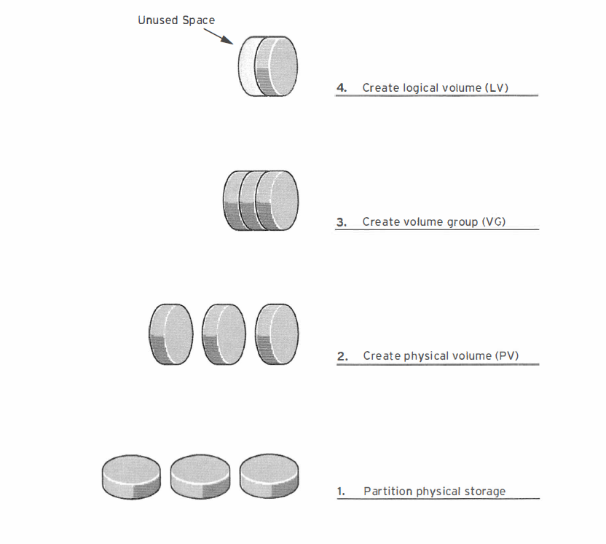
Logical Volume Manager Overview
Logical volume (LV)
  LV are created from free PE in VG and provide the storage device for users , applications etc
Volume group (VG)
  Storage pool made up of one or more PV
Physical volume(PV)
  Physical devices are then registered as physical volume which means these devices are now LVM enabled. LVM automatically segments the PVs into Physical Extents (PE)
Physical devices
  Physical storage devices, block device, disk partitions, whole disks, etc

Slide 184
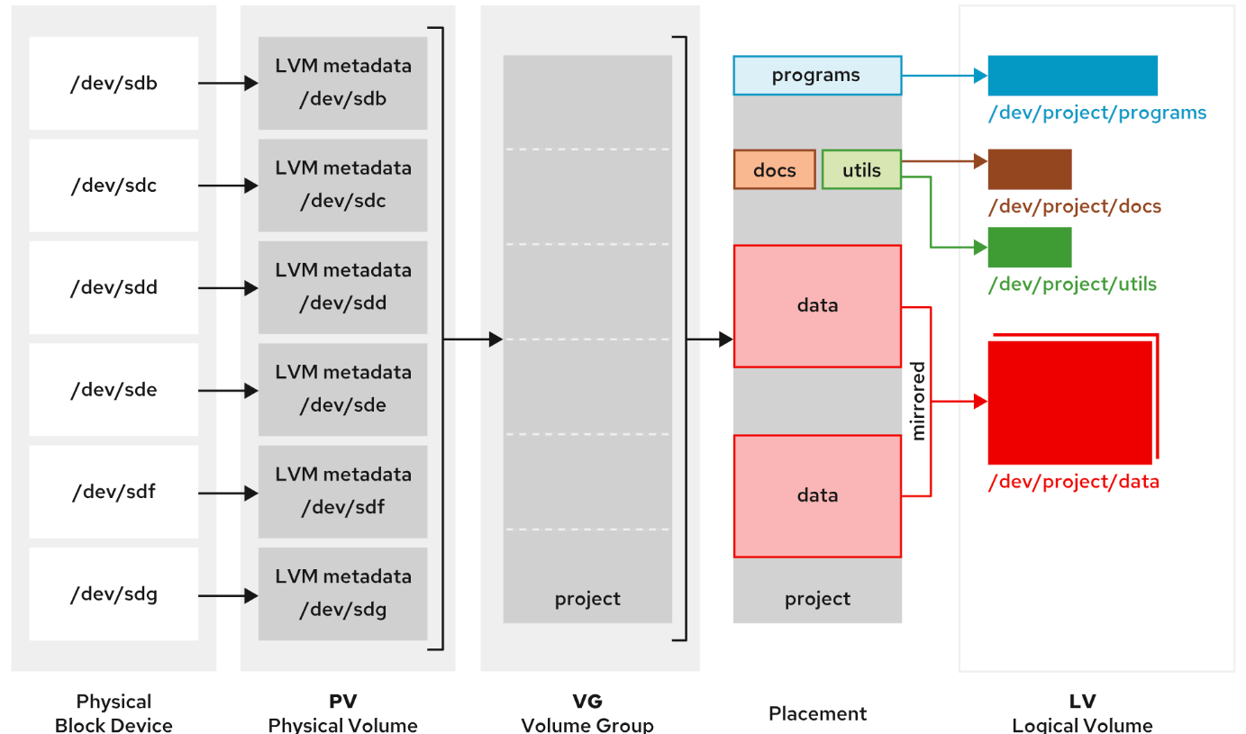
Logical Volume Manager Workflow
Creating LVM storage requires building structures in a logical workflow.
  Determine the physical devices that are used for creating physical volumes, and initialize these devices as LVM physical volumes.
  Create a volume group from multiple physical volumes.
  Create the logical volumes from the available space in the volume group.
  Format the logical volume with a file system and mount it, or activate it as swap space, or pass the raw volume to a database or storage server for advanced structures.

Slide 185
Create a new LV
Prepare Physical Device
  Create new partition or use the complete disk
  Follow steps as per MBR or GPT partition type
Create physical volume PV
# pvcreate /dev/device1 /dev/device2
# pvs
Create volume group VG
# vgcreate vgname /dev/device1 /dev/device2
# vgs
Create Logical Volume LV
# lvcreate –L size –n lvname vgname
# lvs
Create filesystem
# mkfs.ext4 /dev/vgname/lvname or /dev/mapper/vgname-lvname
Add mount point
# mkdir /newlvm
# mount /dev/vgname/lvname /newlvm
fstab entry
/dev/vgname/lvname /newlvm xfs defaults 0 0
# mount -a
# df -h

Slide 186
LV Management (extend,reduce,add,remove)
Extend VG and LV
  pvcreate /dev/device
  vgextend vgname /dev/device
  lvextend –L +size or –l pe’s /dev/vgname/lvname
  Incase of ext fs - resize2fs /dev/vgname/lvname
  or
  Incase of xfs fs - xfs_growfs /dev/vgname/lvname
Reduce VG –
  lsblk
  pvmove /dev/device to be removed
  vgreduce vgname /dev/device to be removed
  pvremove /device
Remove lv and vg and pv
  umount /mnt
  lvremove /dev/vgname/lvname
  vgremove vgname
  pvremove /dev/device1 /dev/device2
LV Reduce - it will not work with xfs FS
  UMOUNT
    Umount /mountpoint
    e2fsck -f /dev/vgname/lvname
  FILESYSTEM REDUCE
    resize2fs /dev/mapper/vgname-lvname targetsize
    resize2fs /dev/mapper/vg_data-lv_lv1 5G
  LV SIZE REDUCE
    lvreduce -L 5G /dev/mapper/vg_data-lv_lv1
  REMOUNT AND VERIFY
    Mount /dev/mapper/vgname-lvname /mountpoint
    Df -h

Slide 187
Physical Extents
LVM automatically segments PV’s into physical extents PE, these are small chunks of data that act as the smallest storage block on a PV
Usage :
  at the time of LV creation, LV size can be given in form of M, G, T etc or PE
Default PE size is 4mb
Check PE details set on a VG
  # vgdisplay vgname
Check logical extent details on a LV
  LE is attached to PE
  # lvdisplay lvpath
Change PE size –
  # vgcreate -s 8m vg_new /dev/sde1 /dev/sde2
  # lvcreate –l 100 –n lvname vgname

Slide 188
Guided Exercise: Add Partitions, File Systems, and Persistent Mounts
Create the physical device HDD on VM . Create two partitions of 256 MiB each and set to the Linux LVM type.
Poweroff VM, rightclick on VM -> setttings -> Add -> Disk -> 1G -> Finish
# gdisk /dev/nvme0n2
n->first sector->last sector +256M -> 8e00 ->w
n->first sector->last sector +256M -> 8e00 ->w
# udevadm settle
Create the vg_system volume group by using the two new PVs.
# vgcreate servera_group /dev/vdb1 /dev/vdb2
Create the lv_data1 logical volume with a size of 400 MiB.
# lvcreate -n servera_volume -L 400M servera_group
Format the newly created LV and mount it persistently.
# mkfs -t xfs /dev/servera_group/servera_volume
Create the /data directory as a mount point.
# mkdir /data
To persistently mount the newly created file system, add the following content in the /etc/fstab file:
/dev/servera_group/servera_volume /data xfs defaults 0 0
Mount the servera_volume LV.
# mount /data
Verify that the mounted file system is accessible, and display the status information of the LVM. Verify that you can copy files to the /data directory.
# cp -a /etc/*.conf /data
# ls /data | wc -l
View the PV VG and LV status information.
# pvdisplay /dev/vdb2
# vgdisplay servera_group
# lvdisplay /dev/servera_group/servera_volume
View the free disk space in human-readable units. The output shows the total size of 395 MiB with the available size of 372 MiB.
# df -h /data

Slide 189
Guided Exercise: LVM Extend
Create one more partitions of 512 MiB and set to the Linux LVM type.
# gdisk /dev/nvme0n2
N->first sector->last sector +512M -> 8e00 ->w
# udevadm settle
# udevadm settle
Add the new partition as a PV.
# pvcreate /dev/vdb3
Using the newly created disk space, extend the file system on the servera_volume to be a total size of 700 MiB.
# vgextend servera_group /dev/vdb3
Extend the existing servera_volume LV to 700 MiB.
# lvextend -L 700M /dev/servera_group/servera_volume
Extend the XFS file system by using the free space on the LV.
# xfs_growfs /data
Verify that the LV size is extended, and that the contents are still present in the volume.
#lvs
Verify the new file-system size. Verify that the previously copied files are still present.
# df -h /data
# ls /data | wc -l

Slide 190
LVM Commands
PV related commands
  pvcreate, pvmove , pvremove
VG related commands
  vgcreate, vgextend, vgremove, vgreduce
LV related commands
  lvcreate, lvextend, lvremove,lvreduce
Verification commands.
  pvs, lvs, vgs, pvscan, lvscan, vgscan, pvdisplay, vgdisplay, lvdisplay

Slide 191
Virtual Data Optimizer (VDO)
Virtual Data Optimizer (VDO) is another advanced storage solution offered in RHEL 8 and above. VDO was developed to provide thin provisioning and reduce disk space usage on block devices by applying deduplication features.
VDO creates volumes, implementing deduplication on top of any type of existing block device. On top of the VDO device, you would either create a file system, or you would use it as a physical volume in an LVM setup.
The main purpose of VDO is data deduplication. It deduplicates data by using three common technologies:
  Zero-block elimination filters out data blocks that contain only zeros.
  Deduplication reduces redundant data blocks.
  Compression occurs when the kvdo kernel module compresses data blocks.
VDO is particularly useful in specific environments. The typical use cases are host platforms for containers and virtual machines, where the deduplication engine ensures much more efficient disk storage use. Commonly, a logical size of up to ten times the physical size can be used for working in this type of environment.
Another typical environment where VDO does well is in cloud block storage.

Slide 192
Virtual Data Optimizer (VDO)
LVM VDO is composed of two logical volumes:
  VDO pool LV
    This LV stores, deduplicates, compresses data, and sets the size of the VDO volume that is backed by the physical device.
  VDO LV
    A virtual device is provisioned on top of the VDO pool LV, and sets the logical size of the VDO volume to store the data before deduplication and compression occur.
LVM VDO presents the deduplicated storage as a regular logical volume (LV). The VDO volume can be formatted with standard file systems, or shared as a block device, or used to build other storage layers, the same as any normal logical volume.
To use VDO deduplication and compression, install the vdo and kmod-kvdo packages.
# dnf install vdo kmod-kvdo
# lvcreate --type vdo -n vdo-lv01 -L 5G vg01
# mkfs.xfs -K /dev/vg01/lv01
# mkdir /mnt/data
Fstab entry -> /dev/vg01/lv01 /mnt/data xfs discard,defaults 0 0

Slide 193
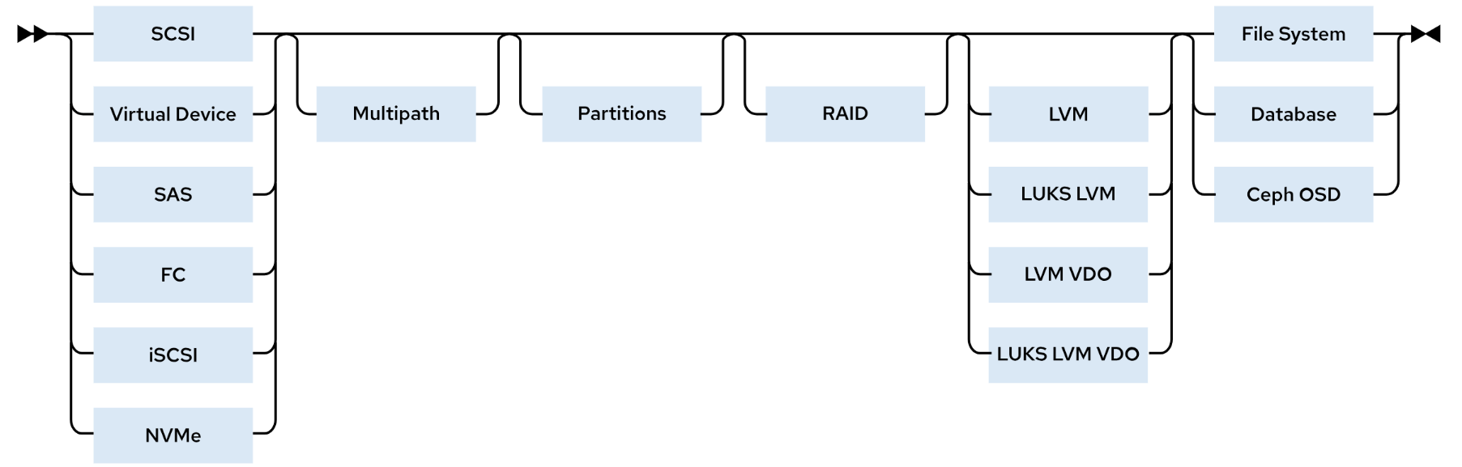
Storage Stack
Storage in RHEL is composed of multiple layers of drivers, managers, and utilities that are mature, stable, and full of modern features.
Managing storage requires familiarity with stack components, and recognizing that storage configuration affects the boot process, application performance, and the ability to provide needed storage features for specific application use cases.

Slide 194
Storage Stack
Block devices are at the bottom of the storage stack. RHEL also supports iSCSI, Fibre Channel over Ethernet (FCoE), virtual machine driver (virtio), serial-attached SCSI (SAS), Non-Volatile Memory Express (NVMe), and other block devices.
  iSCSI target can be a dedicated physical device in a network or an iSCSI software-configured logical device on a networked storage server. The target is the endpoint in a SCSI protocol bus communication, to access the storage as Logical Unit Numbers (LUNs).
  Fibre Channel over Ethernet (FCoE) protocol transmits Fibre Channel frames over Ethernet networks. Typically, each data center has dedicated LAN and Storage Area Network (SAN) cabling, which is uniquely configured for its traffic. With FCoE, both traffic types can be combined into a larger, converged, Ethernet network architecture. FCoE benefits include lower hardware and energy costs.
Multipath is path is a connection between a server and the underlying storage. Device Mapper multipath (dm-multipath) is a RHEL native multipath tool for configuring redundant I/O paths into a single, path-aggregated logical device.
Partitions might consume the entire block device size, or divide the block device for creating multiple partitions. You can use these partitions to create a file system, LVM devices, or directly for database structures or other raw storage.
RAID - A Redundant Array of Inexpensive Disks (RAID) is a storage virtualization technology that creates large logical volumes from multiple physical or virtual block device components. Different forms of RAID volumes offer data redundancy, performance improvement, or both, by implementing mirroring or striping layouts.
Logical Volume Manager - LVM can take almost any form of physical or virtual block devices, and can build storage as new logical storage volumes, and effectively hides the physical storage configuration from applications and other storage clients. LVM now incorporates VDO deduplication and compression as a configurable feature of regular logical volumes. You can use LUKS encryption and VDO together with logical volumes, where the LVM LUKS encryption is enabled underneath the LVM VDO volume.

Slide 195
Stratis
Stratis is a so-called volume-managing file system, and it introduces advanced storage features that were not available in previous versions of RHEL:
Thin provisioning:
  User may see 20 GiB of available storage in total although a much lower amount is actually provisioned to each user.
Snapshots:
  A Stratis snapshot allows users to take a “picture” of the current state of a file system. This snapshot makes it easy to revert to the previous state of a file system, rolling back any changes that have been made.
Cache tier:
  Cache tier is a Ceph storage feature that ensures that data can be stored physically closer to the Ceph client, which makes data access faster.
Programmatic API:
  The programmatic API ensures that storage can easily be configured and modified through API access.
Monitoring and repair:
  Whereas old file systems need tools like fsck to verify the integrity of the file system, Stratis has built-in features to monitor the health of the file system and repair it if necessary.

Slide 196
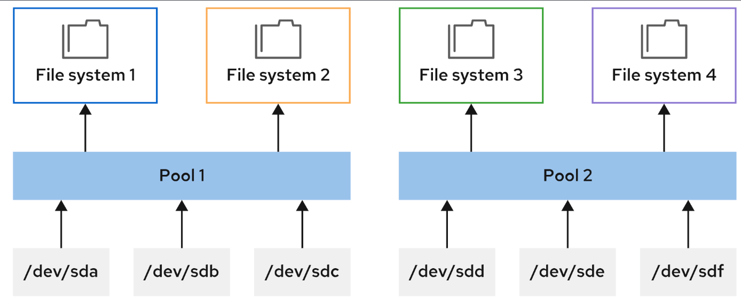
Stratis Architecture
The lowest layer in the Stratis architecture is the pool.
The Stratis pool is comparable to an LVM volume group.
A pool represents all the available storage and consists of one or more storage devices, which in a Stratis environment are referred to as blockdev.
These block devices may not be thin provisioned at the underlying hardware level.
Stratis creates a /dev/stratis/poolname directory for each pool.
From the Stratis pool, XFS file systems are created.
When a file system is created, no size is specified, and each file system can grow up to the size of all the available storage space in the pool.
Stratis file systems are always thin provisioned. The thin volume automatically grows as more data is added to the file system.
Note that Stratis only works with XFS, and the XFS file system it uses is integrated with the Stratis volume.

Slide 197
Stratis Adminstration
install the stratis-cli and stratisd packages.
# dnf install stratis-cli stratisd
The stratis-cli package provides the stratis command, which sends reconfiguration requests to the stratisd system daemon.
# systemctl enable --now stratisd
The stratisd package provides the stratisd service, which handles reconfiguration requests, and manages and monitors Stratis block devices, pools, and file systems.
You can dynamically extend the pool, using below command.
# stratis pool create pool1 /dev/vdb
Now add the Filesystem to the pool1
# stratis filesystem create pool1 fs1
The following commands are available for monitoring statis volumes:
# stratis blockdev:
  Shows information about all block devices that are used for Stratis.
# stratis pool:
  Gives information about Stratis pools. Note in particular the Physical Used parameter, which should not come too close to the Physical Size parameter.
# stratis filesystem:
  Enables you to monitor individual file systems.

Slide 198
Guided Exercise: Manage Stratis
Install and Enable Stratis
# dnf install stratis-cli stratisd
# systemctl enable --now stratisd
Create Stratis Pools pool1
#stratis pool create pool1 /dev/vdb
#stratis pool list
Manage Stratis File System fs1 from pool1
# stratis filesystem create pool1 fs1
# stratis filesystem list
Persistently Mount Stratis File Systems
lsblk --output=UUID
UUID=c7b57190-8fba-463e-8ec8-29c80703d45e /dir1 xfs defaults,x-systemd.requires=stratisd.service 0 0
Add new disk to pool pool1
stratis pool add-data pool1 /dev/vdc
stratis blockdev list pool1
Mount the file system on the /stratisvol directory. Create file1 that contains the text Hello World!. persistently mount the file system on the /stratisvol directory.
# mkdir /stratisvol
# mount /dev/stratis/pool1/fs1 /stratisvol
# echo "Hello World!" > /stratisvol/file1
# umount /stratisvol
# lsblk --output=UUID
UUID=d18c... /stratisvol xfs defaults,x-systemd.requires=stratisd.service 0 0
# systemctl daemon-reload
Destroy Startis filesystem
# stratis filesystem destroy stratispool1 stratis-filesystem1

Slide 199
Summary
You can use LVM to create flexible storage by allocating space on multiple storage devices.
Physical volumes, volume groups, and logical volumes are managed by the pvcreate, vgreduce, and lvextend commands.
Logical volumes can be formatted with a file system or swap space, and they can be mounted persistently.
Storage can be added to volume groups, and logical volumes can be extended dynamically.
Storage stack uses layers and components to manage storage efficiently.
Virtual Data Optimizer (VDO) uses LVM for compression and deduplication of data.
You can use Stratis to configure initial storage or to enable advanced storage features.

Slide 200
Chapter 15: Improve Command-line Productivity
Section 15.1: Write Simple Bash Scripts
Section 15.2: Guided Exercise: Write Simple Bash Scripts
Section 15.3: Loops and Conditional Constructs in Scripts
Section 15.4: Guided Exercise: Loops and Conditional Constructs in Scripts
Section 15.6: Lab: Improve Command-line Productivity
Section 15.7: Summary

Slide 201
Introduction to Bash Shell Scripting
Create and Execute Bash Shell Scripts
  A Bash shell script is an executable file that contains a list of commands and programming logic to control decision-making in the overall task.
Specify the Command Interpreter
  The first line of a script begins with the #! notation, which is commonly referred to as she-bang or hash-bang
  This notation to indicate the command interpreter.
  For Bash syntax script files, the first line is the following directive: #!/usr/bin/bash
Execute a Bash Shell Script
  A shell script file must have execute permissions to run it as an ordinary command.
  If the script is stored in a directory that is listed in the shell's PATH environmental variable, then you can run the shell script by using only its file name
  If a script is not in a PATH directory, then run the script by using its absolute path name
  Alternatively, run a script in your current working directory by using the . directory prefix, such as ./﻿scriptname.

Slide 202
First Shell Script
Create script:
# vi test.sh
#!/bin/bash
# This is a script that greets the world
# Usage: ./test.sh
echo “hello world”
exit 0
chmod +x test.sh
Execute script (multiple ways):
bash script.sh
./script.sh
/root/script.sh

Slide 203
Explanation
#!/bin/bash - this is not a comment , rather first line of a script and its called shebang. this statement opens a subshell where the script will run
# this is a script that greets the world # usage: ./hello : this is a comment
echo “hello world”: this will print message on screen
exit 0: this is exit code 0 means successful execution, exit code for commands can be checked using echo $?
./scriptfile.sh: Execute script file . Use chmod command to apply execute permissions

Slide 204
Variable and Parameters
Variables – A shell variable is a character string in a shell that stores some value. It could be an integer, filename, string, or some shell command itself. Basically, it is a pointer to the actual data stored in memory
Rules for variable definition - A variable name could contain any alphabet (a-z, A-Z), any digits (0-9), and an underscore ( _ ). However, a variable name must start with an alphabet or underscore. It can never start with a number. Following are some examples of valid and invalid variable names:
  Valid Variable Names : ABC , _AV_3 , AV232
  Invalid variable names: 2_AN , !ABD ,$ABC
Defining Variables: variable_name = <variable data>
Accessing variable: Variable data could be accessed by appending the variable name with ‘$’
Parameter - value supplied at the time of execution of script. Example ./hello.sh a b c d
  There are 4 parameters in this example.
  echo $# will print total number of parameters

Slide 205
Output with echo command
Command | Result
# var=$(hostname -s); echo $var
# echo "***** hostname is ${var} *****"
# echo Your username variable is \$USER.
# echo "Will variable $var evaluate to $(hostname -s)?"
# echo 'Will variable $var evaluate to $(hostname -s)?'
# echo "\"Hello, world\""
# echo '"Hello, world"'
# echo "$(ls –l /abcd)" > report.txt 2> error.log

Slide 206
Create a shell script
Create a shell script to collect output of lsblk and df –h in a file /tmp/report.txt
# vi report.sh
#!/usr/bin/bash
echo "This is my first bash script" > ~/output.txt
echo "#####################################################" >> ~/output.txt
echo "LIST BLOCK DEVICES" >> ~/output.txt
lsblk >> ~/output.txt
echo "#####################################################" >> ~/output.txt
echo "FILESYSTEM FREE SPACE STATUS" >> ~/output.txt
df -h >> ~/output.txt
echo "#####################################################" >> ~/output.txt
# chmod +x report.sh ; ./report.sh

Slide 207
Conditional Structures - Use the If/then Construct
if statement checks for condition and executes true block if condition is true otherwise false block will be executed
if [ CONDITION ]
then
<true block>
fi
---------------------------------------------------------------
if [ CONDITION ]
then
<true block>
else
<false block>
fi

Slide 208
Conditional Structures - Use the If/then Construct
The following examples demonstrate the test command with Bash numeric comparison operators:
[user@host ~]$ test 1 -gt 0 ; echo $?
0
[user@host ~]$ test 0 -gt 1 ; echo $?
1
The following examples demonstrate the Bash test command syntax and numeric comparison operators:
[user@host ~]$ [[ 1 -eq 1 ]]; echo $?
0
[user@host ~]$ [[ 1 -ne 1 ]]; echo $?
1
[user@host ~]$ [[ 8 -gt 2 ]]; echo $?
0
[user@host ~]$ [[ 2 -ge 2 ]]; echo $?
0
[user@host ~]$ [[ 2 -lt 2 ]]; echo $?
1
[user@host ~]$ [[ 1 -le 2 ]]; echo $?
0
The following examples demonstrate the Bash string comparison operators:
[user@host ~]$ [[ abc == def ]]; echo $?
1
[user@host ~]$ [[ abc != def ]]; echo $?
0

Slide 209
If/then Example
# vi startservice.sh
#!/bin/bash
systemctl is-active crond > /dev/null 2>&1
if [[ $? -ne 0 ]]
then
sudo systemctl start psacct
else
sudo systemctl stop psacct
fi

Slide 210
If/then/elif Example
Run the mysql client if the mariadb service is active, or to run the psql client if the postgresql service is active, or to run the sqlite3 client if both the mariadb and the postgresql service are inactive:
# vi startservice.sh
#!/bin/bash
systemctl is-active mariadb > /dev/null 2>&1
MARIADB_ACTIVE=$?
sudo systemctl is-active postgresql > /dev/null 2>&1
POSTGRESQL_ACTIVE=$?
if [[ "$MARIADB_ACTIVE" -eq 0 ]]; then
mysql
elif [[ "$POSTGRESQL_ACTIVE" -eq 0 ]]; then
psql
else
sqlite3
fi

Slide 211
Use Loops to Iterate Commands
Repetitive tasks are handled by loops
A repetitive task example is running a command multiple times on a target, such as checking a process every minute for 10 minutes to know whether it has completed.
for VARIABLE in LIST
do
COMMAND VARIABLE
done
Examples
for HOST in host1 host2 host3; do echo $HOST; done
host1
host2
host3
#!/bin/bash
for HOST in servera serverb
do
ssh student@$HOST hostname
done
-----------------------------------------------
#!/bin/bash
for PACKAGE in $(rpm -qa | grep kernel)
do
echo "$PACKAGE was installed on $(rpm -qi $PACKAGE | grep -i date)"
done

Slide 212
Lab: Shell scripting
Create a script file to store the information as per the table on your server from Node1 and Node2 VM
These systems use SSH keys for authentication, and therefore you do not require a password.
Store the output of the listed commands from the following table in the /home/student/output-node2 and /home/student/output-node2 files respectively
Use the hash sign (#) for differentiating the output of the successive commands in the output file.
You can use the sudo command without requiring a password on the Node1 and Node2 hosts. Remember to use a loop to simplify your script. You can also use multiple grep commands that are concatenated with the use of the pipe character (|).
Command or file | Content requested
hostname -f | Store the entire output.
echo "#####" | Append the hash signs to differentiate the following command.
lscpu | Get only the lines that start with the CPU string.
echo "#####" | Append the hash signs to differentiate the following command.
/etc/selinux/config | Ignore empty lines. Also, ignore lines that start with the # character.
echo "#####" | Append the hash signs to differentiate the following command.
/var/log/secure | Get all "Failed password" entries.
echo "#####" | Append the hash signs to differentiate the following command.

Slide 213
Chapter 16: Schedule Future Tasks
Section 16.1: Schedule a Deferred User Job
Section 16.2: Guided Exercise: Schedule a Deferred User Job
Section 16.3: Schedule Recurring User Jobs
Section 16.4: Guided Exercise: Schedule Recurring User Jobs
Section 16.5: Schedule Recurring System Jobs
Section 16.6: Guided Exercise: Schedule Recurring System Jobs
Section 16.7: Manage Temporary Files
Section 16.8: Guided Exercise: Manage Temporary Files
Section 16.9: Quiz: Schedule Future Tasks
Section 16.10: Summary

Slide 214
Schedule a Deferred User Job
Sometimes you might need to run one or more commands at a specific future time.
These scheduled commands are called tasks or jobs, and the deferred term indicates that these tasks run in the future.
at command used for scheduling one time tasks
at package provides the atd system daemon and the at and atq commands to interact with the daemon.
# systemctl enable -–now atd
at <time sequence>
at –l or atq (list pending jobs)
example – echo “date > myjob” | at now +1min
# at 21:03 < myscript
# at 16:30 tomorrow
at> dnf update -y
at> reboot
at> ctrl+d
Verify
# atq
# at –c 2
# atrm 1 (remove job 1)

Slide 215
Schedule Recurring User Jobs
Recurring jobs are scheduled to run repeatedly.
Red Hat Enterprise Linux systems provide the crond daemon, which is enabled and started by default.
Example of job definition:
# .---------------- minute (0 - 59)
# | .------------- hour (0 - 23)
# | | .---------- day of month (1 - 31)
# | | | .------- month (1 - 12) OR jan,feb,mar,apr ...
# | | | | .---- day of week sun,mon,tue. . .
# | | | | |
# * * * * * user-name command to be executed
Execute the command /usr/bin/updatedb at exactly 9am everyday
0 9 * * * /usr/bin/updatedb
# crontab –e –u username
As root user set a cron job for a specific user
Command | Intended use
crontab -l | List the jobs for the current user.
crontab -r | Remove all jobs for the current user.
crontab -e | Edit jobs for the current user.
crontab filename | Remove all jobs, and replace them with jobs that are read from filename. This command uses stdin input when no file is specified.

Slide 216
Cron job Format
The first five fields all use the same syntax rules:
  Use the * character to execute in every possible instance of the field.
  A number to specify the number of minutes or hours, a date, or a day of the week. For days of the week, 0 equals Sunday, 1 equals Monday, 2 equals Tuesday, and so on. 7 also equals Sunday.
  Use x-y for a range, which includes the x and y values.
  Use x,y for lists. Lists might include ranges as well, for example, 5,10-13,17 in the Minutes column, for a job to run at 5, 10, 11, 12, 13, and 17 minutes past the hour.
  The */x indicates an interval of x; for example, */7 in the Minutes column runs a job every seven minutes.

Slide 217
Guided Exercise: Schedule Recurring System Jobs
Schedule a recurring job as the student user that appends the current date and time to the /home/student/my_first_cron_job.txt file every two minutes. Run the job alternative days from current day,
Open the crontab file with the default text editor.
# systemctl enable –now crond
$ crontab -e
*/2 * * * Tue-Thu /usr/bin/date >> /home/student/my_first_cron_job.txt
Verify that the job runs the /usr/bin/date command and appends its output to the /home/student/my_first_cron_job.txt file.
$ crontab -l
*/2 * * * Tue-Thu /usr/bin/date >> /home/student/my_first_cron_job.txt
Remove all the scheduled recurring jobs for the student user.
$ crontab -r
Verify that no recurring jobs exist for the student user.
$ crontab -l

Slide 218
Summary
Deferred jobs or tasks are scheduled to run once in the future.
Recurring user jobs execute the user's tasks on a repeating schedule.
Recurring system jobs accomplish, on a repeating schedule, administrative tasks with system-wide impact.

Slide 219
Chapter 17: Analyze and Store Logs
Section 3.1: Describe System Log Architecture
Section 3.2: Quiz: Describe System Log Architecture
Section 3.3: Review Syslog Files
Section 3.4: Guided Exercise: Review Syslog Files
Section 3.5: Review System Journal Entries
Section 3.6: Guided Exercise: Review System Journal Entries
Section 3.7: Preserve the System Journal
Section 3.8: Guided Exercise: Preserve the System Journal
Section 3.9: Maintain Accurate Time
Section 3.10: Guided Exercise: Maintain Accurate Time
Section 3.11: Lab: Analyze and Store Logs
Section 3.12: Summary

Slide 220
System Logging
Processes and operating system kernel need to be able to record a log of events that happen, these logs are useful in troubleshooting and auditing
By default /var/log directory is where logs are stored
Logging system is based on syslog protocol and many services , programs use this system to record events and organize them in logs
Logs are handled by 2 services
  rsyslog – persistent between boots
    Configuration file - /etc/rsyslog.conf
  systemd-journald:
    Improved log management service that collects messages from kernel at boot process, errors from daemons and its not persistent between boots and collects logs from . Use journalctl command for
      System kernel
      Output from the early stages of the boot process
      Standard output and standard error from daemons
      Syslog events

Slide 221
Rsyslog System Log Files
Log file | Type of stored messages
/var/log/messages | Most syslog messages are logged here. Exceptions include messages about authentication and email processing, scheduled job execution, and purely debugging-related messages.
/var/log/secure | Syslog messages about security and authentication events.
/var/log/maillog | Syslog messages about the mail server.
/var/log/cron | Syslog messages about scheduled job execution.
/var/log/boot.log | Non-syslog console messages about system startup.
Code | Priority | Priority description
0 | emerg | System is unusable
1 | alert | Action must be taken immediately
2 | crit | Critical condition
3 | err | Non-critical error condition
4 | warning | Warning condition
5 | notice | Normal but significant event
6 | info | Informational event
7 | debug | Debugging-level message

Slide 222
Analyze a Syslog Entry
The rsyslog service uses a standard format for recording entries in log files. The following example explains the anatomy of a log message in the /var/log/secure log file.
Mar 20 20:11:48 localhost sshd[1433]: Failed password for student from 172.25.0.10 port 59344 ssh2
  Mar 20 20:11:48 : Records the time stamp of the log entry.
  localhost : The host that sends the log message.
  sshd[1433] : The program or process name and PID number that sent the log message.
  Failed password for …: The message that was sent.
The logger command sends messages to the rsyslog service.
# logger “**********Log entry created on host**************”

Slide 223
Log File Rotation
To maintain log file size and free up space from old logs log rotation is used
logrotate command rotates log files to prevent them from taking too much space in the /var/log directory
Rotations during typically four weeks, the earliest log file is discarded to free disk space.
A scheduled job runs the logrotate command daily to see the rotation requirement of any log files.
Most log files rotate weekly
Logrotate config file - /etc/logrotate.conf

Slide 224
Guided Exercise: Review Syslog Files
Configure the rsyslog service on the machine to log all messages with the debug or higher priority, for any service to the new /var/log/messages-debug log file by changing the /etc/rsyslog.d/debug.conf configuration file.
vi /etc/rsyslog.d/debug.conf
*.debug action(type="omfile" file="/var/log/messages-debug")
Restart the rsyslog service.
# systemctl restart rsyslog
Verify that all the log messages with the debug priority appear in the /var/log/messages-debug log file. Generate a log message with the user type and the debug priority.
# logger -p user.debug "Debug Message Test"
View the last ten log messages from the /var/log/messages-debug log file, and verify that you see the Debug Message Test message among the other log messages.
# tail /var/log/messages-debug

Slide 225
System Journal Entries
Configure the systemd-journald service as follows to preserve system journals persistently across a reboot:
# mkdir /var/log/journal/
# vi /usr/lib/systemd/journald.conf
[Journal]
Storage=persistent
...output omitted...
# systemctl restart systemd-journald
The systemd-journald service stores logging data in a file called a journal.
Use the journalctl command to view all messages in the journal, or to search for specific events based on options and criteria.
# journalctl
To review the last five log entries, you can run the following journalctl command:
# journalctl -n 5
Run the following journalctl command to list journal entries with the err priority or higher:
# journalctl -p err
You can show messages for a specified systemd unit by using the journalctl command -u option and the unit name.
# journalctl -u sshd.service

Slide 226
Maintain Accurate Time
Maintain accurate time synchronization with Network Time Protocol (NTP) and configure the time zone to ensure correct time stamps for events recorded by the system journal and logs.
The chronyd service tracks the usually inaccurate local Real-Time Clock (RTC) by synchronizing it to the configured NTP servers.
The /etc/chrony.conf configuration file is used to define the NTP server. You can define multiple servers and in the chronyd configuration file, one per line.
server time.example.com iburst
  The first argument of the server line is the IP address or DNS name of the NTP server.
  Following the server IP address or name, you can list a series of options for the server.
  iburst option will make chronyd service to take four measurements in a short time period for a more accurate initial clock synchronization after the service starts
Restart the service after making changes
# systemctl restart chronyd
Verify changes using
# chronyc sources –v
The timedatectl command shows an overview of the current time-related system settings
# timedatectl
list a database of time zones
# timedatectl list-timezones
The root user can change the system setting to update the current time zone with the timedatectl set-timezone option.
# timedatectl set-timezone America/Phoenix
The timedatectl set-ntp option enables or disables NTP synchronization for automatic time adjustment
# timedatectl set-ntp true

Slide 227
Summary
The systemd-journald and rsyslog services capture and write log messages to the appropriate files.
The /var/log directory contains log files.
Periodic rotation of log files prevents them from filling up the file-system space.
The systemd journals are temporary and do not persist across a reboot.
The chronyd service helps to synchronize time settings with a time source.
You can update the time zone of the server based on its location.

Slide 228
Install Red Hat Enterprise Linux with custom partitioning

Slide 229
Chapter 18: Archive and Transfer Files
Section 4.1: Manage Compressed tar Archives
Section 4.2: Guided Exercise: Manage Compressed tar Archives
Section 4.3: Transfer Files Between Systems Securely
Section 4.4: Guided Exercise: Transfer Files Between Systems Securely
Section 4.5: Synchronize Files Between Systems Securely
Section 4.6: Guided Exercise: Synchronize Files Between Systems Securely
Section 4.7: Lab: Archive and Transfer Files
Section 4.8: Summary

Slide 230
tar Utility
One of the following tar command actions is required to perform a tar operation:
  -c or --create : Create an archive file.
  -t or --list : List the contents of an archive.
  -x or --extract : Extract an archive.
The following tar command general options are often included:
  -v or --verbose : Show the files that are being archived or extracted during the tar operation.
  -f or --file : Follow this option with the archive file name to create or open.
  -p or --preserve-permissions : Preserve the original file permissions when extracting.
The following tar command compression options are used to select an algorithm:
  -a or --auto-compress : Use the archive's suffix to determine the algorithm to use.
  -z or --gzip : Use the gzip compression algorithm, which results in a .tar.gz suffix.
  -j or --bzip2 : Use the bzip2 compression algorithm, which results in a .tar.bz2 suffix.

Slide 231
Exercise : tar Utility
Create an archive of the /etc directory with gzip compression. Save the archive file as /tmp/etc.tar.gz.
# tar -czf /tmp/etc.tar.gz /etc
Extract the /tmp/etc.tar.gz archive to the /backuptest directory.\
# mkdir /backuptest ; cd /backuptest
# mv /tmp/etc.tar.gz /backuptest
# tar -xzf /tmp/etc.tar.gz

Slide 232
Transfer Remote Files with Secure Copy Protocol
Transfer /tmp/xyz.rpm from serverA to server B’s home directory
  Login to serverA
  # scp /tmp/xyz.rpm student@serverB:
Transfer /tmp/xyz.rpm from serverA to server B’s /tmp/rpm directory
  Login to serverA
  # scp /tmp/xyz.rpm student@serverB:/tmp/rpm
Transfer /usr/bin recursively from serverA to server B’s /tmp/data directory
  Login to serverA
  # scp -r student@serverB:/usr/bin /tmp/data

Slide 233
Transfer Remote Files with RSYNC
The rsync command uses SSH to synchronize files between a remote directory and a local directory.
The advantage of synchronizing files is that only differences need to be considered. So, for example, if you synchronize a 100-MiB file in which only a few blocks have changed since the previous sync, only the changed blocks will be synchronized.
Type rsync -av user@server2:/usr/bin /tmp. This synchronizes the contents of the remote directory /etc in the local directory /tmp.
Type ls -d /tmp/usr to verify that the remote directory has been synchronized

Slide 234
RSYNC command options
Option | Description
-r, --recursive | Synchronize the whole directory tree recursively
-l, --links | Synchronize symbolic links
-p, --perms | Preserve permissions
-t, --times | Preserve time stamps
-g, --group | Preserve group ownership
-o, --owner | Preserve the owner of the files
-D, --devices | Preserve device files
-a | includes all of the above

Slide 235
RSYNC command options
synchronize the local /var/log directory to the /tmp directory on the hosta system:
# rsync -av /var/log hosta:/tmp
In the same way, the /var/log remote directory on the hosta machine synchronizes to the /tmp directory on the host machine:
# rsync -av hosta:/var/log /tmp

Slide 236
Lab: Archive and Transfer Files
On serverb, synchronize the /etc directory tree from servera to the /configsync directory. Log in to serverb as the student user and switch to the root user.
Create the /configsync directory to store the synchronized files from servera.
Synchronize the /etc directory tree from servera to the /configsync directory on serverb.
Create a configfile-backup-servera.tar.gz archive with the /configsync directory contents.
Securely copy the /root/configfile-backup-servera.tar.gz archive file from serverb to the /home/student directory on servera.
On servera, extract the contents to the /tmp/savedconfig/ directory.

Slide 237
Summary
The tar command creates an archive file from a set of files and directories. This command also extracts and lists files from an archive file.
The tar command provides a set of compression methods to reduce archive size.
Besides providing a secure remote shell, the SSH service also provides the scp command to transfer files securely to and from a remote system that runs the SSH server.
The rsync command securely and efficiently synchronizes files between two directories, of which either one can be on a remote system.

Slide 238
Chapter 19: Tune System Performance
Section 5.1: Adjust Tuning Profiles
Section 5.2: Guided Exercise: Adjust Tuning Profiles
Section 5.5: Lab: Tune System Performance
Section 5.6: Summary

Slide 239
Tune Systems
Tuned Profile | Purpose
balanced | Ideal for systems that require a compromise between power saving and performance.
powersave | Tunes the system for maximum power saving.
throughput-performance | Tunes the system for maximum throughput.
accelerator-performance | Tunes the same as throughput-performance, and also reduces the latency to less than 100 μs.
latency-performance | Ideal for server systems that require low latency at the expense of power consumption.
network-throughput | Derived from the throughput-performance profile. Additional network tuning parameters are applied for maximum network throughput.
network-latency | Derived from the latency-performance profile. Enables additional network tuning parameters to provide low network latency.
desktop | Derived from the balanced profile. Provides faster response of interactive applications.
hpc-compute | Derived from the latency-performance profile. Ideal for high-performance computing.
virtual-guest | Tunes the system for maximum performance if it runs on a virtual machine.
virtual-host | Tunes the system for maximum performance if it acts as a host for virtual machines.
intel-sst | Optimized for systems with Intel Speed Select Technology configurations. Use it as an overlay on other profiles.
optimize-serial-console | Increases responsiveness of the serial console. Use it as an overlay on other profiles.
System administrators optimize the performance of a system by adjusting device settings based on various use case workloads. The tuned daemon applies tuning adjustments both statically and dynamically by using tuning profiles that reflect particular workload requirements.
# dnf install tuned
# systemctl enable --now tuned
# tuned-adm list
# tuned-adm active
# tuned-adm profile virtual-guest
# tuned-adm recommend

Slide 240
Guided Exercise: Adjust Tuning Profiles
List the available tuning profiles and identify the active profile.
# sudo tuned-adm list
Change the current active tuning profile to throughput-performance, and then confirm the results
# sudo tuned-adm profile throughput-performance
# sudo tuned-adm active

Slide 241
Summary
The tuned service automatically modifies device settings to meet specific system needs based on a predefined selected tuning profile.
To revert all changes of the selected profile to the system settings, either switch to another profile or deactivate the tuned service.

Slide 242
Chapter 20: Manage SELinux Security
Section 6.1: Change the SELinux Enforcement Mode
Section 6.2: Guided Exercise: Change the SELinux Enforcement Mode
Section 6.3: Control SELinux File Contexts
Section 6.4: Guided Exercise: Control SELinux File Contexts
Section 6.5: Adjust SELinux Policy with Booleans
Section 6.6: Guided Exercise: Adjust SELinux Policy with Booleans
Section 6.7: Investigate and Resolve SELinux Issues
Section 6.8: Guided Exercise: Investigate and Resolve SELinux Issues
Section 6.9: Lab: Manage SELinux Security
Section 6.10: Summary

Slide 243
SELinux Architecture
Security Enhanced Linux (SELinux) is a critical security feature of Linux.
Access to files, ports, and other resources is controlled at a granular level.
Processes are permitted to access only the resources that their SELinux policy or Boolean settings specify
File permissions control file access for a specific user or group. However, file permissions do not prevent an authorized user with file access from using a file for an unintended purpose.
For example, with write access to a file, other editors or programs can still open and modify a structured data file that is designed for only a specific program to write to, which could result in corruption or a data security issue. File permissions do not stop such undesired access, because they do not control how a file is used but only who is allowed to read, write, or run a file.
SELinux consists of application-specific policies that the application's developers define to declare what actions and accesses are allowed for each binary executable, configuration file, and data file that the application uses.
Policies declare the predefined labels that are configured on individual programs, files, and network ports.

Slide 244
SELinux Usage
SELinux has the following operational modes:
  Enforcing : SELinux enforces the loaded policies. This mode is the default in Red Hat Enterprise Linux.
  Permissive : SELinux loads the policies and is active, but instead of enforcing access control rules, it logs access violations. This mode is helpful for testing and troubleshooting applications and rules.
  Disabled : SELinux is turned off. SELinux violations are not denied or logged.
SElinux Config File:
  /etc/selinux/config
SELinux policies:
  Security rules that define how specific processes access relevant files, directories, and ports.
  Every resource entity, such as a file, process, directory, or port, has a label called an SELinux context.
  The context label matches a defined SELinux policy rule to allow a process to access the labeled resource.
  By default, an SELinux policy does not allow any access unless an explicit rule grants access. When no allow rule is defined, all access is disallowed.

Slide 245
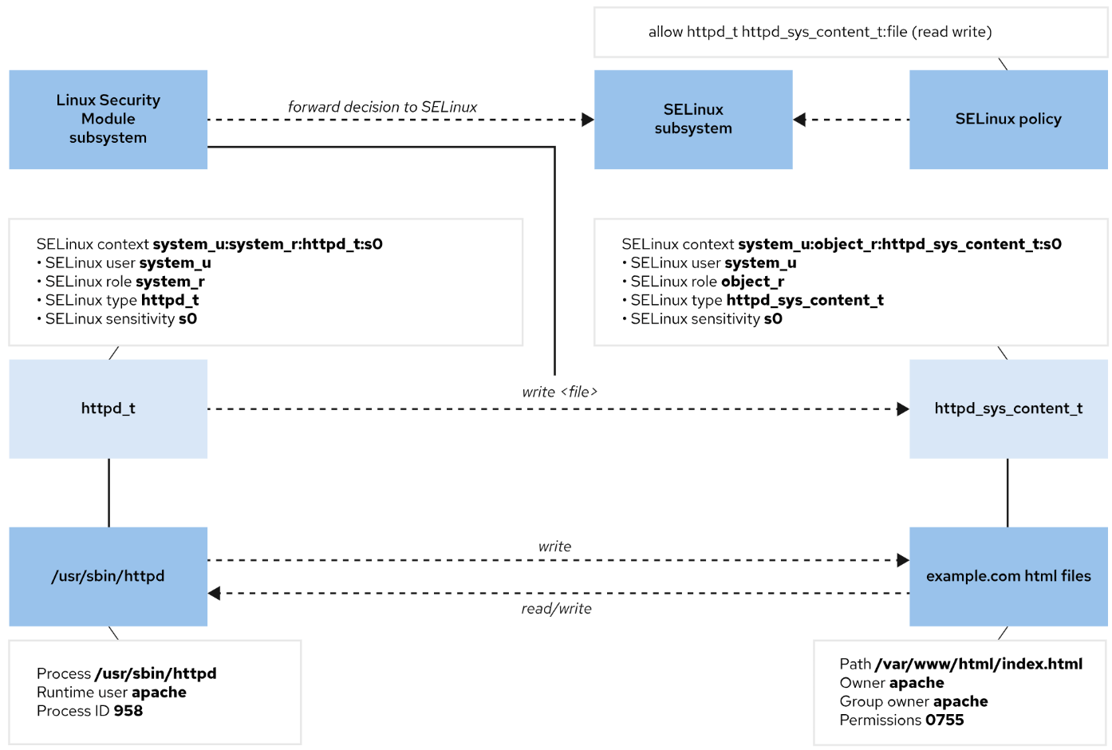
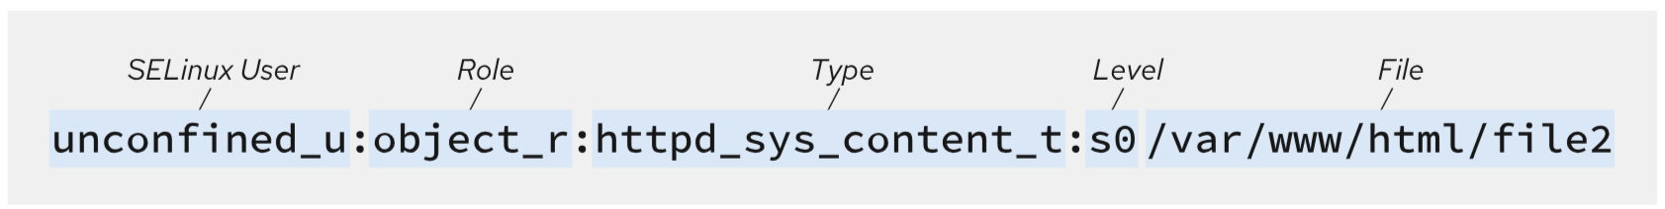
SELinux decision-making flow

Slide 246
Selinux Labels and Mode
Use the getenforce command to view the current SELinux mode.
Use the setenforce command to change the SELinux mode
To configure SELinux persistently, use the /etc/selinux/config file.
configuration sets SELinux to the enforcing mode. The comments list other valid values, such as the permissive and disabled modes
Reboot the system after changing the mode from the config file
# ls –lZ
# ss –tulnpZ
# dnf install httpd –y
# ls –ld /var/www/html
# mkdir /test
# ls –ld /test
# getenforce
# setenforce 0
# setenforce 1
# sestatus -v

Slide 247
SELINUX – setting context type
You can use two commands to set context type:
semanage: This is the command you want to use. The semanage command writes the new context to the SELinux policy, from which it is applied to the file system.
restorecon: to restore the correct selinux context
# semanage port --list
# semanage port -a -t http_port_t -p tcp 83
# semanage fcontext -a -t httpd_sys_content_t "/website(/.*)?
# restorecon -rv /website
To relabel the file system, you can either use the command restorecon -Rv / or create a file with the name /.autorelabel
Selinux Logs – you can get SELinux Messages from /var/log/audit/audit.log , also you can use grep sealert /var/log/messages
When SELinux denies an action, an Access Vector Cache (AVC) message is logged to the /var/log/audit/audit.log security log file
Use the ausearch command to search for AVC events in the /var/log/audit/audit.log log file. Use the -m option to specify the AVC message type and the -ts option to provide a time hint, such as recent.
# ausearch -m AVC -ts recent

Slide 248
Guided Exercise: Run HTTP server on non default settings
Create index.html in /mysite
  # echo “Hello World” /mysite/index.html
  # systemctl restart httpd
Check service failure
  # systemctl status -l httpd.service
  # sealert -a /var/log/audit/audit.log
Run selinux commands to allow http server
  # semanage fcontext -a -t httpd_sys_content_t "/mysite(/.*)?“
  # restorecon -r -v /mysite
  # semanage port -a -t http_port_t -p tcp 8182
Disable firewalld temporarily – to allow httpd to traffic
  # systemctl stop firewalld
Restart httpd
  # systemctl restart httpd
Run httpd server on Port 8182 and load the website from /mysite using http://example.com.
Create /mysite directory
  # mkdir /mysite ; ls –ld /mysite
Configure Apache Virtual Hosts
  # vi /etc/httpd/conf.d/abc.com.conf
  <VirtualHost *:8182>
  ServerName abc.com
  ServerAlias www.abc.com
  DocumentRoot /site/
  ErrorLog /var/log/httpd/abc-error.log
  CustomLog /var/log/httpd/abc-access.log combined
  <Directory "/site/">
  Options Indexes FollowsymLinks Includes ExecCGI
  Require all granted
  </Directory>
  </VirtualHost>
Set up Local Hosts File
# vi /etc/hosts
127.0.0.1 example.com www.example.com

Slide 249
Summary
Use the getenforce and setenforce commands to manage the SELinux mode of a system.
•The semanage command manages SELinux policy rules. The restorecon command applies the context that the policy defines.
The sealert command displays useful information to help with SELinux troubleshooting.

Slide 250
Chapter 21: Manage Network Security
Section 11.1: Manage Server Firewalls
Section 11.2: Guided Exercise: Manage Server Firewalls
Section 11.3: Control SELinux Port Labeling
Section 11.4: Guided Exercise: Control SELinux Port Labeling
Section 11.5: Lab: Manage Network Security
Section 11.6: Summary

Slide 251
Firewall Architecture Concepts
The Linux kernel provides the netfilter framework for network traffic operations such as packet filtering, network address translation, and port translation.
The netfilter framework includes hooks for kernel modules to interact with network packets as they traverse a system's network stack.
Fundamentally, netfilter hooks are kernel routines that intercept events (for example, a packet that enters an interface) and run other related routines (for example, firewall rules).

Slide 252
Firewalld Service
Predefined Service name | Configuration
ssh | Local SSH server. Traffic to 22/tcp.
dhcpv6-client | Local DHCPv6 client. Traffic to 546/udp on the fe80::/64 IPv6 network.
ipp-client | Local IPP printing. Traffic to 631/udp.
samba-client | Local Windows file and print sharing client. Traffic to 137/udp and 138/udp.
cockpit | Red Hat Enterprise Linux web-based interface for managing and monitoring your local and remote system. Traffic to 9090 port.
Start and enable firewalld
# systemctl enable –-now firewalld
List all enabled ports and services
# firewalld-cmd –-list-all
The firewalld package includes many predefined service configurations. You can list the services with the firewall-cmd --get-services command.

Slide 253
Firewalld Command and options
firewall-cmd commands | Explanation
--list-all [--zone=ZONE] | List all configured interfaces, sources, services, and ports for ZONE. If no --zone= option is provided, then the default zone is used.
--add-service=SERVICE [--﻿zone=ZONE] | Allow traffic to SERVICE. If no --zone= option is provided, then the default zone is used.
--add-port=PORT/PROTOCOL [--﻿zone=ZONE] | Allow traffic to the PORT/PROTOCOL ports. If no --zone= option is provided, then the default zone is used.
--remove-service=SERVICE [--﻿zone=ZONE] | Remove SERVICE from the allowed list for the zone. If no --zone= option is provided, then the default zone is used.
--remove-port=PORT/PROTOCOL [--﻿zone=ZONE] | Remove the PORT/PROTOCOL ports from the allowed list for the zone. If no --zone= option is provided, then the default zone is used.
--reload | Drop the runtime configuration and apply the persistent configuration.

Slide 254
Firewalld Commands
Open a root shell. type firewall-cmd --get-default-zone.
  This shows the current default zone. you’ll see the current default zone, which is by default set to public.
To see which zones are available, type firewall-cmd --get-zones.
Show the services that are available on your server by typing firewall-cmd --get-services.
You can use firewall-cmd --get-<item> to request information about a specific item.
To see which services are available in the current zone, type firewall-cmd --list-services. type firewall-cmd --list-all.
Look at the output and compare the output to the result of firewall-cmd --list-all --zone=public. both commands show a complete overview of the current firewall configuration, notice that you see much more than just the zone and the services that are configured in that zone; you also see information about the interfaces and more advanced items.
Type firewall-cmd --add-service=http to add the httpd server to the configuration of the firewall. verify using firewall-cmd --list-all.
Type systemctl restart firewalld and repeat firewall-cmd --list-all. notice that the httpd-server service is no longer listed. This is because the previous command has added the service to the runtime configuration but not to the persistent configuration.
Add the httpd-server service again, but make it permanent this time, using firewall-cmd --add-service http --permanent.
Type firewall-cmd --list-all again to verify. you’ll see that httpd server service is not listed. services that have been added to the on-disk configuration are not added automatically to the runtime configuration. type firewall-cmd --reload to reload the on-disk configuration into the runtime configuration.
Type firewall-cmd --add-port=2022/tcp --permanent, followed by firewall- cmd --reload. verify using firewall-cmd --list-all. you’ll see that a port has now been added to the firewalld configuration.

Slide 255
Guided Exercise: Network security
Create index.html in /mysite
  # echo “Hello World” /mysite/index.html
  # systemctl restart httpd
Check service failure
  # systemctl status -l httpd.service
  # sealert -a /var/log/audit/audit.log
Run selinux commands to allow http server
  # semanage fcontext -a -t httpd_sys_content_t "/mysite(/.*)?“
  # restorecon -r -v /mysite
  # semanage port -a -t http_port_t -p tcp 8182
Disable firewalld temporarily – to allow httpd to traffic
  # systemctl stop firewalld
Restart httpd
  # systemctl restart httpd
Run httpd server on Port 8182 and load the website from /mysite using http://example.com.
Create /mysite directory
  # mkdir /mysite ; ls –ld /mysite
Configure Apache Virtual Hosts
  # vi /etc/httpd/conf.d/example.com.conf
  <VirtualHost *:8182>
  ServerName example.com
  ………
Add port 8182 to firewall
  # systemctl enable –-now firewalld
  # firewall-cmd --permanent --add-port=8182/tcp
  # firewall-cmd --reload
Set up Local Hosts File
# vi /etc/hosts
127.0.0.1 example.com www.example.com

Slide 256
Summary
The netfilter framework enables kernel modules to inspect every packet that traverses the system, including all incoming, outgoing, or forwarded network packets.
The firewalld service simplifies management by classifying all network traffic into zones. Each zone has its own list of ports and services. The public zone is set as the default zone.
•The firewalld service ships with predefined services. You can list these services by using the firewall-cmd --get-services command.
SELinux policy controls network traffic by labeling the network ports. For example, the ssh_port_t label is associated with the 22/TCP port. When a process wants to listen on a port, SELinux verifies whether the port's associated label is allowed to bind that port label.
Use the semanage command to add, delete, and modify labels.

Slide 257
Chapter 22: Access Network-Attached Storage
Section 9.1: Manage Network-Attached Storage with NFS
Section 9.2: Guided Exercise: Manage Network-Attached Storage with NFS
Section 9.3: Automount Network-Attached Storage
Section 9.4: Guided Exercise: Automount Network-Attached Storage
Section 9.5: Lab: Access Network-Attached Storage
Section 9.6: Summary

Slide 258
NFS Services
The classic network file system is NFS (which stands for Network File System). It is a protocol that was developed for UNIX by Sun in the early 1980s, and it has been available on Linux forever. Its purpose is to make it possible to mount remote file systems into the local file system hierarchy
Mounting the NFS Share
  Setting up an NFS server is not a part of the RHCSA exam. However, to practice your NFS-based skills, it’s useful to set up your own NFS test server. To do so, you need to go through a few tasks:
  Create a local directory you want to share. - /data
  Install nfs server
  Edit the /etc/exports file to define the NFS share.
  Start the NFS server.
  Configure your firewall to allow incoming NFS traffic.
NFS clients can mount exported directories in multiple ways:
  Manually by using the mount command.
  Persistently at boot by configuring entries in the /etc/fstab file.
  On demand by configuring an automounter method.

Slide 259
Setup NFS Server
You need a second server to do this exercise. A RHEL 9 / centos 9 server that was installed using the minimal server installation pattern is sufficient. This exercise assumes that a server with the name nfs.example.com is available to offer these services.
Create some local directories that are going to be shared.
  # mkdir /data1 ; mkdir /data2 ; mkdir /data3
Copy some random files to this directory
  # cp /etc/* /data1 ; cp /usr/bin/* /data2 ; cp /var/log/*.log /data3
Install the required packages
  # dnf install -y nfs-utils
Create the /etc/exports file and give it the following contents:
  /data1 *(rw,no_root_squash)
  /data2 *(rw,no_root_squash)
  /data3 *(rw,no_root_squash)
no_root_squash' basically allows the root user on the client to access/create files o n the NFS server as root
Type systemctl enable --now nfs-server to start and enable the NFS server.
Type firewall-cmd --add-service={nfs,rpc-bind,mountd} --permanent to add the NFS bind and mountd services.
To make the newly added services effective at this point, type firewall-cmd --reload.

Slide 260
Setup NFS Client
On Node1, install the nfs-utils RPM package that contains the showmount utility
  # dnf install -y nfs-utils
see all exports available from server2.
  # showmount -e nfs.example.com
On node1, type
  # mount -t nfs -o rw,sync server:/export /mountpoint
verify the mount has succeeded.
  # mount | grep node2
  # ls -l
Permanent mounting-
  # vi /etc/fstab
  nfs.example.com:/data1 /mnt/data1 nfs rw,sync 0 0

Slide 261
Automount on NFS Client
The automounter is a service (autofs) that automatically mounts file systems and NFS exports on demand, and automatically unmounts file systems and NFS exports when the mounted resources are no longer in current use.
Resource use for automounter file systems is equivalent to file systems that are mounted at boot, because a file system uses resources only when a program is reading and writing open files. Mounted but idle file systems and unmounted file systems use almost no resources.
The automounter advantage is that by unmounting the file system each time that it is no longer in use, the file system is protected from unexpected corruption when it is open. When the file system is directed to mount again, the autofs service uses the most current mount configuration.
If your NFS server configuration includes redundant servers and paths, then the automounter can select the fastest connection each time that a new file system is requested.

Slide 262
Setup Automount on NFS Client
create the mapping files. Each mapping file identifies the mount point, mount options, and source location to mount for a set of automounts.
  # vim /etc/auto.demo
  data1 -rw,sync nfs.example.com:/data1
  data2 -rw,sync nfs.example.com:/data2
  data3 -rw,sync nfs.example.com:/data3
Restart autofs
  # systemctl restart autofs
Verify
  # cd /mnt/data1
Install the autofs package.
  # dnf install autofs –y
  # systemctl enable --now autofs
Add master map file to /etc/auto.master.d. This file identifies the base directory for mount points, and identifies the mapping file to create the automounts.
  # vim /etc/auto.master.d/demo.autofs
Include the following content in the master map entry for indirectly mapped mounts:
  /mnt /etc/auto.demo

Slide 263
Setup Wildcard Automount on NFS Client
create the mapping files. Each mapping file identifies the mount point, mount options, and source location to mount for a set of automounts.
  # vim /etc/auto.demo
  * -rw,sync nfs.example.com:/&
Restart autofs
  # systemctl restart autofs
Verify
  # cd /mnt/data1
Install the autofs package.
  # dnf install autofs –y
  # systemctl enable --now autofs
Add master map file to /etc/auto.master.d. This file identifies the base directory for mount points, and identifies the mapping file to create the automounts.
  # vim /etc/auto.master.d/demo.autofs
Include the following content in the master map entry for indirectly mapped mounts:
  /mnt /etc/auto.demo

Slide 264
Summary
Mount and unmount an NFS share from the command line.
Configure an NFS share to mount automatically at startup.
Configure the automounter

Slide 265
Chapter 23: Control the Boot Process
Section 10.1: Select the Boot Target
Section 10.2: Guided Exercise: Select the Boot Target
Section 10.3: Reset the Root Password
Section 10.4: Guided Exercise: Reset the Root Password
Section 10.5: Repair File-system Issues at Boot
Section 10.6: Guided Exercise: Repair File-system Issues at Boot
Section 10.7: Lab: Control the Boot Process
Section 10.8: Summary

Slide 266
Red Hat Enterprise Linux 9 Boot Process
The machine is powered on. The system firmware, either modern UEFI or earlier BIOS, runs a Power On Self Test (POST) and starts to initialize the hardware.
The UEFI boot firmware is configured by searching for a bootable device, which searches for or configures the Master Boot Record (MBR) on all disks.The system
The system firmware reads a boot loader from disk and then passes control of the system to the boot loader. On a Red Hat Enterprise Linux 9 system, the boot loader is the GRand Unified Bootloader version 2 (GRUB2). RHEL 9 provides a prebuilt /boot/efi/EFI/redhat/grubx64.efi file, which contains the required authentication signatures for a Secure Boot system.
GRUB2 loads its configuration from the /boot/grub2/grub.cfg file for BIOS, and from the /boot/efi/EFI/redhat/grub.cfg file for UEFI, and displays a menu to select which kernel to boot.
After you select a kernel, or the timeout expires, the boot loader loads the kernel and initramfs from disk and places them in memory.
An initramfs image is an archive with the kernel modules for all the required hardware at boot, initialization scripts, and more. In Red Hat Enterprise Linux 9, the initramfs image contains a bootable root file system with a running kernel and a systemd unit.The initramfs image is configured by using the /etc/dracut.conf.d/ directory, the dracut command, and the lsinitrd command to inspect the initramfs file.
The boot loader hands control over to the kernel, and passes in any specified options on the kernel command line in the boot loader, and the location of the initramfs image in memory.
The kernel initializes all hardware for which it can find a driver in the initramfs image, and then executes the /sbin/init script from the initramfs image as PID 1. On Red Hat Enterprise Linux 9, the /sbin/init script is a link to the systemd unit.The script is configured by using the kernel init= command-line parameter.
The systemd unit from the initramfs image executes all units for the initrd.target target. This unit includes mounting the root file system on disk to the /sysroot directory. Configured by using the /etc/fstab file.
The kernel switches (pivots) the root file system from the initramfs image to the root file system in the /sysroot directory. The systemd unit then re-executes itself by using the installed copy of the systemd unit on the disk.
The systemd unit looks for a default target, which is either passed in from the kernel command line or is configured on the system. The systemd unit then starts (and stops) units to comply with the configuration for that target, and solves dependencies between units automatically. A systemd unit is a set of units that the system activates to reach the intended state. These targets typically start a text-based login or a graphical login screenConfigured by using the /etc/systemd/system/default.target file and the /etc/systemd/system/ directory.

Slide 267
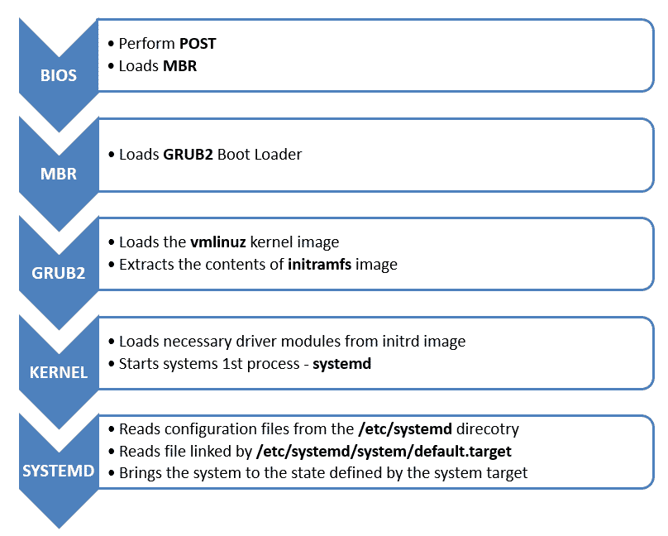
Boot Process Abstract view (BIOS)

Slide 268
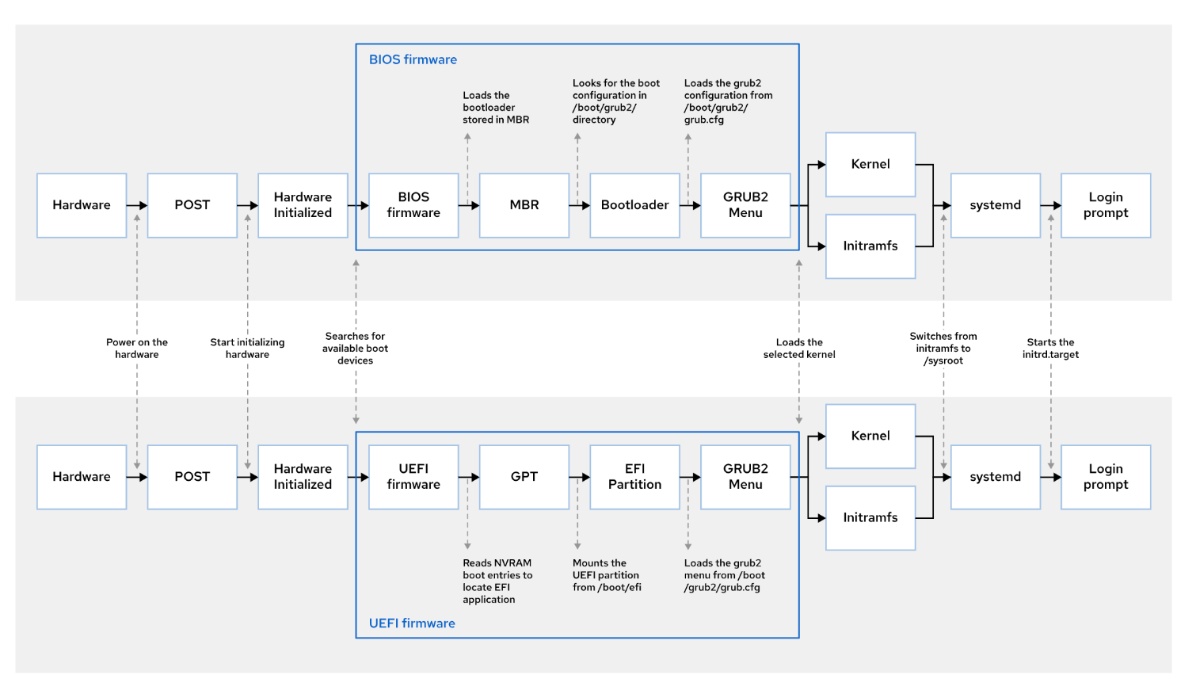
Boot Process BIOS vs UEFI

Slide 269
GRUB2
The GRUB 2 boot loader is one of the first things that needs to be working well to boot a Linux server (Grand Unified Bootloader version 2)
As an administrator, you will sometimes need to apply modifications to the GRUB 2 boot loader configuration.
The GRUB 2 boot loader makes sure that you can boot Linux. GRUB 2 is installed in the boot sector of your server’s hard drive and is configured to load a Linux kernel and the initramfs
  The kernel is the heart of the operating system, allowing users to interact with the hardware that is installed in the server.
  The initramfs contains drivers that are needed to start your server. It contains a mini file system that is mounted during boot. In it are kernel modules that are needed during the rest of the boot process (for example, the LVM modules for accessing disks that are not supported by default).
Normally, GRUB 2 works just fine and does not need much maintenance. In some cases, though, you might have to change its configuration.
GRUB 2 configuration file
  the starting point is the /etc/default/grub file, which has options that tell GRUB what to do and how to do it.
  Main configuration file
    If your system is a BIOS system, the name of the file is /boot/grub2/grub.cfg
    On a UEFI system the file is written to /boot/efi/EFI/redhat/grub.cfg
After making modifications to the GRUB 2 configuration, you’ll need to regenerate the relevant configuration file, which is why you should know the name of the file that applies to your system architecture. Do not edit it, as this file is automatically generated

Slide 270
GRUB2 – Modify configuration
GRUB_CMDLINE_LINUX
  which defines how the Linux kernel should be started
GRUB_TIMEOUT
  This defines the amount of time your server waits for you to access the GRUB 2 boot menu before it continues booting automatically
To write the modified configuration to the appropriate files, you use the grub2- mkconfig
Open the file /etc/default/grub with an editor and remove the rhgb and quiet options from the GRUB_CMDLINE_LINUX line.
From the same file, set the GRUB_TIMEOUT parameter to 10 seconds. Save changes to the file and close the editor.
From the command line, type grub2-mkconfig > /boot/grub2/grub.cfg to write the changes to GRUB 2
In case of UEFI firmware - Grub2-mkconfig > /boot/efi/EFI/redhat/grub.cfg
Reboot and verify that while booting you see boot messages scrolling by

Slide 271
Systemd Target
Target | Purpose
graphical.target | This target supports multiple users, and provides graphical- and text-based logins.
multi-user.target | This target supports multiple users, and provides text-based logins only.
rescue.target | This target provides a single-user system to enable repairing your system.
emergency.target | This target starts the most minimal system for repairing your system when the rescue.target unit fails to start.
A systemd target is a set of systemd units that the system must start to reach an intended state
You can view these dependencies with the following command:
  #systemctl list-dependencies graphical.target | grep target
To list the available targets, use the following command:
  # systemctl list-units --type=target –all
Select a Target at Runtime
  # systemctl isolate multi-user.target
Set a Default Target
  # systemctl get-default
  # systemctl set-default graphical.target

Slide 272
Systemd - Select a Different Target at Boot Time
To select a different target at boot time, append the systemd.unit=target.target option to the kernel command line from the boot loader
Use this method to select a different target at boot time:
  Boot or reboot the system.
  Interrupt the boot loader menu countdown by pressing any key (except Enter, which would initiate a normal boot).
  Move the cursor to the kernel entry to start.
  Press e to edit the current entry.
  Move the cursor to the line that starts with linux which is the kernel command line.
  Append systemd.unit=target.target, for example, systemd.unit=emergency.target.
  Press Ctrl+x to boot with these changes.

Slide 273
Reset the Root Password-RHEL9
To access that root shell, follow these steps:
  Reboot the system.
  Interrupt the boot-loader countdown by pressing any key, except Enter.
  Move the cursor to the rescue kernel entry to boot (the entry with the rescue word in its name).
  Press e to edit the selected entry.
  Move the cursor to the kernel command line (the line that starts with linux).
  Append rd.break console=tty1. With that option, the system breaks just before the system hands control from the initramfs image to the actual system.
  Press Ctrl+x to boot with the changes.
  Press Enter to perform maintenance when prompted.
  Remount /sysroot as read/write
    # mount -o remount,rw /sysroot
  Switch into a chroot jail, where /sysroot is treated as the root of the file-system tree.
    # chroot /sysroot
  Set a new root password.
    # passwd root
  Ensure that all unlabeled files, including /etc/shadow at this point, get relabeled during boot.
    # touch /.autorelabel
  #exit #exit
On Red Hat Enterprise Linux 9, the scripts that run from the initramfs image can be paused at certain points, to provide a root shell,
Default kernel asks for the root password when you try to enter maintenance mode. Thus, to reset a lost root password, you must use the rescue kernel.

Slide 274
Reset the Root Password-RHEL10
To access that root shell, follow these steps:
  Reboot the system.
  Interrupt the boot-loader countdown by pressing any key, except Enter.
  Move the cursor to the kernel entry to boot (the entry with the rescue word in its name).
  Press e to edit the selected entry.
  Move the cursor to the kernel command line (the line that starts with linux).
  End of the line add init=/bin/bash. With that option, the system breaks just before the system hands control from the initramfs image to the actual system.
  Press Ctrl+x to boot with the changes.
  Press Enter to perform maintenance when prompted.
  Remount /sysroot as read/write
    # mount -o remount,rw /
  Set a new root password.
    # passwd root
  Ensure that all unlabeled files, including /etc/shadow at this point, get relabeled during boot.
    # touch /.autorelabel
  exec /sbin/init
On Red Hat Enterprise Linux 10, the scripts that run from the initramfs image can be paused at certain points, to provide a root shell,
Default kernel asks for the root password when you try to enter maintenance mode. Thus, to reset a lost root password, you must use the rescue kernel.

Slide 275
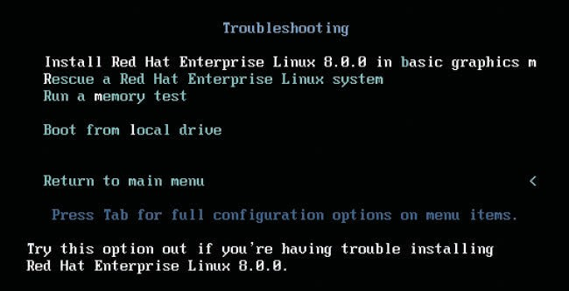
Rescue Mode – Using RHEL DVD
When you encounter trouble, you’ll be able to boot from hard disk. If you are a bit less lucky, you’ll just see a blinking cursor on a system that does not boot at all. If that happens, you need a rescue disk.
The default rescue image for Red Hat Enterprise Linux or CENTOS is on the installation disk or ISO.
When booting from the installation disk, you’ll see a Troubleshooting menu item.
Select this item to get access to the options you need to repair your machine.

Slide 276
Rescue Mode – Using RHEL DVD
The rescue mode detects your installation and mounts it on the /mnt/sysroot directory.
Use the chroot /mnt/sysroot command to make the contents of this directory your actual working environment.
If you do not use this chroot command, many utilities will not work,
Using the chroot command ensures that all path references to configuration files are correct.
  Restart your server from the installation disk. Select the Troubleshooting menu option.
  From the Troubleshooting menu, select Rescue a Red Hat Enterprise Linux System. This prompts you to press Enter to start the installation. Do not worry: This option does not overwrite your current configuration; it just loads a rescue system.
  The rescue system now prompts you that it will try to find an installed Linux system and mount on /mnt/sysroot. Press 1 to accept the Continue option
  If a valid Red Hat installation was found, you are prompted that your system has been mounted under /mnt/sysroot. At this point, you can press Enter twice to access the rescue shell.
  Your Linux installation at this point is accessible through the /mnt/sysroot directory. Type chroot /mnt/sysroot. At this point, you have access to your root file system and you can access all tools that you need to repair access to your system.
  Type exit and reboot to restart your machine in a normal mode.

Slide 277
Troubleshoot: GRUB
Firmware BIOS
  rescue mode
  # grub2-install /dev/nvme0n1
  exit exit -> reboot
Firmware UEFI
  rescue mode
  # mount /dev/sr0 /mnt
  # vi /etc/yum.repos.d/local.repo
  [baseos]
  name=xxxx
  baseurl= file:///mnt/BaseOS
  enabled=1
  # dnf reinstall grub2-efi shim
  # grub2-mkconfig -o /boot/efi/EFI/redhat/grub.cfg

Slide 278
Troubleshoot: Initramfs and FileSystem
Occasionally, the initramfs image may get damaged as well. If this happens, you cannot boot your server into normal operational mode.
To repair the initramfs image after booting into the rescue environment, you can use the dracut command. If used with no arguments, this command creates a new initramfs for the kernel currently loaded.
# dracut --force (to overwrite existing initramfs)
Recover filesystem issues
  Ext = # e2fsck –f /dev/partition
  Xfs = # xfs_repair –f /dev/partition

Slide 279
Summary
The systemctl isolate target-name.target command switches to a new target at runtime.
The systemctl get-default and systemctl set-default commands can query and set the default target.
You can use the rd.break option on the kernel command line to interrupt the boot process before control is handed over from the initramfs image. The root file system is mounted read-only under /sysroot.

Slide 280
Chapter 24:
Run Containers
Section 13.1: Container Concepts
Section 13.2: Quiz: Container Concepts
Section 13.3: Deploy Containers
Section 13.4: Guided Exercise: Deploy Containers
Section 13.5: Manage Container Storage and Network Resources
Section 13.6: Guided Exercise: Manage Container Storage and Network Resources
Section 13.7: Manage Containers as System Services
Section 13.8: Guided Exercise: Manage Containers as System Services
Section 13.9: Lab: Run Containers
Section 13.10: Summary

Slide 281
Introduction to Containers
What are Containers?
  Improved method to package, deploy, and run distributed applications in isolated environments.
  Encapsulate all dependencies (libraries, binaries, services) to ensure consistency across environments.
Traditional vs. Containerized Deployment
  Traditional: Applications on single servers may face conflicts due to dependencies.
  Containers: Package applications with all requirements, allowing isolated, conflict-free environments.
Container Characteristics
  Containers run as isolated processes on Linux or Windows.
  Can be started, stopped, or moved between servers independently without affecting others.
Key Linux Features Enabling Containers
  Control Groups (cgroups): Limit resource consumption (CPU, memory, network) for process groups.
  Namespaces: Isolate system resources (PIDs, network) for secure and independent process execution.
  seccomp and SELinux: Provide additional security by restricting container access to the host system and processes.

Slide 282
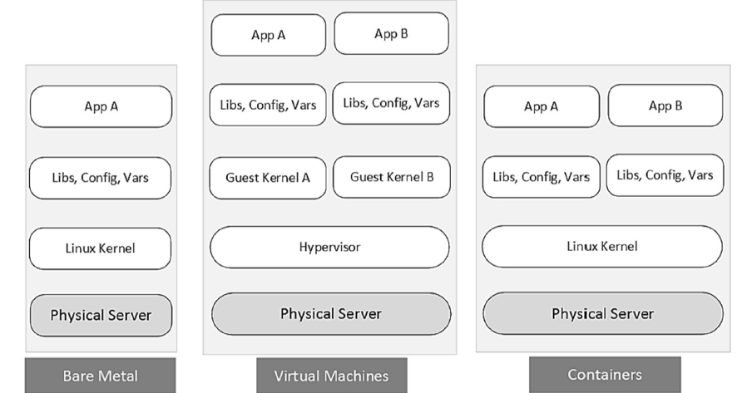
Benefits of Containers
Isolation & Loose Coupling: Containers operate independently, unaffected by host OS changes.
Efficiency: Containers are lightweight, require fewer resources, and have rapid start/stop times.
Portability & Reusability: Containers can be easily moved between servers (bare metal or virtual) and reused across environments.
Manageability: Independent maintenance, version control, and faster deployment, testing, and scaling.

Slide 283
Containers and Virtual Machines
Containers provide many of the same benefits as virtual machines, such as security, storage, and network isolation.
Both technologies isolate their application libraries and runtime resources from the host operating system or hypervisor, and vice versa.
A virtual machine has the following characteristics:
  Enables multiple operating systems to run simultaneously on a single hardware platform.
  Uses a hypervisor to divide hardware into multiple virtual hardware systems.
  Requires a complete operating system environment to support the application.
A container has the following characteristics:
  Runs directly on the host operating system, and it shares resources with all containers on the system.
  Shares the host's kernel, but it isolates the application processes from the rest of the system.
  Requires far fewer hardware resources than virtual machines, so containers are also quicker to start.
  Includes all dependencies, such as system and programming dependencies, and configuration settings.

Slide 284
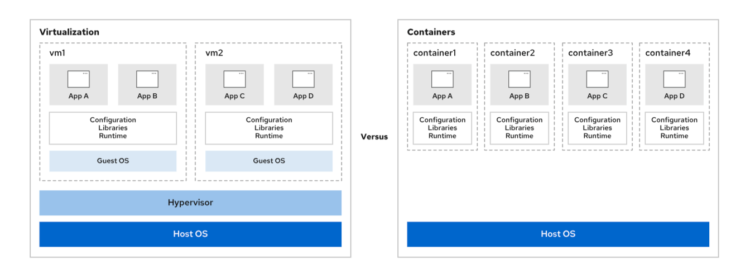

Slide 285
Rootless and Rootful Containers
On the container host, you can run containers as the root user or as a regular, unprivileged user. Containers that a privileged user runs are called rootful containers. Containers that non-privileged users run are called rootless containers.
A rootless container is not allowed to use system resources that are usually reserved for privileged users, such as access to restricted directories, or to publish network services on restricted ports (below 1024). This feature prevents a possible attacker from gaining root privileges on the container host.
Although you can run containers directly as root if necessary, this scenario weakens the security of the system if a bug enables an attacker to compromise the container.

Slide 286
Rootless and Rootful Containers
On the container host, you can run containers as the root user or as a regular, unprivileged user. Containers that a privileged user runs are called rootful containers. Containers that non-privileged users run are called rootless containers.
A rootless container is not allowed to use system resources that are usually reserved for privileged users, such as access to restricted directories, or to publish network services on restricted ports (below 1024). This feature prevents a possible attacker from gaining root privileges on the container host.
Although you can run containers directly as root if necessary, this scenario weakens the security of the system if a bug enables an attacker to compromise the container.

Slide 287
Container Management Tools
Red Hat Enterprise Linux provides a set of container tools that you can use to run containers in a single server:
  podman manages containers and container images.
  skopeo inspects, copies, deletes, and signs images.
  buildah creates container images.
These tools are compatible with the Open Container Initiative (OCI). With these tools, you can manage any Linux containers that OCI-compatible container engines create, such as Podman or Docker. These tools are designed to run containers under Red Hat Enterprise Linux on a single-node container host.

Slide 288
Container Images and Registries
Container Image:
  A static file containing application binaries, libraries, configuration, and environment data needed for containerized app execution.
OCI Compliance:
  RHEL supports the Open Container Initiative (OCI) standard for image format and management using tools like Podman and Docker.
FQIN (Fully Qualified Image Name):
  Identifies container images using the format registry_name/user_name/repo_name:tag.
  docker.io/amitb/httpd:latest
Registries:
  Images are stored in public or private registries (e.g., registry.redhat.io, hub.docker.com). Some registries require authentication.

Slide 289
Podman Command
Command | Description
podman build | Build a container image with a container file.
podman run | Run a command in a new container.
podman images | List images in local storage.
podman ps | Print information about containers.
podman inspect | Display configuration of a container, image, volume, network, or pod.
podman pull | Download an image from a registry.
podman cp | Copy files or directories between a container and the local file system.
podman exec | Execute a command in a running container.
podman rm | Remove one or more containers.
podman rmi | Remove one or more locally stored images.
podman search | Search a registry for an image.
Install Podman and verify
  # dnf install container-tools
registries.conf file
  # cat /etc/containers/registries.conf
View podman config and version
  $ podman info
Display the local images
  $ podman images
Search Images
  $ podman search httpd
Download Images
  $ podman pull httpd

Slide 290
Run Container
Download Docker container image
  $ podman pull httpd
Run container application
  $ podman run –d httpd
  $ podman ps or podman ps –a
  $ podman run –d --name web1 –p 8000:80 httpd
  $ podman ps or podman ps -a
Enable port-number in firewall
  # firewall-cmd –-add-port=8000/tcp –-permanent
  # firewall-cmd –-reload
verify
  Via browser
Download Redhat container image
  $ podman login registry.redhat.io
  $ podman pull registry.redhat.io/httpd
Run container application
  $ podman run –d httpd
  $ podman ps or podman ps –a
  $ podman run –d --name web1 –p 8000:80 httpd
  $ podman ps or podman ps -a
Enable port-number in firewall
  # firewall-cmd –-add-port=8000/tcp –-permanent
  # firewall-cmd –-reload
verify
  Via browser

Slide 291
Container Management
Manage Containter images
  $ podman images
  $ podman rmi <image_id>
Manage Containers
  $ podman ps
  $ podman ps –a
  $ podman stop <cont_name>
  $ podman start <cont_name>
  $ podman kill <cont_name>
  $ podman rm <cont_name>
  $ podman logs <cont_name>
Login to a running container app
  $ podman exec -it <con_name> /bin/bash
Run a command within a running container app
  $ podman exec <con_name> ps –ef
Find how to use containter
  $ skopeo inspect <cont_name> | grep usage

Slide 292
Containers – Attaching storage
Step1 - pull container image – we will use httpd image from catalog.redhat.com
  $ podman pull httpd
Step2 - create a directory and give ownership and write permission to others
  $ sudo mkdir –p /mysite/
  $ sudo chmod –R o+w /mysite
  $ sudo chown -R user:group /mysite
  $ cd /mysite/html ; vi index.html
  $ sudo firewall-cmd –add-port=8081/tcp –permanent ; sudo firewall-cmd –reload
Step3 - run container image
  $ podman run -d --name web1 -p 8081:80 \
  -v /mysite:/var/www/html:Z rhel8/httpd-24
  $ podman exec –it web1 bash
Step4 – verify
  $ podman ps -a
  Open the browser and use vm IP:8080

Slide 293
Containers – As a service unit
Always ssh to machine directly as non-root user
Create a new user john
  $ sudo useradd john
  $ sudo passwd john
  Log in as user john (no su or sudo).
Create the directory where the systemd user files will be created
  $ mkdir -p ~/.config/systemd/user
  $ cd ~/.config/systemd/user
Start container app
  $ podman run -d --name httpd -p 8080:80 docker.io/library/httpd
  $ podman ps
Create the systemd user files
  $ podman generate systemd --name httpd --files
  $ ls –l
Stop the container
  $ podman stop httpd
Start it again by running
  $ systemctl --user start container-httpd.service
Enable linger for user john
  $ sudo loginctl enable-linger john
Enable the systemd user service.
  $ systemctl --user enable container-httpd.service
Verify the service has the state of enabled.
  $ systemctl --user status container-httpd.service
Reboot your server, and after rebooting, verify that the container is automatically started.

Slide 294
Building a custom container Image
Create a container build file
  $ vi Containerfile
Type below lines
  FROM ubi10
  RUN dnf -y install httpd
  CMD ["httpd","-DFOREGROUND"]
Create container image
  podman build -f Containerfile -t httpd:custom
Run and test the container app
  podman run -d --name web5 -p 8282:80 localhost/httpd:custom

Slide 295
Summary
Containers provide a lightweight way to distribute and run an application with its dependencies so that it does not conflict with installed software on the host.
Containers run from container images that you can download from a container registry or create yourself.
You can use container files with instructions to build a customized container image.
Podman, which Red Hat Enterprise Linux provides, directly runs and manages containers and container images on a single host.
Containers can be run as root, or as non-privileged rootless containers for increased security.
Although container storage is temporary, you can attach persistent storage to a container by using the contents of a directory on the container host, for example.
You can configure a systemd unit file to automatically run containers when the system starts.

Slide 296
Comprehensive Review
Section 14.1: Comprehensive Review
Section 14.2: Lab: Fix Boot Issues and Maintain Servers
Section 14.3: Lab: Configure and Manage File Systems and Storage
Section 14.4: Lab: Configure and Manage Server Security

